Slide 1



AAPCKC Annual Conference
Compliance Panel
August 2025

Slide 2
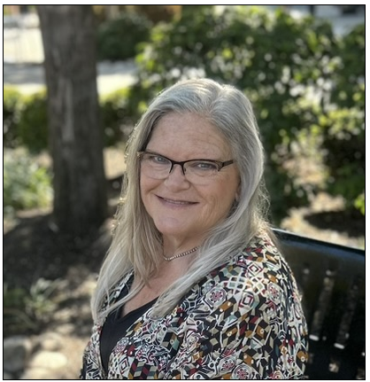


Brenda Edwards, CPC, CDEO, CPB, CPMA, CPC-I, CEMC, CRC, CPMS, CMRS, CMCS, CEMA, CPA-RA, CPA-EDU
Brenda has been in healthcare over 35 years working closely with practices, providers and residency programs to ensure documentation is compliant and accurate.
She has written many articles for national publications. Her humorous and engaging presentation style has made her a conference favorite for AAPC, AMBA, Training Leader, and Decision Health as well as AAPC local chapter meetings across the country.
Brenda leads training for NAMAS and AAPC. Mentoring the next generation of coders, billers, and auditors is her passion. She co-founded the northeast Kansas (NEKAAPC) chapter. Brenda serves on the national advisory board for AMBA and previously served on the AAPC Chapter Association Board of Directors.

Slide 3
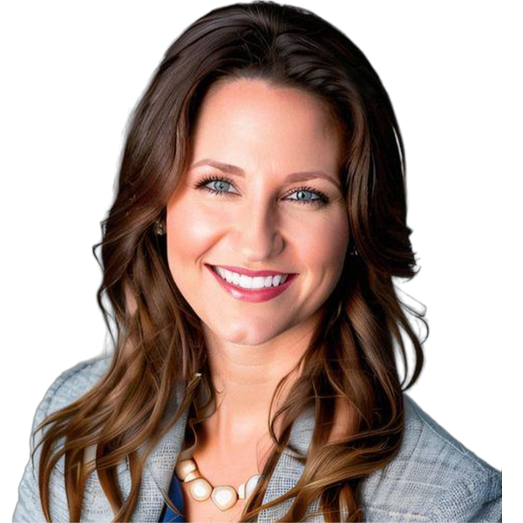
Richelle Marting, JD, MHSA, RHIA
CPC, CEMC, CPMA, CPC-I
Richelle Marting is a healthcare attorney and certified coder whose practice focuses on reimbursement matters for healthcare professionals and facilities. She has in-house experience as a health information management professional including as interim director of managed care contracting; interim health system privacy officer, compliance coordinator, billing office coordinator, medical coder, medical records clerk and certified nurse aide. She has helped successfully recover or retain tens of millions of dollars for healthcare organizations and individuals through defending payor audits and preparing appeals. Richelle has also served as an expert in litigation supporting attorneys on matters related to health information management, reimbursement, and privacy.

Slide 4
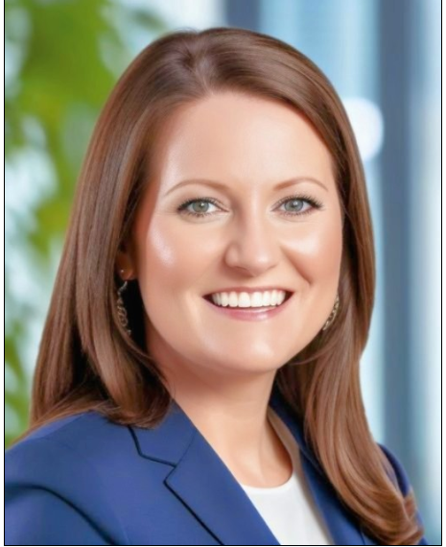
Elizabeth Hickert Fike, Director, Corporate Compliance, BJC Health System.
Elizabeth joined the compliance team at Saint Luke’s Health System in February 2021. In 2024, following a merger with BJC Health System, the Saint Luke’s team became part of the BJC Health System integrated corporate compliance department. She works on various billing and compliance related matters throughout the system and also leads the team who focuses on facility billing audits and investigations.
Elizabeth previously spent 11 years as an attorney and regulator with the Office of the Kansas Insurance Commissioner. While at the Insurance Department, she worked in Consumer Affairs and Legal, primarily focusing on market regulation of life and health insurance companies.
Elizabeth has a B.A. from Baker University and a J.D. from Washburn University School of Law. She sits on the Board of Directors for the Alliance for a Healthy Kansas, serves as an alumna volunteer for Alpha Chi Omega Sorority, and chairs the Science Club Committee for her son’s school P.T.O. She resides in Lawrence, Kansas with her husband and two children.
Elizabeth Hickert Fike, JD

Slide 5

Scott Walterbach, JD
Scott Walterbach is partner at Bessine Walterbach, LLP, a small law firm in Kansas City where he has worked since February 2010. He practices in high-volume collections and creditors’ rights throughout Missouri & Kansas seeking to collect medical debt, student loans, rent, utilities & various other consumer obligations. Scott handles litigation, post-judgment collection, policies & procedures, compliance, risk management, client relations, business development & personnel. He also handles worker’s compensation claims, bankruptcy claims, hospital liens, & real estate matters. Scott recently has presented CLEs on collections law, FDCPA, FCRA, CFPB, & real estate law.
Scott has a B.A. in journalism from Truman State University in 2003, a Master’s in Public Administration from UMKC in 2006, & a J.D. from Indiana University School of Law in 2007. He lives in the Kansas City northland with his wife, Katie, and four kids, Nash (12), Bo (10), Judd (8) & Hannah (6).

Slide 6

AI Compliance for Attorneys
(& how that affects you)
CFPB Supervisory Highlights 1/17/25 – NO compliance exceptions for “advanced technologies”
AI Policies – why?
NON-AI HOT TOPICS
Medical debt credit reporting rule
FDCPA & incidentals / non-patient liability

Slide 7
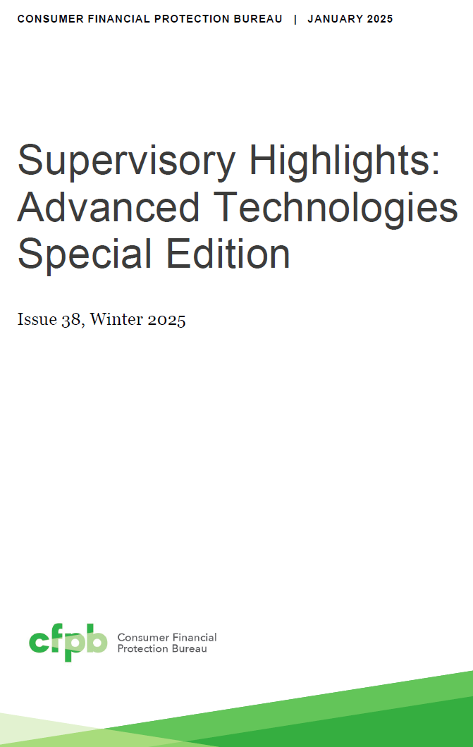
CFPB Compliance
New “Technologist Program” to cross-collaborate
Creditworthiness decisions & credit scoring
      BIAS in LLM or machine learning?
Applies to FDCPA also – reverse engineering even if you don’t do legal collections

Slide 8

AI “Hallucinations”
  May 2022 UT lawyer sanctioned by appeals court, failure to supervise & check cites
  June 2023: 2 NY lawyers $5k fine for cover-up
  Feb 2025 Morgan & Morgan fined $5k in Wyoming for 8 of 9 cites being non-existent
  March 2025 IL atty claims fake cites were demonstration to her daughter of pitfalls of AI, submitted wrong version
  May 2025 FL $2k fines + $5k atty fees, atty corrected
  July 2025 Col. MyPillow CEO lawyers fined $3k
  July 2025 AL fed judge disqualified 3 attorneys
Only federal, & just a snippet. One law school library attempting to collect cases lists 30 for just 2025.
https://libraryguides.law.uic.edu/c.php?g=1431863&p=10971016

Slide 9

Why bother with it at all?
AI is inevitable; a tool requires human supervision & has beneficial uses (summaries, searches, rephrasing, background encyclopedia, photos)
Disclosure of use or non-use
Rules of ethics unchanged – competence, diligence, candor, communication, fees, confidentiality, supervisory lawyers
Policy should explain what GAI is, define data sets, set principles, & require oversight
AI comes from the most unreliable data source on the planet – the internet!

Slide 10

Credit Reporting
1/7/25 CFPB finalized rule to remove $49B in medical bills from 15M Americans’ reports saying not reflective of creditworthiness (but seeCFPB v. Vanderbilt Homes case, sued for not considering creditworthiness factors like healthcare expenses)
Was to take effect 3/17/25, TX court stayed it til 6/15/25 & then after regime change, CFPB consented to rule being blocked

Slide 11

Non-patient liability
Child, spouse (separated or now-ex), step-parent
FDCPA limits on incidentals
Attorney fees, collection costs, late fees, interest
State law
Contract language
Necessaries

Slide 12
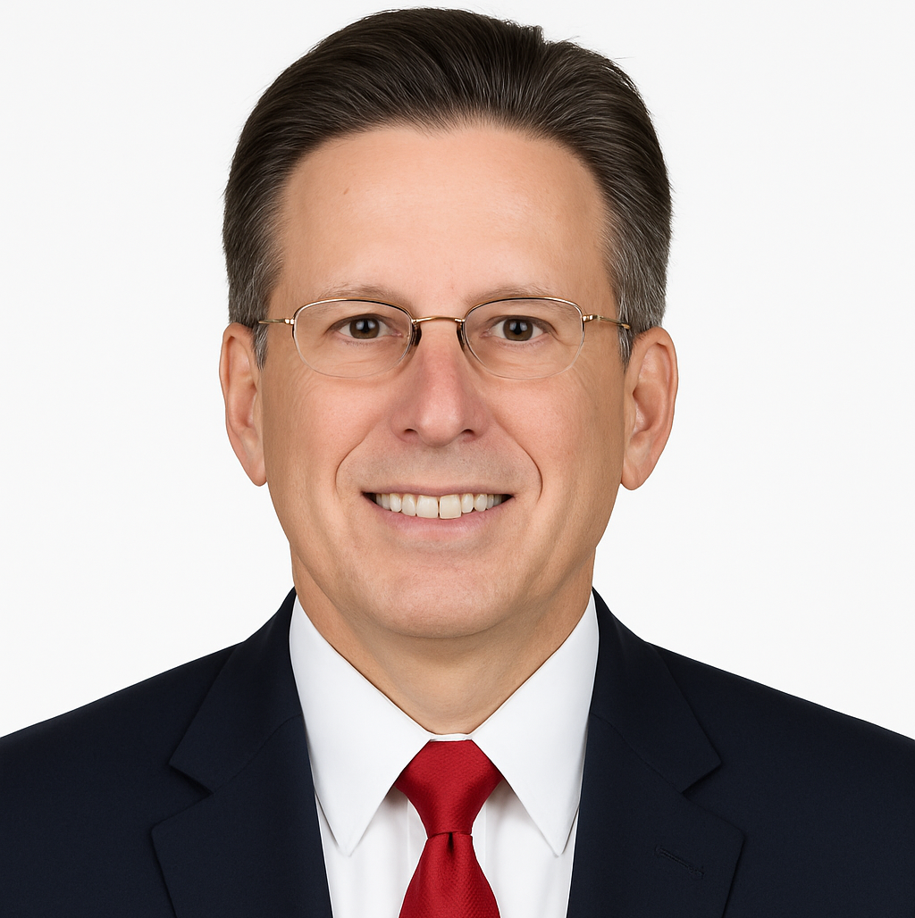
Doug Hohulin
Working on how AI can save 1 Billion lives
AI projects “When the AI System Has to Be Right"
  AI in Healthcare,
  Regulation, Governance, Policy, Ethics
  AV & Road Safety
  Education and Energy.
Advisor to AI Startup Companies
  AI & Partners – EU AI Act Risk Assessment
  MyPlanKeeper Intelligent Retirement Planning with AI
Worked for Motorola and Nokia for 33 years in Strategy, Business Development, Account Management and Engineering
  Go to Market Strategies
Co-author with Dr. Harvey Castro MD
  2030: A Blueprint for Humanity's Exponential Leap
  Tech Powered Healing: The Future of Medicine in the AI Age
President/Founder of Exponential Blueprint Consulting
Kansas City AI Club Board Member - Humanities Chair
VRARA Chapter President - Kansas City,
Generative AI Committee Chair.
Former KU School of Nursing Advisory Board
Affiliate Faculty – XR Immersive Learning
Former KU Cyber Security Advisory Board
KC Digital Drive Member - Healthcare Innovation
Doug Hohulin | LinkedIn

Slide 13
AI - Go To Market
How Are You and Your Organization Using AI Today?
Solving the Way The Body Fails with AI and Billing for it
America's AI Action Plan: Winning the Race
AI Literacy - Collaborative Intelligence
What Workers Really Want from AI – Leveraging the AI Tool to Amplify Your Ability
  Have the AI Do Difficult, Dangerous, Dirty or Dull Jobs
AI Literacy, KC AI Club, Workforce Development
Call To Action

Slide 14
AI Questions to the Audience
Do You Used Generative AI Daily/Weekly?
  For Work? For Personal Use?
Do You Think AI Will Be More of a Benefit to You? or Cause More Problems?
Does Your Work Environment:
  Encourage the Use of AI?
  Requires You to Use AI?
  Restricts the Use of AI?

Slide 15
Making The Best Health Decisions With the Aid of AI
“13,600 diagnoses, or ways in which the human body can fail.
Now more than 6,000 drugs can be prescribed, and 4,000 medical and surgical procedures can be performed.” -- Dr. Atul Gawande
http://news.harvard.edu/gazette/story/2011/09/the-battle-for-medicine%E2%80%99s-soul/ http://www.ted.com/talks/atul_gawande_how_do_we_heal_medicine
Dr. David Fajgenbaum, “9,000 human diseases don't have a single FDA approved therapy”
Every Cure - Chasing My Cure: A Doctor's Race to Turn Hope into Action
“Leverage The Power of AI to predict promising treatments”
Will AI Help Develop More medical and surgical procedures?
Dr. Gawande: "How many types of problems must clinicians be ready to handle?“
Billing codes: "How many ways do we have to record, justify, and pay for those problems?“
In the U.S., there are roughly 260,000–280,000 active medical billing codes across ICD-10, CPT, HCPCS, and drug classifications.

Slide 16
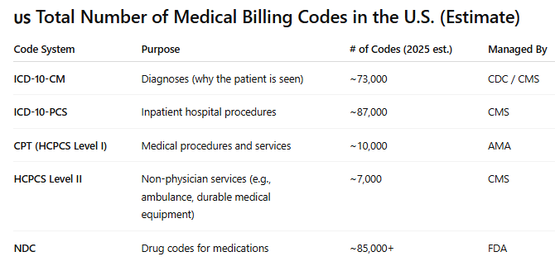
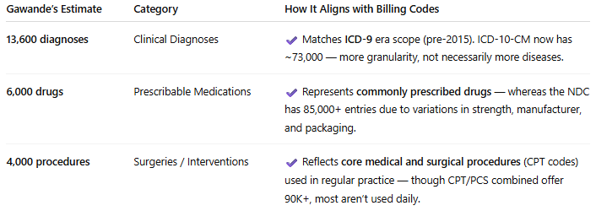

Slide 17
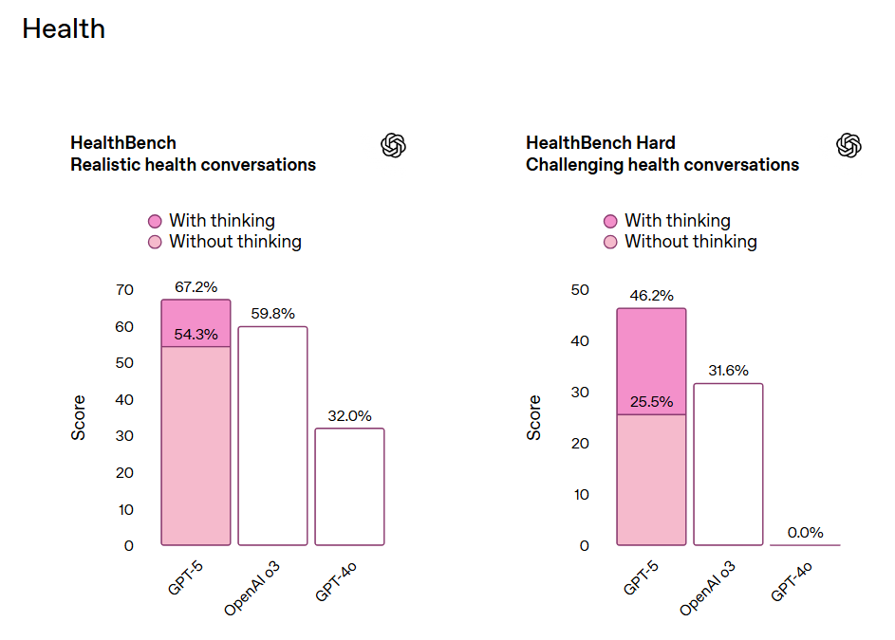
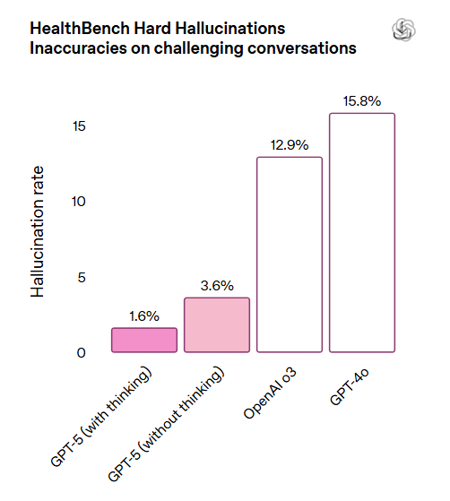
Introducing GPT-5
Our smartest, fastest, most useful model yet, with built-in thinking
that puts expert-level intelligence in everyone’s hands.
https://openai.com/index/introducing-gpt-5/

Slide 18
National AI Action Plan, EO 14179 (“Removing Barriers to American Leadership in AI”)
White House Office of Science and Technology Policy (OSTP)
10,000 comments submitted in response to RFP on the development of the AI Action Plan
470 responses came from private-sector companies and industry/professional associations
Healthcare Information and Management Systems Society (HIMSS)
Align Government Policies to Enhance AI Development: HIMSS highlighted the importance of structuring federal healthcare policies to promote data exchange, … initiatives like the 21st Century Cures Act and efforts by the Department of Health and Human Services (HHS) aim to improve interoperability. … minimizing bias in AI processes.
Develop AI Use Cases to Reduce Clinician Burden: collaboration between NSF and HHS to create AI applications that address clinician workload. They noted that many current documentation requirements are unnecessarily burdensome, diverting clinicians from patient care. AI could streamline these processes, allowing healthcare professionals to focus more on delivering better outcomes.
Invest in Workforce Training for AI Integration:
America's Health Insurance Plans (AHIP)
American Academy of Nursing
American Academy of Pediatrics
American Association of Nurse Anesthesiology
American Clinical Laboratory Association
American College of Cardiology
American College of Emergency Physicians
American College of Gastroenterology
American College of Radiology
American Council of Life Insurers
American Health Information Management Association
American Institute of Artificial Intelligence
American Institute of CPAs
American Medical Association
American Medical Informatics Association (AMIA)
American Nurses Association
American Optometric Association
American Osteopathic Association
American Public Human Services Association
American Society of Echocardiography
American Society of Health-System Pharmacists
Artificial Intelligence Infrastructure Coalition (AIC)
Assistive Technology Industry Association
Association for Clinical Oncology
Association for Computing Machinery
Association for Intelligent Information Management
Association for the Advancement of Artificial Intelligence
Association for the Advancement of Business AI
Autonomous Vehicle Industry Association
Blue Cross Blue Shield Association
College of American Pathologists
College of Healthcare Information Management Executives
Federation of American Hospitals
Federation of American Societies for Experimental Biology
Healthcare Leadership Council
National Association of Community Health Centers
National Association of Mutual Insurance Companies
Personalized Medicine Coalition
Pharmaceutical Research and Manufacturers of America
The American Counseling Association
all responses https://www.nitrd.gov/coordination-areas/ai/90-fr-9088-responses/

Slide 19
America's AI Action Plan: Winning the Race
https://www.whitehouse.gov/wp-content/uploads/2025/07/Americas-AI-Action-Plan.pdf
https://www.linkedin.com/posts/doughohulin_white-house-unveils-americas-ai-action-plan-activity-7354213641799319552-fZ8b/
Pillar I: Accelerate AI Innovation
  Remove Red Tape: Streamline regulations to foster private-sector AI development.
  Enable AI Adoption/Empower American Workers: Expand AI literacy, skills development, and retraining programs.
  Support Next-Generation Manufacturing/Invest in AI-Enabled Science: Fund research, build world-class datasets, and advance AI science.
Pillar II: Build American AI Infrastructure
  Streamline Permitting: Expedite construction of data centers, semiconductor facilities, and energy infrastructure.
  Bolster Critical Infrastructure Cybersecurity/Develop a Robust Grid: Upgrade the U.S. electric grid to support AI's energy demands.
  Train a Skilled Workforce: Develop talent for building, operating, and maintaining AI infrastructure.
Pillar III: Lead in International AI Diplomacy and Security
  Export American AI: Drive adoption of U.S. AI technology and standards globally.
  Counter Foreign Influence: Advocate for American values in international AI governance.
  Invest in Biosecurity/Strengthen Security: Enhance export controls and evaluate national security risks in frontier AI models.

Slide 20
🔧Empowering American Workers in the Age of AI 🔧
📢 America’s AI Action Plan outlines bold steps to ensure American workers thrive in the AI revolution.
https://www.linkedin.com/posts/doughohulin_white-house-unveils-americas-ai-action-plan-activity-7354213641799319552-fZ8b/
A worker-first AI agenda, while AI will accelerate productivity and create new industries, it will also redefine how work is done.
Key Actions to Prepare the U.S. Workforce:
🧠 AI Literacy at Scale: Federal education and workforce programs—including CTE, apprenticeships, and workforce retraining—will prioritize AI skill development.
🏛️ Tax-Free Upskilling: Treasury will clarify how AI education can qualify as employer-provided, tax-free educational assistance under IRC Section 132.
📊 Labor Market Intelligence: BLS, Census, and BEA will track AI’s impact on job creation, displacement, and wages.
🧪 AI Workforce Research Hub: A new DOL-led entity will lead scenario planning and deliver actionable insights for policymakers.
🚀 Rapid Retraining Pilots: Programs will be launched to proactively retrain and upskill Americans at risk of AI-related job displacement.
🎯 The vision? Help American workers navigate disruption, seize opportunity, and become the builders, operators, and innovators of the AI-powered economy.

Slide 21
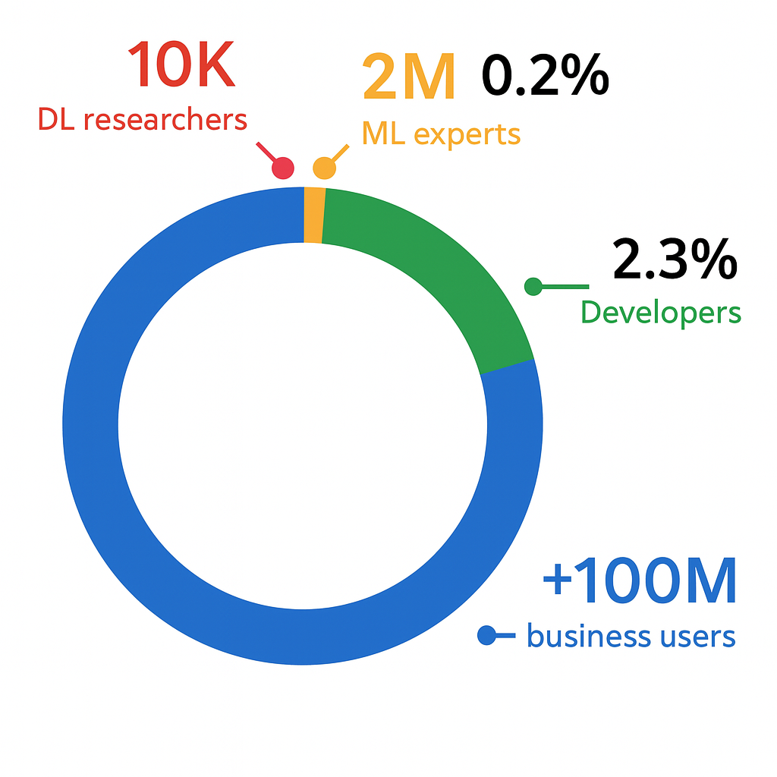
"Enable every company to be an AI company“
Generative AI Use Cases For the Enterprise
Kansas City AI/ML Day May 2023 (rsvp.withgoogle.com)
"Enable every company to be an AI company by reducing the challenges of AI model creation down to only the steps that require human judgement or creativity.“ - Google Cloud
Have the AI Do What is Difficult, Dangerous, Dirty or Dull
1 Billion Knowledge Worker
For Payers: Medical coders ensure claims accuracy and regulatory compliance by applying human judgment and expertise to ambiguous documentation and edge cases where AI alone cannot determine medical necessity or detect fraud.
For Providers: Coders reduce administrative burden by validating and correcting AI-suggested codes, ensuring accurate reimbursement while preserving the clinical integrity of provider documentation.
For Patients: Coders act as guardians of the patient narrative—ensuring their medical stories are accurately captured and ethically coded, which supports proper billing, reduces denials, and ultimately protects care continuity.
Who Are Knowledge Workers And How Do We Enable Them? (forbes.com)

Slide 22
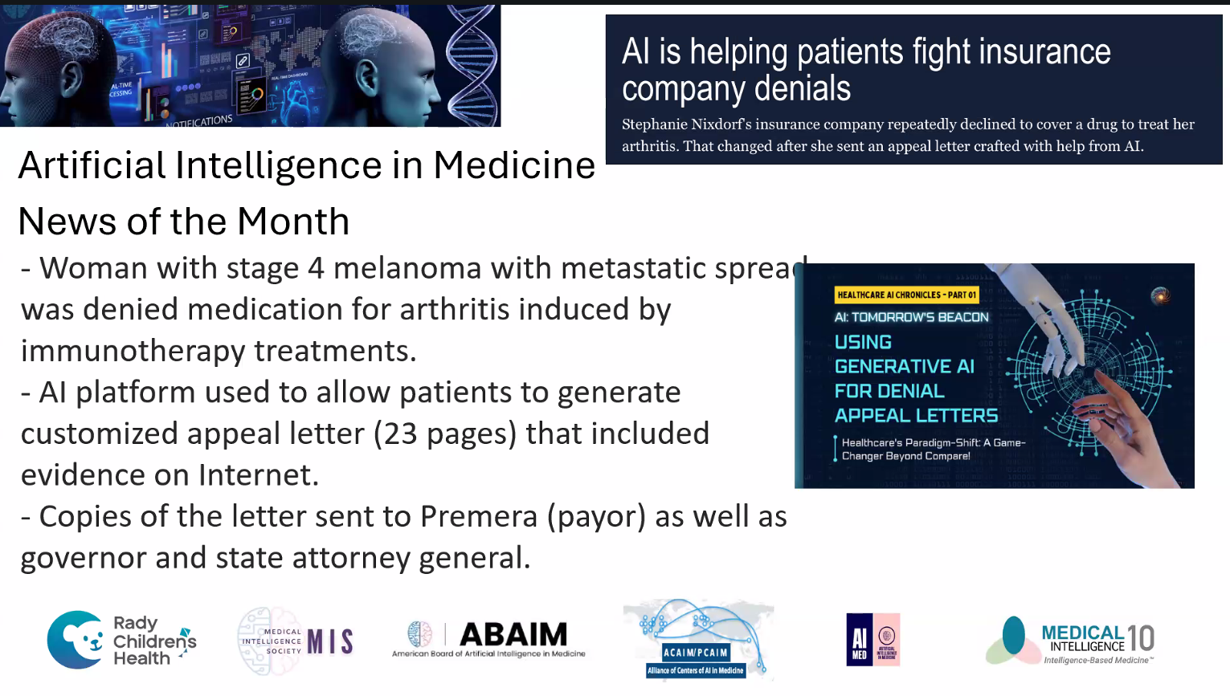
Most patients never appeal—success rates for appeals can be 40–60%, but only ~0.2–1% of denials are formally appealed in some markets.
With universal AI letters: Appeal rates could jump 100x+, overwhelming insurer administrative teams.
If every denied patient used AI to craft strong appeal letters, denial rates would drop, approvals would rise, and insurer review systems could be overwhelmed. This would drive higher costs, regulatory pressure, and potentially an AI-versus-AI standoff—ultimately pushing insurers toward fairer, more transparent claim processes or risk systemic breakdown.
How Are Patients are Starting to Use AI For “Medical Billing and Information” Problems?
Dr. Anthony Chang Chief Intelligence and Innovation Officer https://choc.org/medical-intelligence-and-innovation-institute/
https://www.yahoo.com/news/ai-helping-patients-fight-insurance-100040026.html

Slide 23
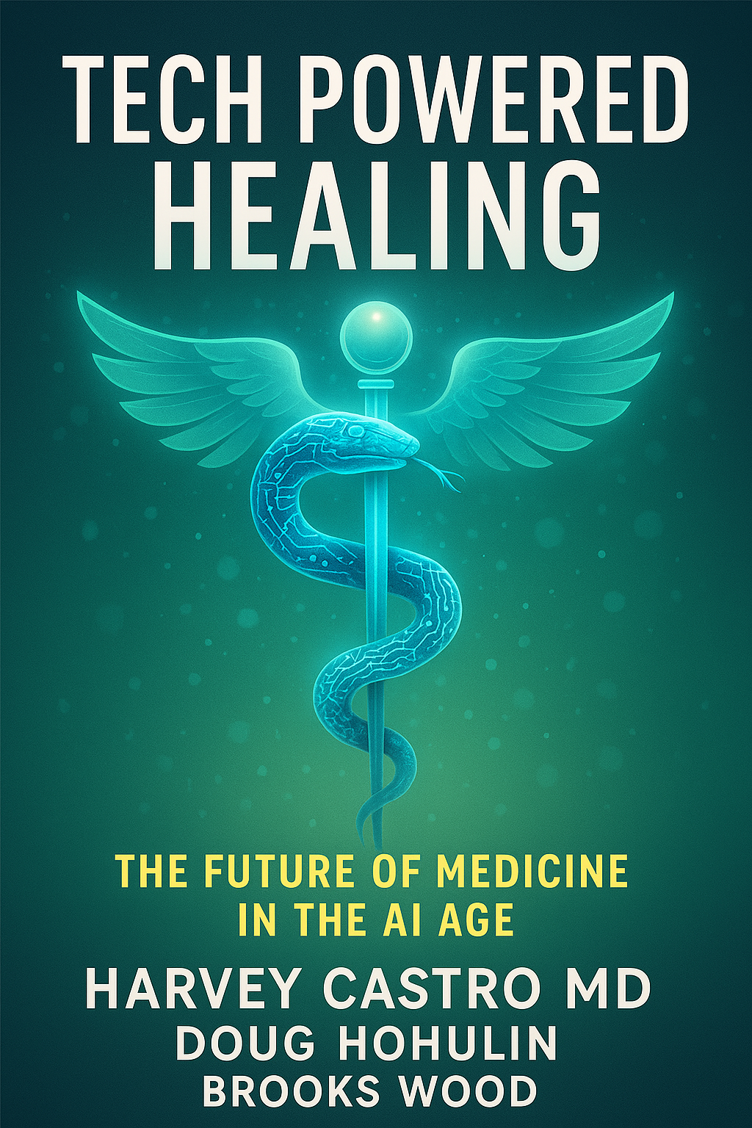
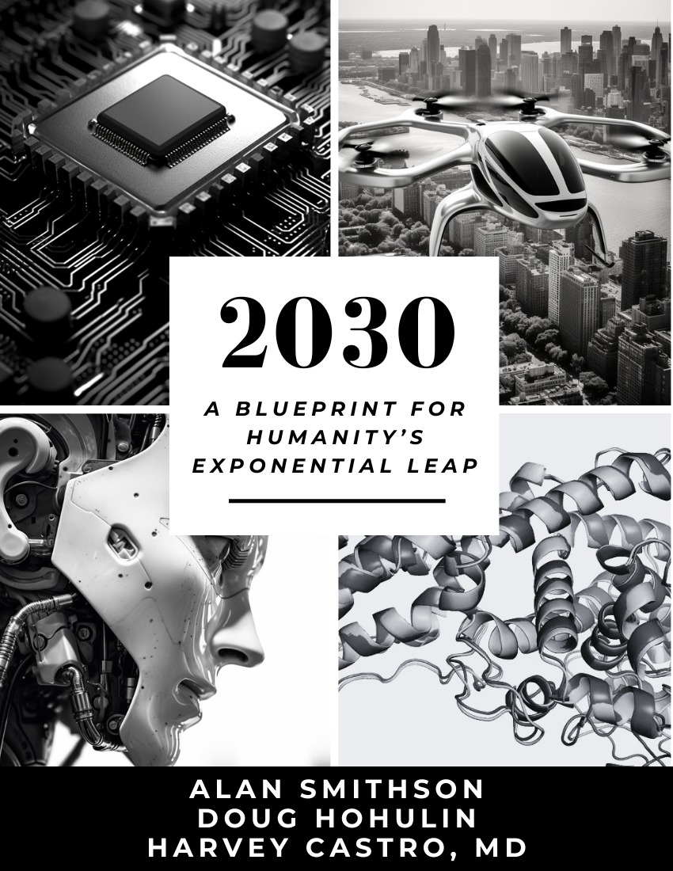
“Healthcare at its best is a conversation between a doctor and a patient trying to solve a problem.
WHAT PATIENTS WANT… To live their lives with minimal impact of illness… To get support and a sense of control.
WHAT DOCTORS WANT…Practice medicine without hassle factor … Innovation that makes a difference.” – Jordan Shlain, MD
To be useful, AI must be harnessed to enhance the patient-doctor relationship (not replace it), improve preventative care, and address the modifiable risk factors that lead to chronic disease and early mortality.
For Medical Coders, AI can help automate repetitive tasks like code suggestions and document parsing—but medical coders remain essential for applying clinical judgment, regulatory understanding, and ethical decision-making that machines cannot replicate.
2030Book.org
Notes:
A medical coder is a healthcare professional who translates clinical encounters into standardized codes that accurately represent diagnoses, procedures, and services delivered. These codes serve as the foundation for reimbursement, compliance, and data analytics across the healthcare system.
A medical coder can be an AI-augmented knowledge worker:
Support providers by reducing documentation burdens, validating clinical accuracy, and ensuring alignment with coding and billing guidelines;
Empower payers by promoting integrity, reducing fraud and denials, and ensuring claims are consistent with medical necessity and contractual coverage;
Serve patients by contributing to timely, accurate reimbursement and the sustainability of care systems, while helping ensure their clinical story is captured with precision and dignity.
Victoria Moll, CPC, COC, CRC, CPRC, AAPC: AI and Medical Coding: Separating Fear from Fact https://www.youtube.com/watch?v=H62Z8zjPfy4

Slide 24
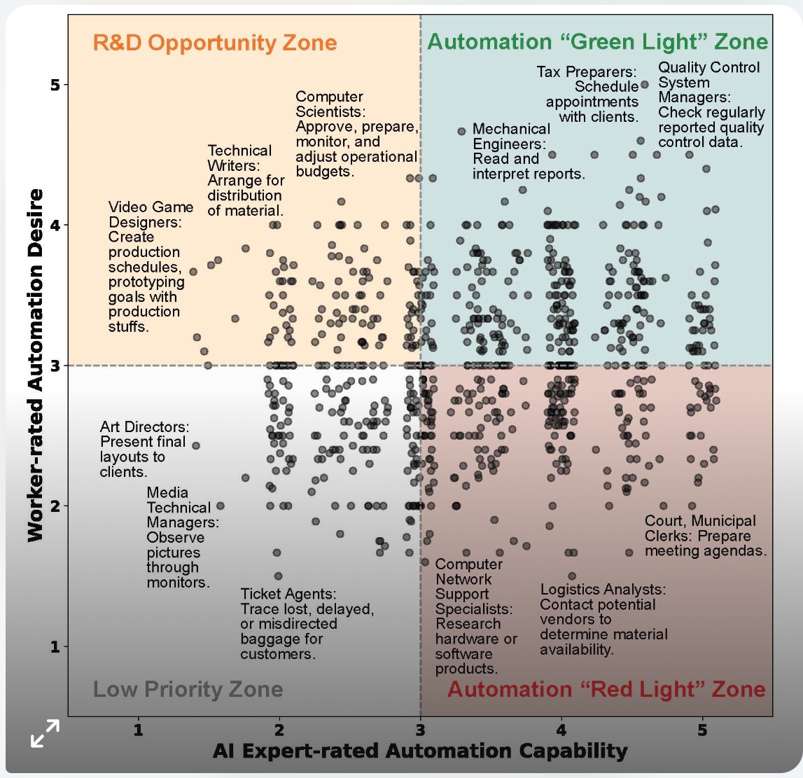
What Workers Really Want from AI
https://hai.stanford.edu/news/what-workers-really-want-from-artificial-intelligence
A Stanford study captures the gap between worker desires and AI’s abilities, and highlights areas ripe for research and development.
Four categories:
Green Light Zone: Tasks with Workers high automation desire and AI high capability.
  Have the AI Do What is Difficult, Dangerous, Dirty or Dull
Red Light Zone: Tasks with Workers low automation desire and AI high capability.
  You do the Jobs that require human judgement or creativity or fun to do
R&D Opportunity Zone: Tasks with Workers high AI automation desire but AI low capability.
Low Priority Zone: Tasks with Workers low desire and AI low capability.
Source: Shao, Y., Zope, H., Jiang, Y., Pei, J., Nguyen, D., Brynjolfsson, E., & Yang, D. (2025). Future of Work with AI Agents: Auditing Automation and Augmentation Potential across the U.S. Workforce. arXiv:2506.06576. Figure 5:

Slide 25
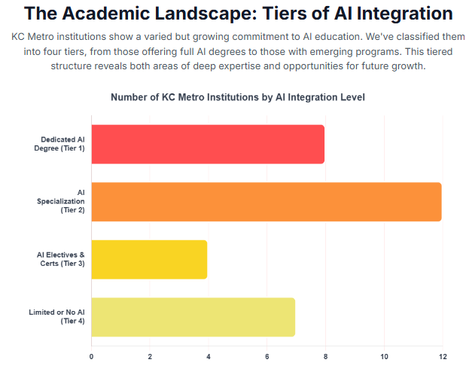
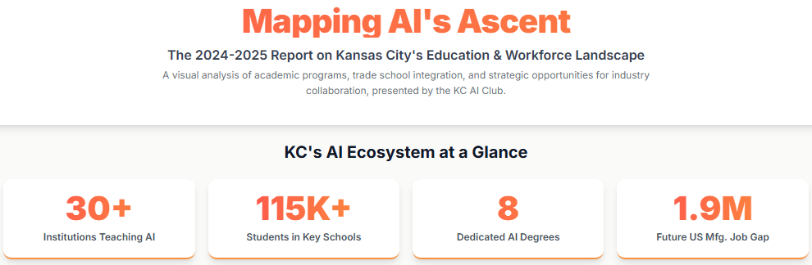
Kansas City is home to a thriving tech community and the Kansas City AI Club https://www.kansascity.ai/ is a place to connect, learn and discuss all things AI. Our goal is to make KC an AI Hub of Innovation.
We have over 3,200 people following us on LinkedIn: https://www.linkedin.com/company/kc-ai-club/posts/
The KC AI Club Tracks AI companies in the KC Area:
https://www.kansascity.ai/top-kansas-city-ai-companies
The plan to have a similar list for KC Universities and Trade Schools with AI Programs or Clubs.
The KC AI Club is Calling All KC Metro University & Trade School AI Innovators for a quarterly call!
Support AI Healthcare Initiatives and Partner with Other KC Digital/Healthcare Organizations
KC Tech Council
Kansas City Digital Drive Health Innovation Team
Digital Health KC

Slide 26
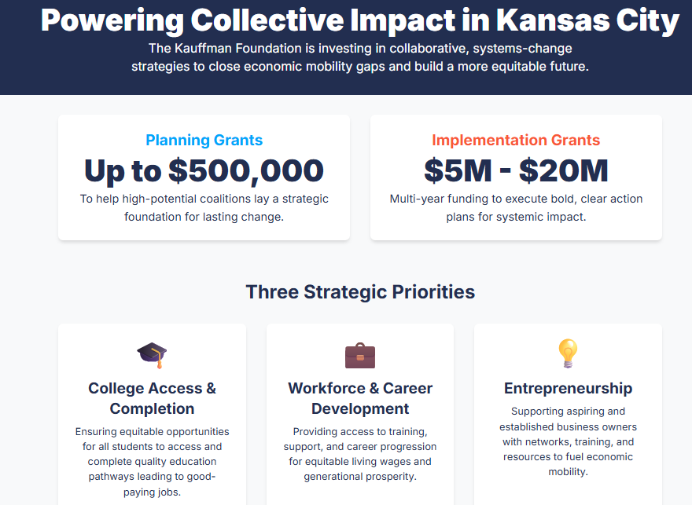
Kaufmann Grant Advancing Equitable Economic Mobility in Kansas City: https://www.kauffman.org/currents/six-coalitions-awarded-collective-impact-funding/ https://www.kauffman.org/funding/grants/collective-impact/
The Collective Impact grant for coalitions of high-capacity organizations to create a systems-change strategy to close economic mobility gaps in the Kansas City region
We are especially interested in proposals related to two key focus areas – education and employer connection and equitable access
https://www.kctechbridge.org/projectvision
The 6 Collective Impact coalitions announced for the Kaufmann Grant.
Coalition for Equity and Opportunity Coalition members include Phoenix Family (lead), Economic Mobility Pathways, Goodwill of Western Missouri and Eastern Kansas, Great Jobs KC, KC Digital Drive, Pete’s Garden, and United Way of Greater Kansas City.
Entrepreneurship Education Initiative Coalition members include Kansas City Kansas Community College (lead), Piper Schools, Kansas City Kansas Public Schools, University of Missouri – Kansas City, Babson College, The Porter House KC, and The Toolbox KC.
KC Tech Council Coalition members include KC Tech Council (lead), Garmin, H&R Block, Panasonic Energy, JE Dunn, and Burns and McDonell. They also include training partners such as Per Scholas, Goodwill, WeCodeKC, i.c. Stars, and Apprenti, among others. Educational collaborators include the University of Kansas, Kansas State University, Rockhurst University, Metropolitan Community College, and the University of Saint Mary.
https://www.kctechbridge.org/projectvision
Regional University Research Collective Coalition members include KC Digital Drive (lead), the University of Kansas, Kansas State University and the University of Missouri – Kansas City.
Returning Citizen Consortium Coalition members include Workforce Partnership (lead), Kansas Department of Corrections, Kansas City Kansas Community College, Kansas Chamber of Commerce, Reaching Out from Within, Starting Early, and Goodwill Industries.
The Teach KC Collaborative: From Education to Economic Mobility Initial coalition members include BLAQUE KC (lead), Teachers Like Me, The Educator Academy, Starting Early, Parent Power Lab, Urban League, Greater Kansas City LINC, Brothers Liberating Our Community (BLOC), 3rd District Kansas City Housing Accelerator, The Latinx Education Collaborative, and Credit & Homeownership Empowerment Services (CHES, Inc.)

Slide 27
Middle Zone where the machines are helping us,
but Humans are still indispensable to creating value
Because that middle zone is kind of a nice one for us humans where the machines are helping us, but humans are still indispensable to creating value and that would be, that's a zone where you can have higher productivity, more wealth and performance, but also more likely to have shared prosperity because labor is sort of inherently distributed, whereas technology and capital, as Eric (Schmidt) was just saying, potentially could be very concentrated. - Eric Brynjolfsson Stanford ECON295-CS323
Middle Zone for Medical Coders
Amplify Efficiency Without Displacement: AI handles repetitive tasks (e.g., code suggestions), freeing coders for complex decision-making.
Guardians of Ethical Coding: Coders remain vital for interpreting clinical nuance AI can’t fully grasp.
Create Collaborative Intelligence: Coders + AI form a feedback loop improving both model performance and accuracy.
Support Providers and Patents to Solve Their Medical Billing Problems
This middle zone positions coders as essential value creators, not casualties of automation
Notes:
In the next year, you're going to see very large context windows, agents and text action. transcripts/Stanford ECON295-CS323 2024 The_Age_of_AI,_Eric_Schmidt· GitHub
AI systems will soon translate textual commands directly into executable actions, bridging the gap between language and operational tasks.
Stanford ECON295/CS323 I 2024 I The AI Awakening, Erik Brynjolfsson
https://www.getrecall.ai/summary/stanford-online/stanford-econ295cs323-i-2024-i-the-ai-awakening-erik-brynjolfsson
Ex-Google CEO's BANNED Interview | Eric Schmidt (youtube.com)
Anatolii on X: "Stanford ECON295/CS323 I 2024 I The Age of AI, Eric Schmidt [REUPLOAD] The source video appears to be taken down less than a day since being posted https://t.co/tWV9AvM9AD" / X
transcripts/Stanford ECON295-CS323 2024 The_Age_of_AI,_Eric_Schmidt· GitHub
Stanford ECON295/CS323 I 2024 I The AI Awakening, Erik Brynjolfsson

Slide 28
How Are Providers Using AI Tools Today? – How Can You Support Them?
70% of Providers believing AI can improve well-being by reducing paperwork, coders can shift toward more auditing, quality assurance, and compliance roles—areas AI alone can’t handle.
Pew Research Oct 2024 For the General Workers
9% who use AI chatbots (at work) every day/few times a week
7% a few times a month
55% rarely/never
29% who have not heard of workplace AI chatbot use.
On Future AI Use in Workplace, US Workers More Worried Than Hopeful | Pew Research Center
Rock Health, "AI is in the doctor’s bag—and primary care is ready to use it,"
https://rockhealth.com/insights/ai-is-in-the-doctors-bag-and-primary-care-is-ready-to-use-it/
“Electronic health records 92% use them at least weekly, clinical decision support 83% at least weekly and patient engagement tools 74%.
AI-driven clinician support tools are showing up in workflows – Be Ready.
50% reported having used AI tools for at least one use case at work.
32% have used AI for clerical support (e.g., message drafting,
Ambient clinical documentation —with over half in this category using it daily.
AI-powered information management (24%)
AI-enabled clinical decision support (23%) tools.
More than 90% of survey respondents have tried or are open to trying each one of the professional AI solution categories referenced in the survey”

Slide 29
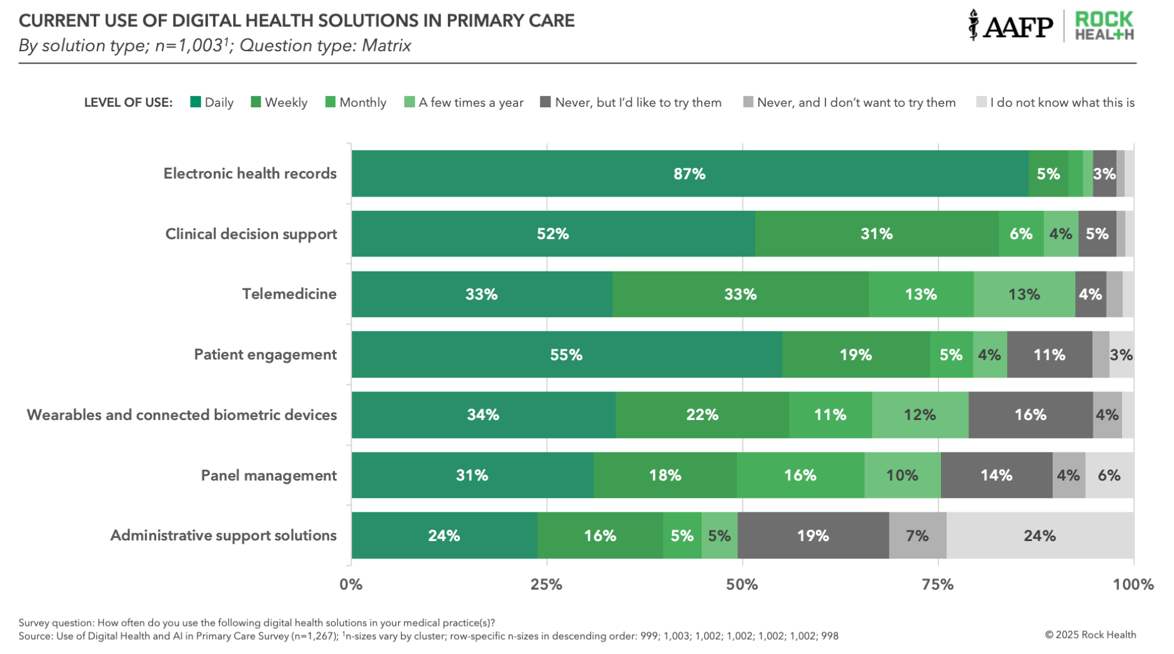
Source: Rock Health, "AI is in the doctor’s bag—and primary care is ready to use it," 2024. Retrieved from https://rockhealth.com/insights/ai-is-in-the-doctors-bag-and-primary-care-is-ready-to-use-it/
Notes:
Healthcare AI Guy Weekly | 3/4

Slide 30
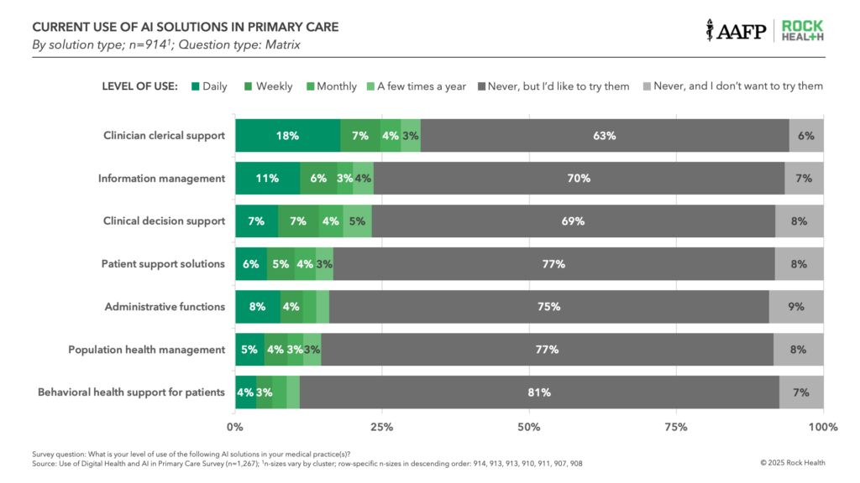
Source: Rock Health, "AI is in the doctor’s bag—and primary care is ready to use it," 2024. Retrieved from https://rockhealth.com/insights/ai-is-in-the-doctors-bag-and-primary-care-is-ready-to-use-it/
Notes:
Healthcare AI Guy Weekly | 3/4

Slide 31
Call To Action
Master the Tools That Work for You:
  Focus on AI tools that enhance your productivity—not replace your role.
Learn from Early Adopters:
  Connect with peers already using AI to simplify their workflows.
Stay Informed, Not Overwhelmed:
  Understand AI trends—but no need to become a developer (unless you're curious!).
Build AI Literacy & Spot Automation Opportunities:
  Identify repetitive tasks ripe for automation—and embrace collaborative intelligence.
Double Down on Human Value:
  Follow healthcare AI trends and invest in tasks that require judgment, nuance, and creativity—the very things AI can’t replicate.

Slide 32
Managed Care Compliance
Extends beyond government programs
Contractual compliance
Follow policies and procedures
Tracking challenges: volume
Education, operationalizing
Intersection with coding rules

Slide 33




Questions?

