Slide 1
Compliance with ICD-10-CM Official Guidelines for Coding and Reporting of Diagnostic Services
AAPC of Kansas City Annual Conference
August 22, 2025

Slide 2

About the Speaker
Judy Bielby, MBA, RHIA, CCS, FAHIMA is coding educator and auditor for an area hospital. Her clinical interests include health care classification and terminology systems, accurate and consistent application of coding rules, conventions, and guidelines, and semantic interoperability.
Judy has over 35 years of experience in the health care industry including coding, compliance, risk management, quality management, survey preparation, documentation improvement, and various special projects. In her previous work as an independent contractor and health record coding consultant, she has worked on numerous projects involving hospitals, state entities, national organizations, and federal government. She has extensive coding experience at several hospitals.
Judy received a B.S. in medical record administration from the University of Kansas in 1987 and an MBA from the University of Kansas in 1995.

Slide 3
Objectives
After this presentation, the audience will be able to
Identify resources related to ICD-10-CM coding requirements for coding diagnostic services
Explain documentation that is required to support coding diagnoses and other reasons for diagnostic services
Accurately assign ICD-10-CM codes for common reasons for diagnostic services

Slide 4

Don’t blindly trust AI!
Humans with knowledge and expertise in coding should be involved in assessing, maintaining, monitoring, and evaluating AI-powered coding applications

Slide 5
Human in the loop
“IFHIMA supports the indispensable role of the ‘human in the loop’ (HITL) as AI adoption grows in healthcare. Simply put, health information professionals and clinicians must remain active participants in AI-assisted processes. AI should support, not replace, their judgment.”
Source: IFHIMA. 2025. Position Statement: Ensuring Responsible Use of AI in Healthcare Information Collection and Use. Available at https://ifhimasitemedia.s3.us-east-2.amazonaws.com/wp-content/uploads/2025/06/11211739/AI_Position_Paper.pdf.

Slide 6


Slide 7


Slide 8

Participate using your cell phone
Text judy2015 to 37607
To: 37607
judy2015

Slide 9

Compliance with the guidelines
Why is it so important?

Slide 10
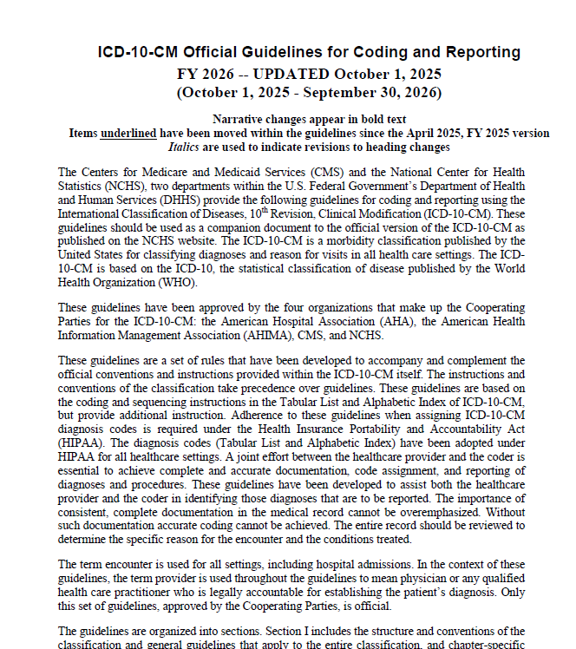
Official Coding Guidelines
ICD-10-CM Official Guidelines for Coding and Reporting are part of the ICD-10-CM code set
All healthcare settings are required to adhere to these official coding guidelines (45 CFR §162.1002 Medical data code sets)
National Center for Health Statistics. FY 2026 ICD-10-CM Official Guidelines for Coding and Reporting: p. 1.

Slide 11
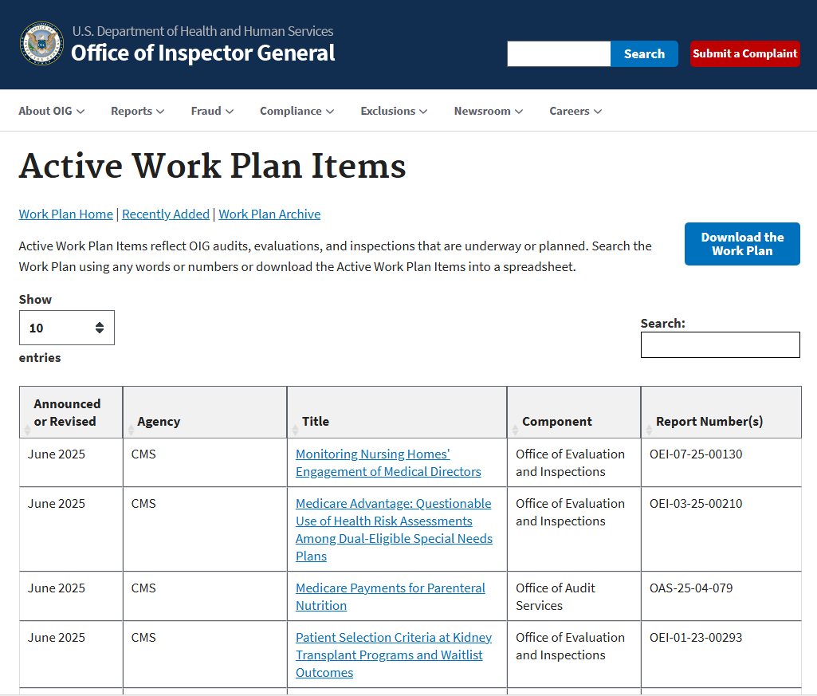
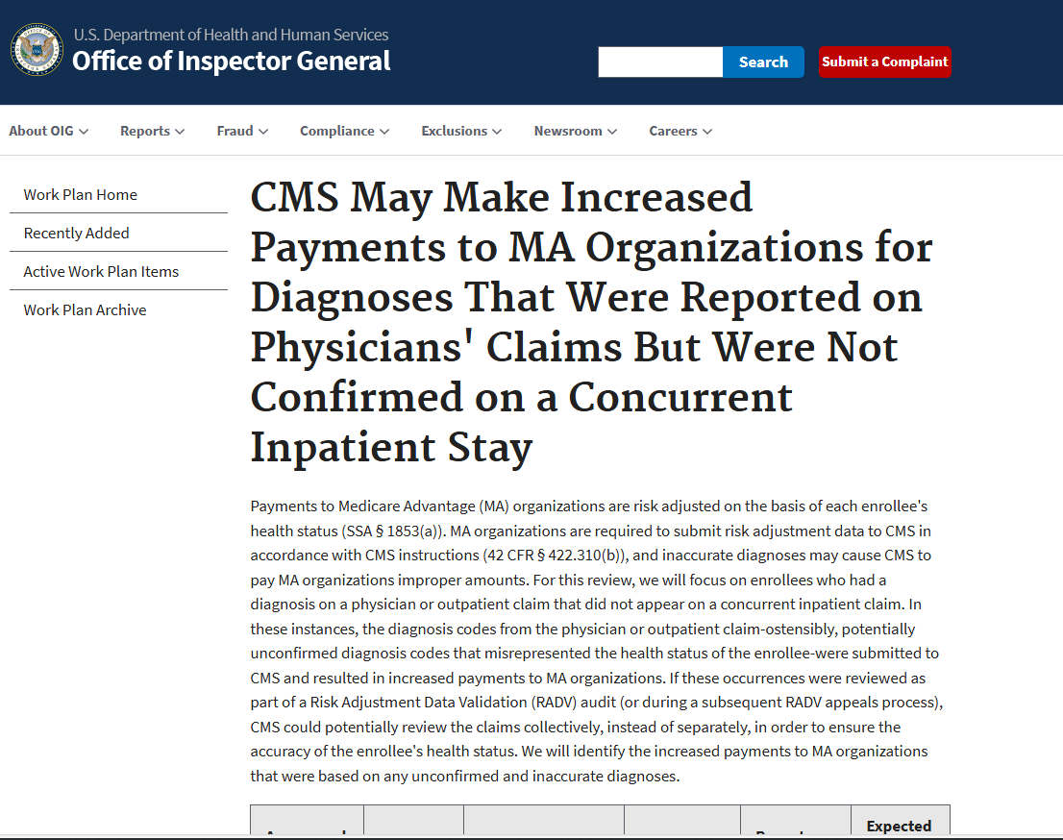
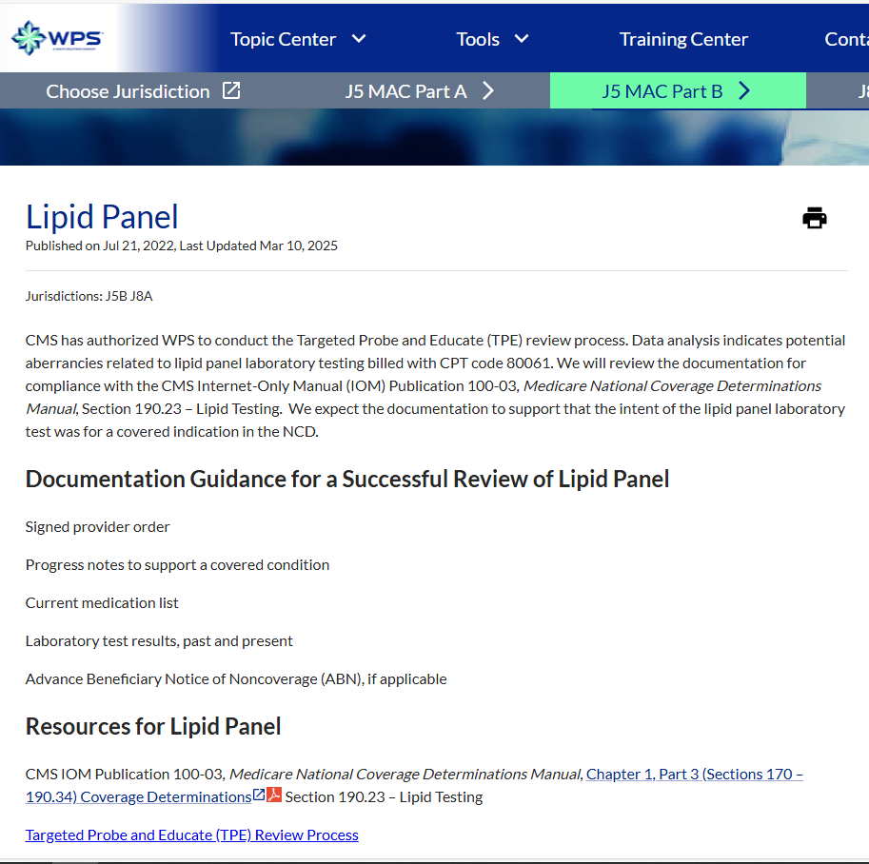
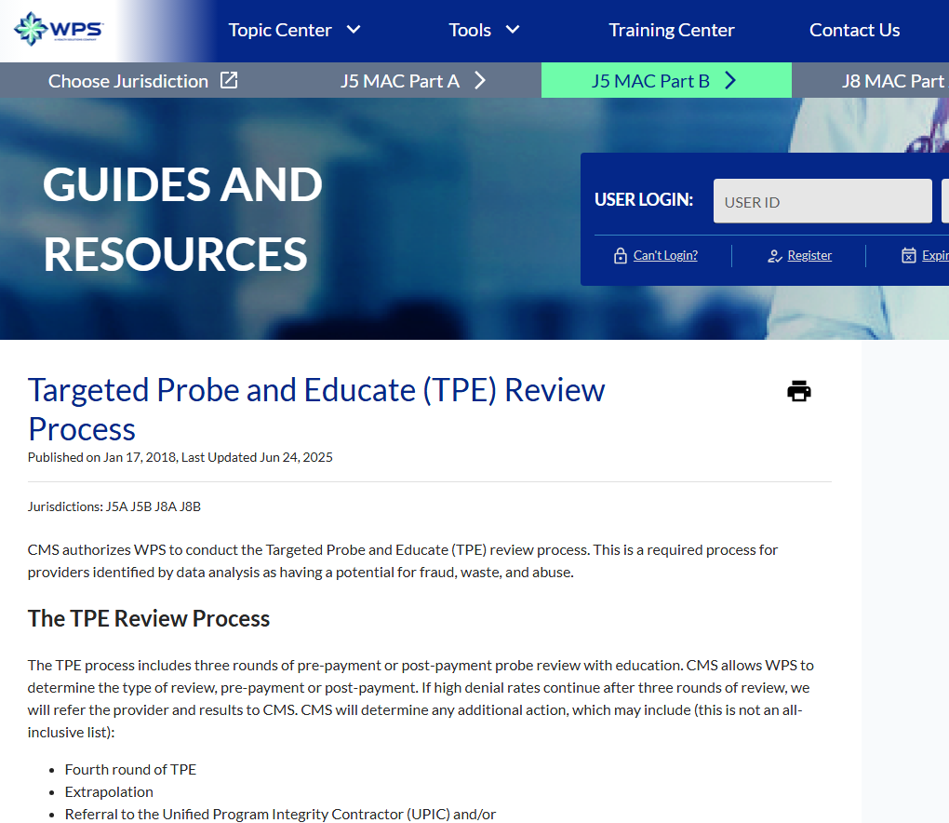
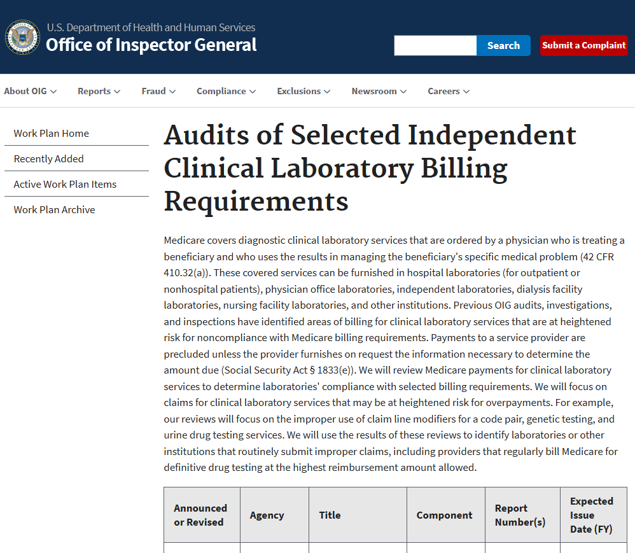

Slide 12

ICD-10-CM codes are used for many purposes
ICD-10-CM code assignment and interpretation for pre-registration processes
Software and related interfaces for registration, reservations, CPOE, specialized clinical department systems, payment systems, clinical pathways, etc.
Sufficient documentation to support medical necessity of services and procedures
Reports that use ICD codes
Processes that are triggered by ICD codes

Slide 13
Compliance with documentation requirements

Slide 14

Important!
Diagnosis codes must be based on documentation in the health record by physicians and other providers who are legally accountable for establishing the medical diagnoses
complete medical record documentation
correct diagnosis and procedure coding
accurate reporting

Slide 15
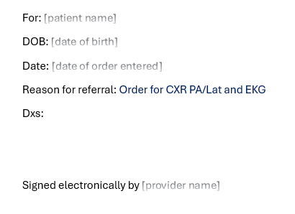
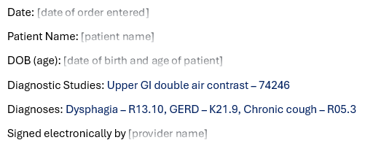
Which order is missing important information?
CPT copyright 2024 American Medical Association. All rights reserved. CPT is a registered trademark of the American Medical Association.

Slide 16
Documentation requirements for the order
Authenticated documentation by treating provider of the
intent for a test to be performed
medically necessary diagnosis or other basis for testing
Sources:
Medicare Program Integrity Manual, Chapter 6, Section 6.9.1
Medicare Claims Processing Manual, Chapter 35, Section 20
CMS MLN Fact Sheet Complying with Documentation Requirements for Lab Services

Slide 17
Comply with ABN requirements!
If you expect Medicare payment to be denied on a test or service performed on a Medicare beneficiary, then issue Advance Beneficiary Notice of Noncoverage (ABN)
You must comply with ABNs and other beneficiary notices initiatives when procedures and services are planned for Medicare beneficiaries

Slide 18
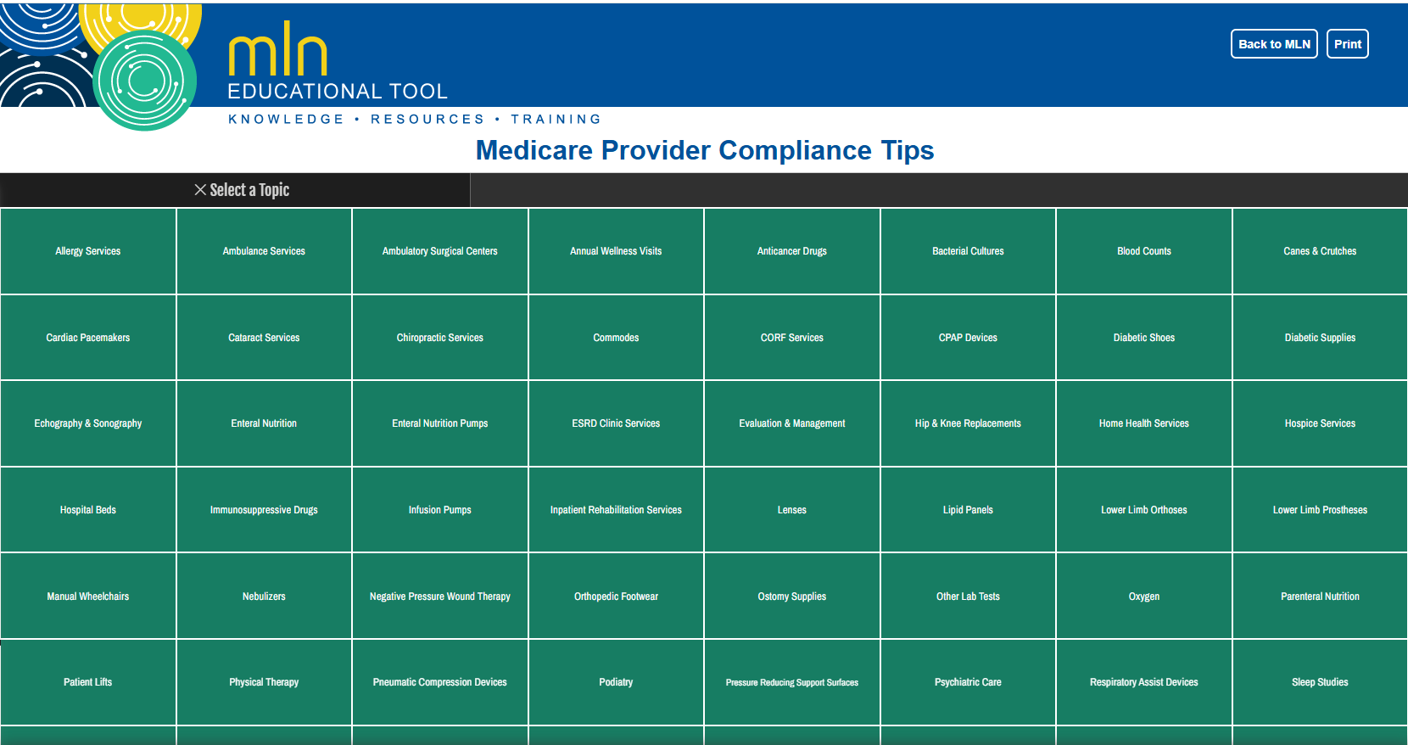

Available https://www.cms.gov/Outreach-and-Education/Medicare-Learning-Network-MLN/MLNProducts/medicare-provider-compliance-tips/medicare-provider-compliance-tips.html

Slide 19

WPS Training Resources
WPS is the Medicare Administrative Contractor providing both Part A and Part B Medicare benefit administration for Iowa, Kansas, Missouri, and Nebraska
Check out the resources available on the WPS Training Center website and sign up for email notifications at https://www.wpsgha.com/training

Slide 20
Review other payer policies
Other payers might have different policies. It is important to review each plan’s specific requirements.
Make sure there is a mechanism in your organization for monitoring and disseminating updates to payer-specific requirements on coding and reimbursement.

Slide 21

Overview of ICD-10-CM coding requirements

Slide 22
Participate using your cell phone
Text judy2015 to 37607
To: 37607
judy2015

Slide 23

What resources do you consult when you are unsure how to code a diagnosis?

Slide 24
Authoritative Resources
What are the authoritative sources of coding guidelines and advice?

Slide 25
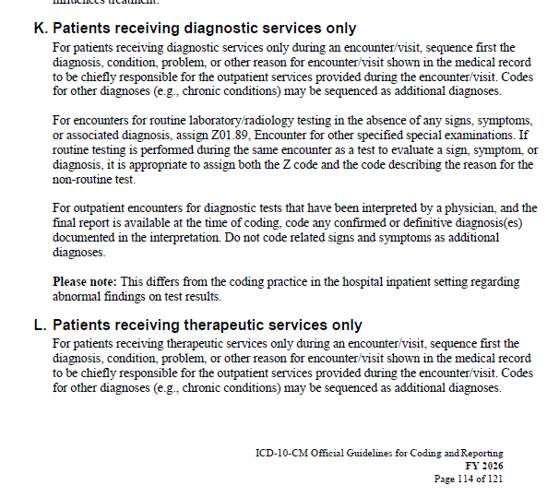
Follow the conventions and guidelines!
Source: National Center for Health Statistics. FY 2026 ICD-10-CM Official Guidelines for Coding and Reporting: p. 114.

Slide 26
Basic ICD-10-CM Coding Steps
Review the patient’s health record and identify the diagnoses that meet guidelines for reporting as principal/first-listed or additional diagnosis. For each diagnosis, condition, or reason for visit, perform steps 2 through 5 until all of the elements are completely reported.
Locate the main term in the index. Read and follow any notes that appear under the main term. These include:
  Modifiers of main terms
  Subterms
  Cross references
Locate and verify the correct code(s) in the tabular list. Follow any instructional notes in the tabular list that apply to the code.
Review the following sources for additional instruction:
  ICD-10-CM Official Guidelines for Coding and Reporting
  AHA’s Coding Clinic for ICD-10-CM and ICD-10-PCS
  Payer-specific coding guidelines
  Facility-specific coding guidelines
Report the correct code(s) identified.
Reprinted with permission from Judy Bielby’s ICD-10-CM Worksheets

Slide 27
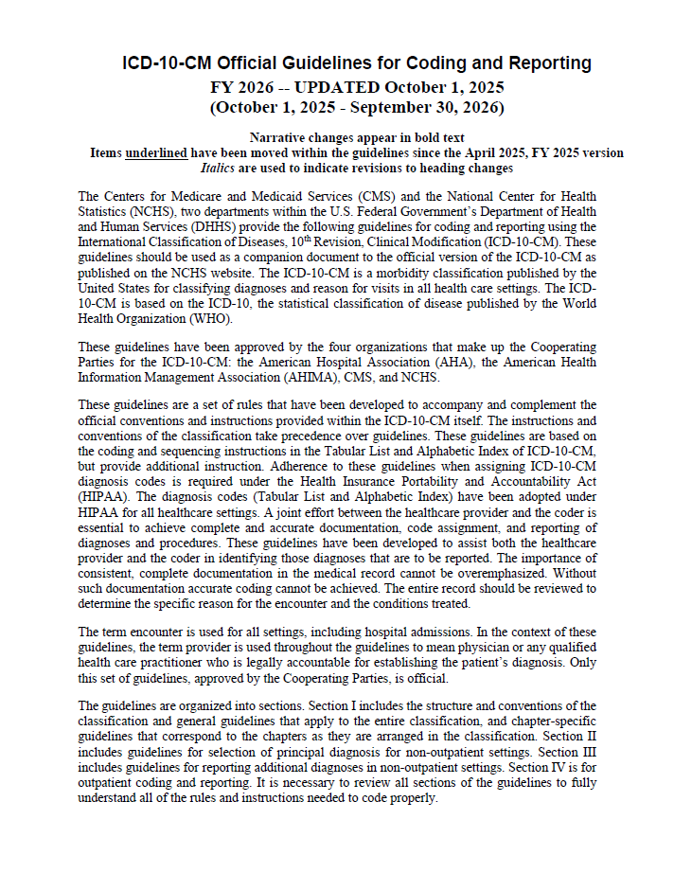
What does this statement mean?
The instructions and conventions of the classification take precedence over guidelines.
Source: National Center for Health Statistics. FY 2026 ICD-10-CM Official Guidelines for Coding and Reporting: p. 1.

Slide 28
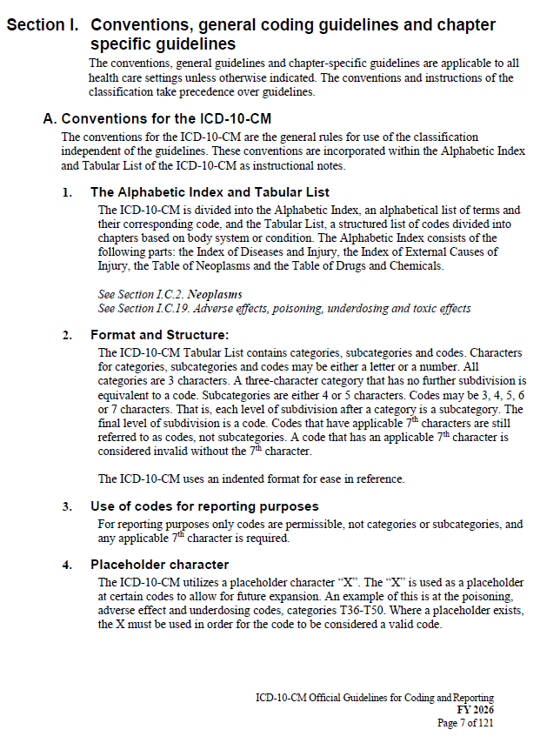
What are conventions?
Source: National Center for Health Statistics. FY 2026 ICD-10-CM Official Guidelines for Coding and Reporting: p. 7.

Slide 29
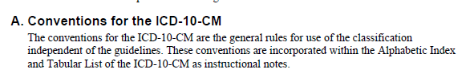
Source: National Center for Health Statistics. FY 2026 ICD-10-CM Official Guidelines for Coding and Reporting: p. 7.

Slide 30
Follow the conventions and guidelines!
Section IV.K is particularly relevant for today’s topic
Source: National Center for Health Statistics. FY 2026 ICD-10-CM Official Guidelines for Coding and Reporting: p. 114.

Slide 31
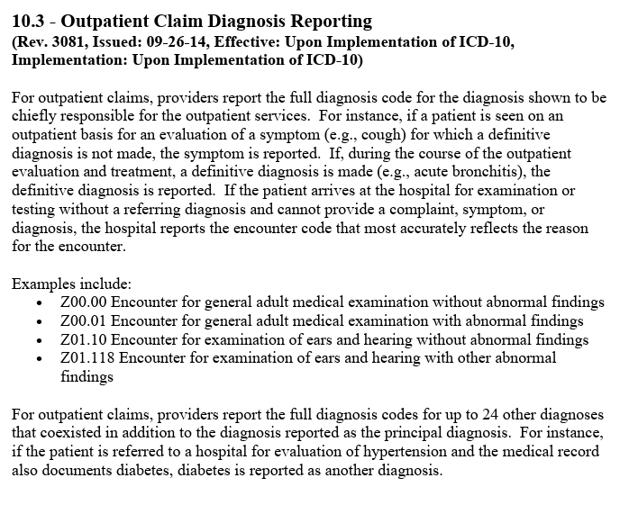
See also Medicare policy
For example, see Medicare Claims Processing Manual, Chapter 23 – Fee Schedule Administration, Section 10.3 https://www.cms.gov/regulations-and-guidance/guidance/manuals/downloads/clm104c23.pdf

Slide 32

Common but problematic scenarios
ICD-10-CM coding for diagnostic test and services

Slide 33
Participate using your cell phone
Text judy2015 to 37607
To: 37607
judy2015

Slide 34
ICD-10-CM coding for diagnostic services
What types of diagnostic services encounters do you find challenging to code, inadequately documented, or incorrectly coded?

Slide 35

Preoperative evaluation

Slide 36

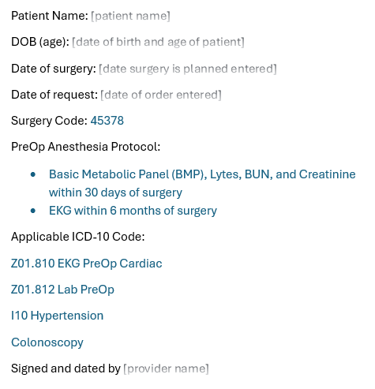
What’s wrong with this order?

Slide 37
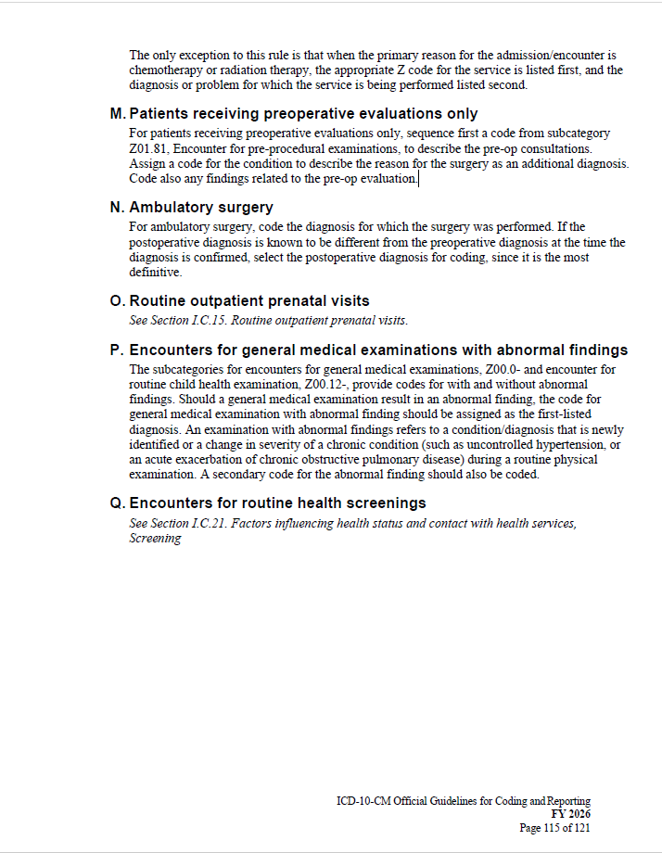
ICD-10-CM coding requirements
“For patients receiving preoperative evaluations only, sequence first a code from subcategory Z01.81, Encounter for pre-procedural examinations, to describe the pre-op consultations. Assign a code for the condition to describe the reason for the surgery as an additional diagnosis. Code also any findings related to the pre-op evaluation.”
Source: National Center for Health Statistics. FY 2026 ICD-10-CM Official Guidelines for Coding and Reporting: p. 115.

Slide 38
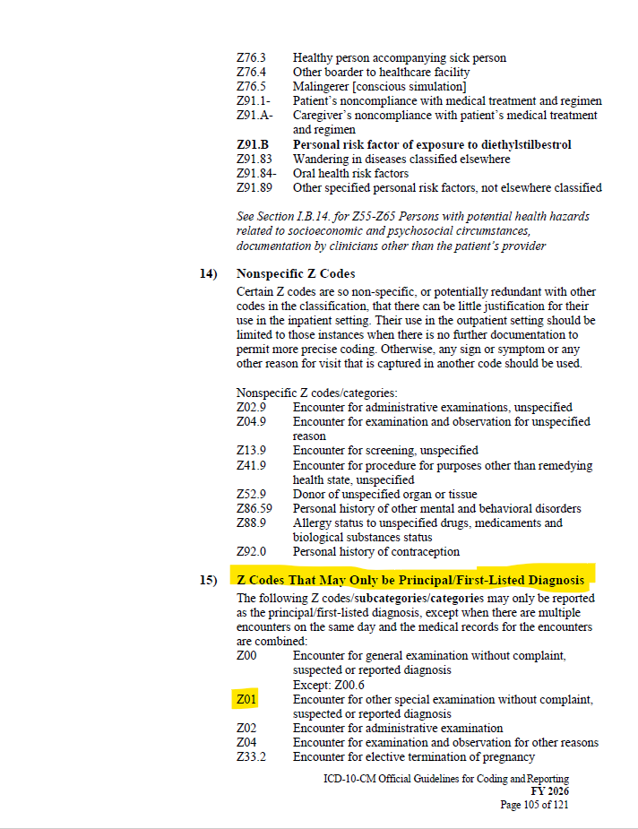
ICD-10-CM coding requirements
OCG I.C.21.c.15 states that ICD-10-CM category Z01 codes may only be principal/first-listed diagnosis
Source: National Center for Health Statistics. FY 2026 ICD-10-CM Official Guidelines for Coding and Reporting: p. 105.

Slide 39
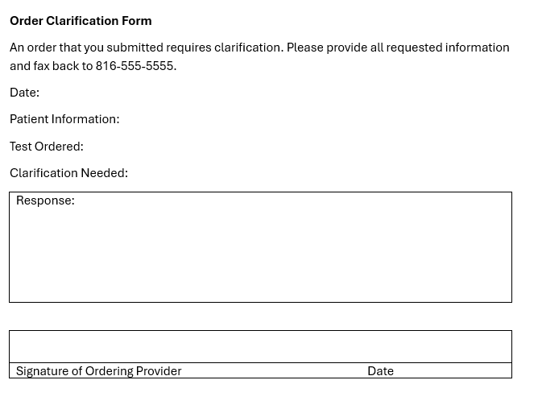
Documentation requirements
Seek clarification of the reason for surgery if it is not documented

Slide 40
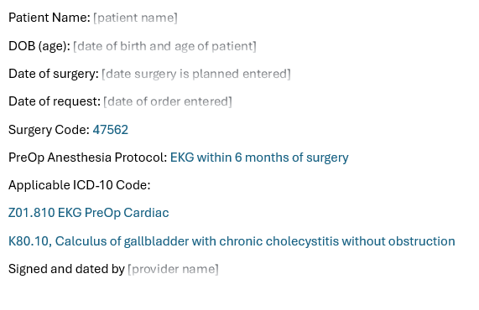

Reason for surgery documented

Slide 41
Lipid panel

Slide 42
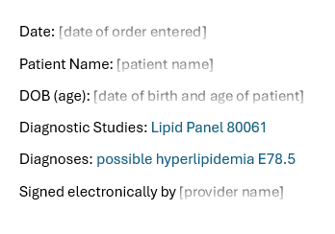
What’s wrong with this order?

Slide 43
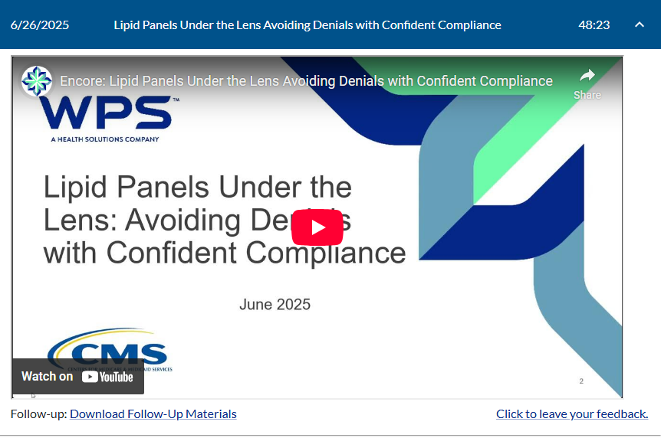
Hot topic for WPS GHA
WPS GHA’s June 26, 2025, encore presentation on Lipid Panels is available at https://www.wpsgha.com/training/encore-presentations

Slide 44
What is the reason for the lipid panel test?
Do not assign codes for uncertain diagnoses in the outpatient setting.
Is it for diagnostic purposes or screening purposes?
If a test is being performed to see if a patient has hyperlipidemia, code the reason why hyperlipidemia is suspected. If there are no signs or symptoms, this would be a screening.

Slide 45
Lipid panel – MAC TPE review
WPS reported on results from recent Targeted Probe and Educate (TPE) reviews
Problem error rate for lipid panel is 62%!
Top reasons for denial of lipid panel include
  The documentation submitted did not include a signed physician order or documentation to support intent for order
  Documentation submitted does not support medical necessity as listed in coverage requirements in NCD 190.23 – Lipid Testing
  Documentation provided does not support the medical necessity for the number of times reported within the timeframe reviewed
Source: WPS. (2025). J5 Part B Targeted Probe and Educate Problem Error Rates. Published 8/4/2025. Available at https://www.wpsgha.com/news-updates/view/741.

Slide 46
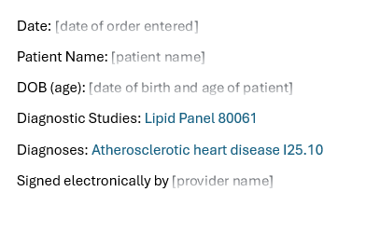
Hyperlipidemia suspected because of ASHD

Slide 47
Order for rehab

Slide 48
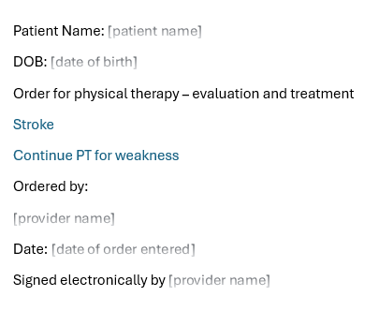
What’s wrong with this order?

Slide 49
ICD-10-CM coding requirements
OCG I.B.10 Sequela (Late Effects) states, “The code for the acute phase of an illness or injury that led to the sequela is never used with a code for the late effect.”
OCG I.C.9.d Sequela of cerebrovascular disease states, “Category I69 is used to indicate conditions classifiable to categories I60-I67 as the causes of sequela (neurologic deficits), themselves classified elsewhere.”
Source: National Center for Health Statistics. FY 2026 ICD-10-CM Official Guidelines for Coding and Reporting: pp. 14, 53-54.

Slide 50
ICD-10-CM coding requirements
OCG II.K Admissions/Encounters for Rehabilitation provides an example where an encounter for rehab for right-sided dominant hemiplegia following cerebrovascular infarction would be assigned ICD-10-CM code I69.351, Hemiplegia and hemiparesis following cerebral infarction affecting right dominant side, as the first-listed or principal diagnosis.
National Center for Health Statistics. FY 2026 ICD-10-CM Official Guidelines for Coding and Reporting: p. 110.
Coding Clinic for ICD-10-CM and ICD-10-PCS provides support to assigning a code from ICD-10-CM subcategory I69.3 when the patient is being treated for sequela as opposed to being treated for the acute CVA.

Slide 51
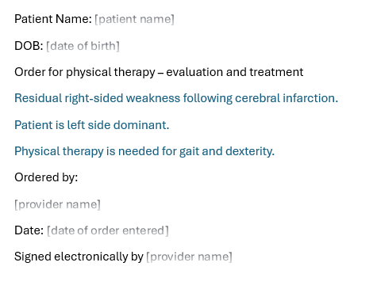
PT ordered for sequela of infarction
I69.353, Hemiplegia and hemiparesis following cerebral infarction affecting right non-dominant side

Slide 52
History vs. current condition

Slide 53
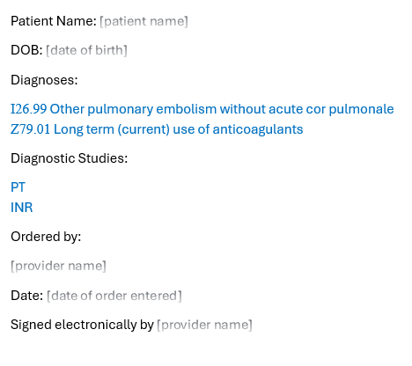
What’s wrong with this order?
Office notes describe only a history of pulmonary embolism

Slide 54
ICD-10-CM History codes
OCG I.C.21.c.4 states, “Personal history codes explain a patient’s past medical condition that no longer exists and is not receiving any treatment, but that has the potential for recurrence, and therefore may require continued monitoring.”
Source: National Center for Health Statistics. FY 2026 ICD-10-CM Official Guidelines for Coding and Reporting: p. 97.
OCG I.C.21.c.4 states, “The reason for the encounter (for example, screening or counseling) should be sequenced first and the appropriate personal and/or family history code(s) should be assigned as additional diagnos(es).”
Source: National Center for Health Statistics. FY 2026 ICD-10-CM Official Guidelines for Coding and Reporting: p. 97.
Example: Z86.711, Personal history of pulmonary embolism

Slide 55
ICD-10-CM Aftercare codes
OCG I.C.21.c.7 states, “Aftercare visit codes cover situations when the initial treatment of a disease has been performed and the patient requires continued care during the healing or recovery phase, or for the long-term consequences of the disease. The aftercare Z code should not be used if treatment is directed at a current, acute disease.”
Source: National Center for Health Statistics. FY 2026 ICD-10-CM Official Guidelines for Coding and Reporting: pp. 99-100.
Example: Z51.81, Encounter for therapeutic drug level monitoring

Slide 56
ICD-10-CM Follow-up codes
OCG I.C.21.c.8 states, “The follow-up codes are used to explain continuing surveillance following completed treatment of a disease, condition, or injury. They imply that the condition has been fully treated and no longer exists.”
Source: National Center for Health Statistics. FY 2026 ICD-10-CM Official Guidelines for Coding and Reporting: pp. 100-101.
Example: Z08, Encounter for follow-up examination after completed treatment for conditions other than malignant neoplasm

Slide 57
Documentation requirements
“History” as used in provider documentation might be too vague
  Does the patient have a history only of a condition that has resolved? Or
  Does the patient have a current chronic condition?
If the documentation is vague, then query the provider for clarification
Source: American Hospital Association. History of atrial fibrillation on anticoagulant therapy. Coding Clinic for ICD-10-CM and ICD-10-PCS, Fourth Quarter 2013: 101-102.

Slide 58
BMI

Slide 59
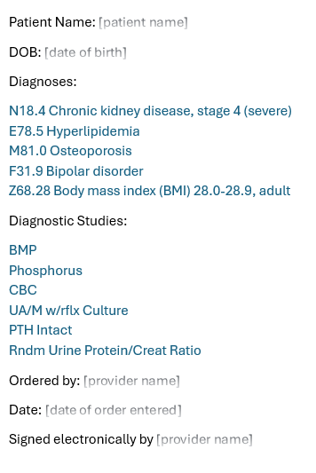
What’s wrong with this order?

Slide 60
ICD-10-CM coding requirements
OCG I.C.21.C.3 states, “BMI codes should only be assigned when there is an associated, reportable diagnosis (such as obesity). Do not assign BMI codes during pregnancy.”
Source: National Center for Health Statistics. FY 2026 ICD-10-CM Official Guidelines for Coding and Reporting: p. 95.

Slide 61
Documentation requirements
The diagnosis associated with the BMI must be documented and coded for the BMI to be coded.
Code assignment must be based on documentation.
  The specific BMI obtained for the patient must be documented to determine the ICD-10-CM code for BMI.

Slide 62
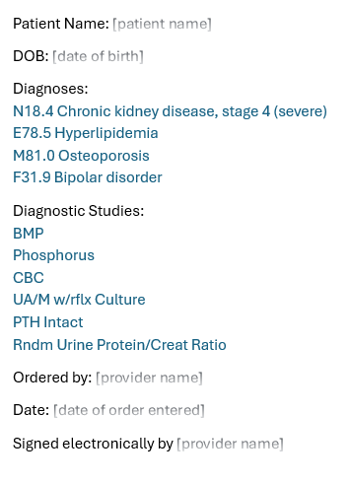
Don’t code BMI if there is no associated diagnosis

Slide 63
Liver function tests and studies

Slide 64
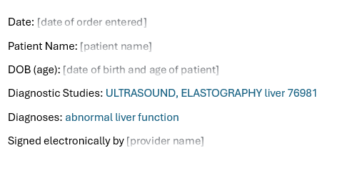
What’s wrong with this order?

Slide 65
Abnormal liver function test or study?
Findings, abnormal, inconclusive, without diagnosis -see also Abnormal
--function study NEC R94.8
----liver R94.5
Abnormal, abnormality, abnormalities -see also Anomaly
--function studies
----liver R94.5
Source: National Center for Health Statistics. FY 2026 ICD-10-CM Index to Diseases and Injuries: pp. 5, 600.

Slide 66
Abnormal liver function test or study?
Findings, abnormal, inconclusive, without diagnosis -see also Abnormal
--liver function test -see also Elevated, liver function, test R79.89
Abnormal, abnormality, abnormalities -see also Anomaly
--liver function test -see also Elevated, liver function, test R79.89
Source: National Center for Health Statistics. FY 2026 ICD-10-CM Index to Diseases and Injuries: pp. 5, 601.

Slide 67
Elevated liver function test vs. study
Elevated, elevation
--alanine transaminase(ALT) R74.01
--ALT(alanine transaminase) R74.01
--aspartate transaminase(AST) R74.01
...
--AST(aspartate transaminase) R74.01
...
--liver function
----study R94.5
----test R79.89
----alkaline phosphatase R74.8
----aminotransferase R74.01
----bilirubin R17
----hepatic enzyme R74.8
----lactate dehydrogenase R74.02
Source: National Center for Health Statistics. FY 2026 ICD-10-CM Index to Diseases and Injuries: p. 533.

Slide 68
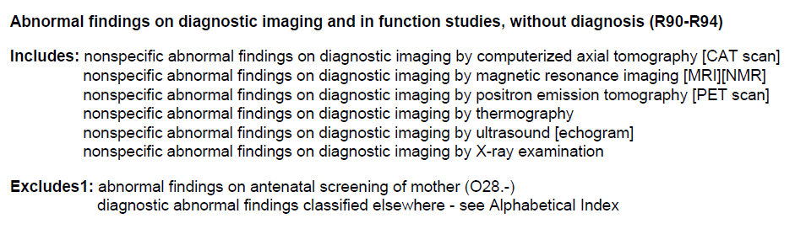
Elevated liver function study
ICD-10-CM code R94.5, Abnormal results of liver function studies, is classified to the block of codes for Abnormal findings on diagnostic imaging and in function studies, without diagnosis (R90-R94)
National Center for Health Statistics. FY 2026 ICD-10-CM Tabular List: p. 1284.

Slide 69
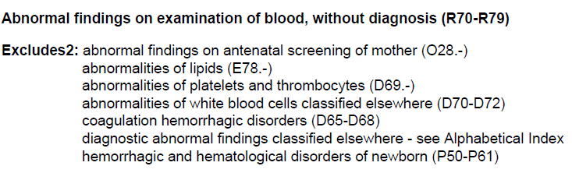
Elevated liver function test
These codes are classified to the block of codes for Abnormal findings on examination of blood, without diagnosis (R70-R79)
  ICD-10-CM code R74.01, Elevation of levels of liver transaminase levels
  ICD-10-CM code R74.02, Elevation of levels of lactic acid dehydrogenase [LDH]
  ICD-10-CM code R74.8, Abnormal levels of other serum enzymes
  ICD-10-CM code R79.89, Other specified abnormal findings of blood chemistry
National Center for Health Statistics. FY 2026 ICD-10-CM Tabular List: p. 1273.

Slide 70
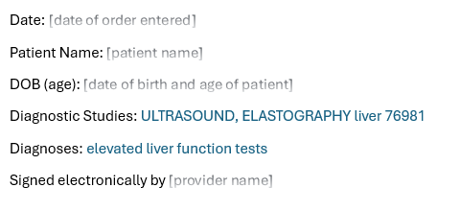
Indication for test clearly documented

Slide 71
Long-term prescribed drug use

Slide 72
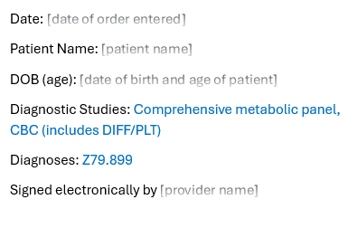
What’s wrong with this order?

Slide 73
ICD-10-CM category Z79
The code description states: Long term (current) drug therapy
  That means it is not used for short term drug therapy!
OCG I.C.21.C.3 states, “Codes from this category indicate a patient’s continuous use of a prescribed drug (including such things as aspirin therapy) for the long-term treatment of a condition or for prophylactic use. It is not for use for patients who have addictions to drugs. This subcategory is not for use of medications for detoxification or maintenance programs to prevent withdrawal symptoms (e.g., methadone maintenance for opiate dependence). Assign the appropriate code for the drug use, abuse, or dependence instead.”
Source: National Center for Health Statistics. FY 2026 ICD-10-CM Official Guidelines for Coding and Reporting: p. 95.

Slide 74
Documentation requirements
The mere use of a drug for a long time does not necessarily warrant assigning a code from ICD-10-CM category Z79.
All assigned ICD-10-CM codes must meet conventions and guidelines for reporting.
  OCG I.B.1 states, “Read and be guided by instructional notations that appear in both the Alphabetic Index and the Tabular List.”
  OCG IV.J states, “Code all documented conditions that coexist at the time of the encounter/visit and that require or affect patient care, treatment or management.”
Source: National Center for Health Statistics. FY 2026 ICD-10-CM Official Guidelines for Coding and Reporting: pp. 12, 114.

Slide 75
ICD-10-CM code Z79.899
ICD-10-CM code Z79.899, Other long term (current) drug therapy, is especially vague.
Do not assign vague codes just to get a test or service to meet medical necessity!
Always report the reason for test as accurately as possible.

Slide 76
Appropriate use of ICD-10-CM code Z79.899
OCG I.C.1.a.2.i. HIV managed by long-term use of antiretroviral medication
Coding Clinic Third Quarter 2017 Prescribed long term cannabis use during pregnancy
Coding Clinic Third Quarter 2023 Prescribed long term cannabis use for chronic pain

Slide 77
Long-term use of prescribed drugs
Coding Clinic for ICD-9-CM published several articles on codes for long-term use of drugs after this concept was first introduced October 1, 1995 – do a search for “long-term”
Articles include
  Fourth Quarter 1995 “History of venous thrombosis/long-term anticoagulation therapy 1995”
  Second Quarter 1996 “Chronic recurrent urinary tract infection w/o urinary symptoms”
  Fourth Quarter 1998 “Long term use of antibiotics”

Slide 78
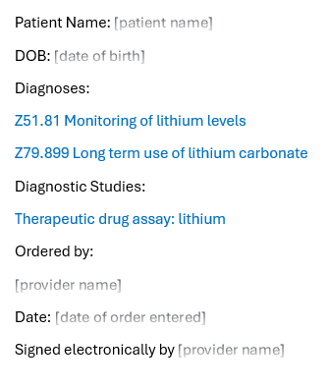
Monitoring lithium level

Slide 79
Unspecified codes –
Good or Bad?

Slide 80
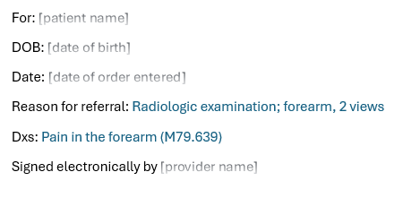
What’s wrong with this order?

Slide 81
Laterality
OCG I.B.13 states, “When laterality is not documented by the patient’s provider, code assignment for the affected side may be based on medical record documentation from other clinicians. If there is conflicting medical record documentation regarding the affected side, the patient’s provider should be queried for clarification. Codes for “unspecified” side should rarely be used, such as when the documentation in the record is insufficient to determine the affected side and it is not possible to obtain clarification.”
Source: National Center for Health Statistics. FY 2026 ICD-10-CM Official Guidelines for Coding and Reporting: p. 15.

Slide 82
Participate using your cell phone
Text judy2015 to 37607
To: 37607
judy2015

Slide 83
Laterality
Provide an example where it would be acceptable to report an unspecified code for laterality

Slide 84
Use of unspecified codes
OCG I.B.18 states, “When sufficient clinical information isn’t known or available about a particular health condition to assign a more specific code, it is acceptable to report the appropriate ‘unspecified’ code (e.g., a diagnosis of pneumonia has been determined, but not the specific type). Unspecified codes should be reported when they are the codes that most accurately reflect what is known about the patient’s condition at the time of that particular encounter. It would be inappropriate to select a specific code that is not supported by the medical record documentation or conduct medically unnecessary diagnostic testing in order to determine a more specific code.”
Source: National Center for Health Statistics. FY 2026 ICD-10-CM Official Guidelines for Coding and Reporting: p. 17.

Slide 85
Documentation requirements
Diagnoses should be documented and coded to the greatest specificity possible, but unspecified codes should be used when they are the most accurate code to report according to the official coding guidelines.

Slide 86
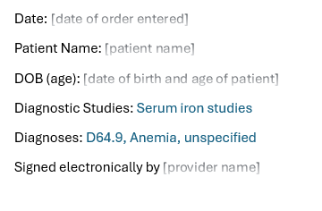
Workup to determine type of anemia

Slide 87
In summary…Here’s what we covered
Identify resources related to ICD-10-CM coding requirements for coding diagnostic services
Explain documentation that is required to support coding diagnoses and other reasons for diagnostic services
Accurately assign ICD-10-CM codes for common reasons for diagnostic services

Slide 88
Questions?
Presented by: Judy Bielby, MBA, RHIA, CCS, FAHIMA

Slide 89
References
American Hospital Association. (1984-2025). Coding Clinic for ICD-10-CM and ICD-10-PCS.
American Medical Association. (2024). CPT 2025 Professional Edition.
Centers for Medicare and Medicaid Services. Medicare Claims Processing Manual. Available at https://www.cms.gov/medicare/regulations-guidance/manuals/internet-only-manuals-ioms.
Centers for Medicare and Medicaid Services. Medicare Program Integrity Manual. Available at https://www.cms.gov/medicare/regulations-guidance/manuals/internet-only-manuals-ioms.
Centers for Medicare and Medicaid Services. MLN Fact Sheet Complying with Documentation Requirements for Lab Services. Available at https://www.cms.gov/files/document/mln909221-complying-documentation-requirements-lab-services.pdf.
Centers for Medicare and Medicaid Services. MLN Educational Tool Provider Compliance Tips. Available at https://www.cms.gov/Outreach-and-Education/Medicare-Learning-Network-MLN/MLNProducts/medicare-provider-compliance-tips/medicare-provider-compliance-tips.html.
IFHIMA. 2025. Position Statement: Ensuring Responsible Use of AI in Healthcare Information Collection and Use. Available at https://ifhimasitemedia.s3.us-east-2.amazonaws.com/wp-content/uploads/2025/06/11211739/AI_Position_Paper.pdf.
National Center for Health Statistics. FY 2026 ICD-10-CM Index, Tabular List, and Official Guidelines for Coding and Reporting. Available at https://www.cdc.gov/nchs/icd/icd-10-cm/files.html.
WPS Training Center. Available at https://www.wpsgha.com/training.

