Slide 1
Interviewing Tips
From a Hiring Manager
Cathy Jennings, CPC, CRC, CEDC, CHONC, AAPC Approved Instructor
Ambulatory Coding Education & Training Manager
cjennings3@kumc.edu

Slide 2
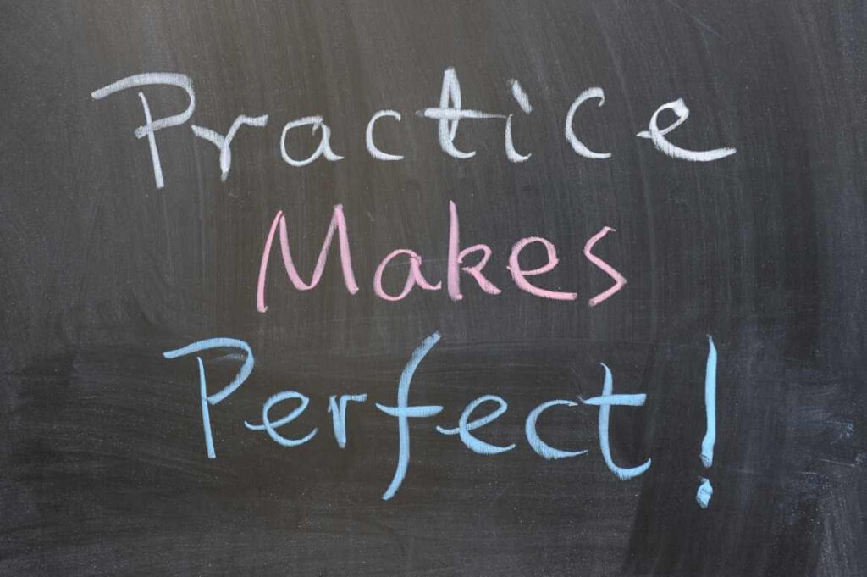
Prepare for the Interview
Research - Look at the organization’s website, social media posts, and/or recent news
Practice – Think about common questions and practice your answers. Have examples ready.
  Use the STAR method when answering behavioral or competency-based questions (ie, questions that start with “Tell me about a time when…” or “How would you react if…”)
    Situation – What is the context?
    Task – What was your role?
    Action – What did you do?
    Result – What happened?
  Be prepared to explain any gaps in your resume
Know – Know the job – re-read the job description
Prepare – Come up with a couple of smart questions for your interview that give your information you need.
There are lots of tools online with tips, videos, mock interviews, etc.
Notes:
Research – this will help you make decisions later about if this is the right fit
It can lead you to questions you want to ask
It will keep you from asking questions that show you know little about the organization
If you know someone who works there, talk to them. Ask them questions but remember that they may share info with your hiring manager. Let them know you’ve applied.
Practice (super important) - Answers should be 1.5-2 minutes long. You will be asked about any gaps in your employment history or if you change positions after only a short time.
Know – Make sure you know the job you are applying for.
Prepare – Prep at least 3 questions that show depth and interest. Tie question to research. Ask about next steps.
Are there opportunities to take on additional initiative outside the job description?
How does your company support work-life balance?
Can you tell me about the team I’d be working with?
What do you like best about working here?
How will I be trained for this role, and how long is the process?
DO NOT ASK
What is the PTO policy?
How many others are interviewing?
Will you contact my references?
When’s my first performance review?

Slide 3

Common Interview Questions
Tell me about yourself?
Why do you want to work here?
What was most rewarding about your last position? What was least rewarding about your last position?
Explain a time when you’ve had a large project or task to complete requiring many steps. What tools did you use to track necessary steps to ensure everything was completed?
What do you do if you can’t meet a deadline?
If a physician is asking you to do something that you know is incorrect, what do you do?
What are your short-term goals? What are your long-term goals?
What are your two biggest strengths? What are your opportunities for growth/weaknesses?
Tell me what makes you the best candidate for the position?
What are you looking for in your next job? What is important to you?
What question do you have for me?

Slide 4

Interview Day
Plan your interview attire in advance
Have your resume ready
Arrive early
Don’t be surprised if there is more than one person interviewing you
Stay calm, confident, positive, and focused
Be polite and respectful – treat everyone you talk to like they are your hiring manager
Win them over – don’t be overly modest; smile; be genuine and honest; maintain eye contact
Beware or body language – appear relaxed and with good posture
Make sure they know your qualifications for the job specific to the job description
SMILE!!!
Notes:
Plan your interview attire. More on this later.
Research the dress code if you can.
Even if its WFH and a virtual interview, still dress professionally and as if you were interviewing in person.
Have your resume ready
If in person, have copies ready to go
If virtual, have the file handy and ready to send quickly and easily.
Arrive early
You never want to be late. Allow time for traffic, parking, or technical issues
Be respectful
Treat everyone you talk to like they are your hiring manager – even when parking, entering building, etc. You don’t know who the hiring manager might ask for feedback.
Win them over
Be genuine and honest
Always be positive
Some recommend a “fail portfolio” to show you are aware of the failure and its impact, you learned from it, and you can stop it from happening again.
Keep answers concise and focused and positive
This is part of why you prepared.

Slide 5
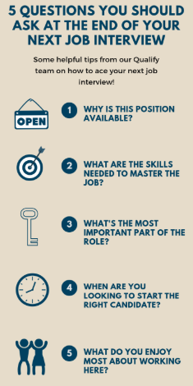
After the Interview
To make yourself more memorable, send a thank-you email. It’s okay to ask about next steps and see if there is any information they require from you.
Don’t dwell on what didn’t go well – learn and grow.
Be honest with yourself. It’s best to turn down a job that’s not the right fit for you.
Notes:
If you interview is in-person, ask each person for their business card. If it’s virtual, you should have email from the interview set-up. Don’t wait too long to do this-within 24 hours.
Don’t email them just to tell them what you did wrong. You can expand on an answer you give during the interview, but don’t point out your errors. It’s hard to retract answers you’ve already given.

Slide 6

Other Tips
Brush up on active listening skills.
Showcase your strengths and areas for improvement.
Describe your accomplishments.
Be aware of body language.
Reiterate your interest in the position.

Slide 7

Any Questions
Cathy Jennings, CPC, CRC, CEDC, CHONC, AAPC Approved Instructor
Ambulatory Coding Education & Training Manager
University of Kansas Health System
cjennings3@kumc.edu

