Slide 1
Welcome To
AAPC of Kansas City’s
“Career Night”
Tuesday – June 17th, 2025
NKC Health
2800 Clay Edwards Drive
Kansas City, MO 64116

Slide 2
Resume Basics
Syd Stevens CPC, CIMC, AAPC Fellow-Emeritus
ADVICE From the Employer’s Perspective

Slide 3
Common Oversights When Constructing Your Resume
Claiming credit for all you know and have done! Credentials!!!
Conveying leadership/management skills – even if you did not have the title of “manager”
Internal and “subtle” promotions and increase in responsibilities
Involvement in major projects; moves, installations of new software, practice sales/mergers, new management, new carriers, implementation of new regulations from Government/State entities, i.e., new credentialing/re-validations, new providers – and the list goes on!
Assessing “pre-coding” experience and effectively translating that experience/skill sets to your new coding career
Neglecting to include special honors, certifications, commendations, nominations, offices held, and community service recognitions

Slide 4

The Most Damaging Thing YOU Can Do . . . . .
YOU not being your first and best “cheerleader”
YOU not believing you can do more, handle more, be more, make more!
YOU refusing to acknowledge your experience and tenacity in order to achieve CPC status
YOU allowing unfortunate and unfair experiences to color your outlook on YOU!
YOU letting fear of failure determine your future

Slide 5
Getting What You Want and Where You Want is Hard Work!
Do It Afraid!
Seek Out Resources!
Beg, Buy, Borrow or Steal Some Elbow Grease!
Develop Your Network! Get Involved!
Find A Mentor!

Slide 6
Let’s Talk About a New/Different Position or Promotion:
Are you boxed in where you are
Is there a corporate structure that allows for growth
Is there an opportunity for an “in-house” promotion - Different title – Different responsibilities
Are you “settling” or settled? (Good drive time, great benefits, vacation time, parking, nice co-workers)
Are you “out there” – do people know you, see you, want you, need you – Network Advantage
Are you the first one in/last one out of the office and/or meetings
Do you routinely “think outside the box”
Does your physician/boss depend upon you
Are you a problem solver or maker

Slide 7
Have You Thought Of These Places Where Coding Opportunities Exist?
Physician Offices – Private and Corporately Owned
Hospitals
Independent Physical Therapy Facilities
Ambulatory Surgical Centers
Home Health Agencies
Medical Equipment – DME Businesses
Hospice Companies
Billing Companies
Insurance Companies
Government/State
Here’s where your networking becomes a real advantage!

Slide 8
Entry Level Positions and Opportunities
Physician Offices – Private and Corporately Owned
Hospitals
Independent Physical Therapy Facilities
Ambulatory Surgical Centers
Home Health Agencies
Medical Equipment – DME Businesses
Hospice Companies
Billing Companies
Insurance Companies/Specialty Audit Co’s
Front Desk Assistant
Medical Records
Office Assistant
Data Entry
Accounts Receivable
Accounts Payable
Customer Service Agents
Externs

Slide 9
How To Prepare For Getting That Coding Job or Promotion!
Do
Don’t
Develop a Positive Attitude & Outlook
Get Involved With Your Local Chapter
Attend Everything
Volunteer
Network
Get on List Serves and Blogs
Get a Mentor
Ask to Extern
Listen to Negative People – Get Away from Them
Be Afraid to Run For Chapter Office or Serve on a Committee
Not Attend Insurance, Medicare, etc., Meetings Outside of the AAPC – Valuable Future Contacts Are Out There!
Sit by Yourself and Fail to Introduce Yourself to Others – Don’t Be Afraid to Approach Leaders
Think You Can Do It By Yourself – You Can Always Use Assistance & Advice
Be Afraid to Extern Yourself Outside Your Comfort Zone

Slide 10
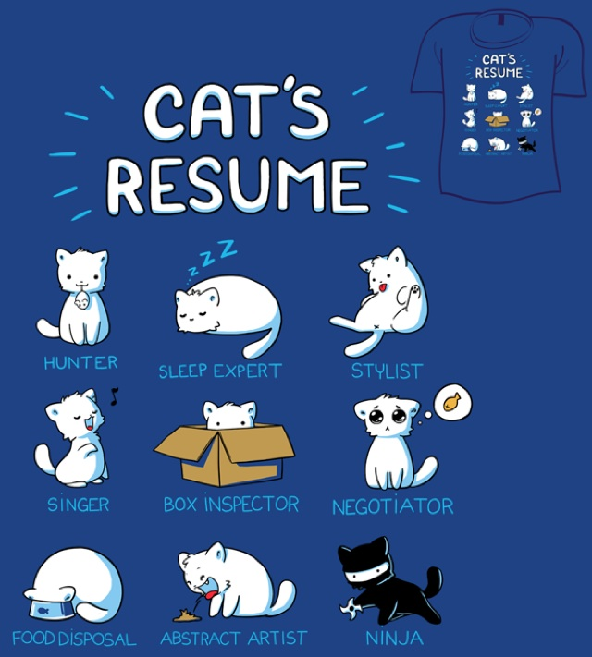
Your Professional Resume
Get It Right, Update It and Keep It Updated

Slide 11
How To Develop a Professional Resume
Construct a Professional Resume With Another Set of Professional Eyes
Begin with an Objective or Goal – Simply Stated
Your Experience is Best Displayed Using Action Verbs and Important Accomplishments
As a Professional – You need PROFESSIONAL REFERENCES THAT CAN BE CHECKED
Cover Letter IS important
You Almost Always “Downgrade” Yourself – Don’t Let That Come Across
Most Employers Spend Less than 2 Minutes Reviewing Your Resume
If it is Unorganized, Messy, has Typos, Funky Fonts and Backgrounds – You Are Doomed!
Get Rid of your Cutie pie or Sexy Email Address – It Screams “I’m Not a Professional”
Remember your VM & Facebook Presence – Professional?

Slide 12
OK!

Slide 13
OK to
Great!

Slide 14
Professional Cover Letter

Slide 15
The Interview – Makes it or Breaks It!
Did You Scour the Prospective Employer’s Website? Can You Comment on Some Upcoming or Just Recently Held Event or Change?
Wear a Suit, Nylons, and Dress Shoes – Bring a Portfolio with Several Copies of Your Resume and References
Turn Your Cell Phone Off – Don’t Even Have It In Your Hands
Don’t Trash Former Employers or Co-Workers (even if they deserve it) – Practice Your Presentation – Recommend Role Play – Grammar!
Do Your Homework
Dress For Success
Use Great Grammar

Slide 16
The Interview – Makes it or Breaks It!
Interviews Can Be Intimidating – The More You Practice – The More You Do It – The Easier It Becomes
You Are Essentially a Salesman – Think of the Best Salesman You’ve Ever Come Across
Remember the Goldilocks Body Language Rule: “Not Too Relaxed – Not Too Rigid” – Just Right!
Remember the Goldilocks Makeup and Jewelry Rule: “Not Too Much – Not too Little” – Just Right!
If You Have More Hardware in/on Your Face and Mouth Than My Tacked Up Horse Does . . . . .
Do It – Afraid!
Check Your Body Language
You’re Selling Something! – You!

Slide 17
Questions Prospective Employers May Ask and the Less Than Optimal Answers I’ve Received:
Question:
Real Life Answer:
You only have just received your CPC? Do you have enough experience to handle this position?
Tell me about a situation in your current/previous position where you were able to solve a dispute between yourself and a co-worker.
Tell me how you’ve professionally interacted with physicians/providers in your current/previous positions
You notice a physician/provider has not been completing notes in a timely fashion – how would you handle/address this situation?
A co-worker gives you her password and asks you to time in for her on Friday – her child has been ill and she’s having car trouble – she’ll only be about 45 min late. What would you do in this situation?
“I was told that you would consider a CPC-A”
“I told my supervisor”
“I always act professionally”
“I’d probably tell him he needs to catch up”
“I probably wouldn’t do it”

Slide 18
Less Than Optimal Answers I’ve Received:
Question:
Real Life Answer:
If I were to meet your previous boss and ask her about you – what would she say?
If a previous co-worker were to give me a personal reference about you – what would they say?
Tell me about a project for which you were responsible or the lead and how you successfully completed that project.
Describe your personal work ethic
Our department is really behind on claims entry – about two months. This is a newly added position because we are so busy. Are you willing to work overtime to help with this backlog?
A physician/provider is upset that his patients have been triple booked today and comes to you to find out why. How would you respond to this?
“I think she’d say I did pretty good work”
“I don’t know”
“I always get my work done”
“I have good ethics” “I don’t know what you mean?”
“I just got married and we need together time after work”
“I’d ask the front desk lady to talk to the doctor”

Slide 19
The Post Interview – Can Seal the Deal!
A handwritten or typed letter is best – a followup email along with the physical note covers all the bases!
Thank the interviewer for his/her time. Make sure you get names and titles correct.
Reference your interview in a positive way – mention something nice about the office, the staff, the location, etc.
Reinforce your confidence that you can benefit XYZ Practice/Company
Politely ask for a followup conversation and indicate your flexibility to meet again or converse over the phone
Write A Thank You Note
Use Great Grammar
Ask For Follow Up

Slide 20
Congratulations! You Got The Job! Now – A Word to the Wise. . . . . . . . . . . .
Do
Don’t
Give an appropriate, professional notice
Finish your projects or transition them appropriately
Thank your current bosses
Give your best efforts – up to the last day
Leave a checklist or “manual” for the next person
Leave your office/work area clean and neat
Offer to help train a replacement
Offer to render assistance after you’ve left
Flip Up and Flame Out
Leave unfinished work/projects – be honest as to where you are with your current work
Talk trash about the place and rabblerouse – grit it out
You’re still being paid – do a good job – you’re representing a credential as well as yourself
Be selfish – remember when you were new? Help the next guy – what goes around/comes around!
Refuse to help – it says so much about you!
Burn bridges – life has a funny way of backtracking!

Slide 21

Congratulations! You Got The Promotion! Now – A Word to the Wise. . . . . . . . . . . .
Do
Don’t
Thank your boss and teammates
Finish your projects or transition them appropriately
Ask your new teammates for advice
Ask for a job description – help create it
Leave a checklist or “manual” for the next person
Leave your office/work area clean and neat
Offer to help train your replacement
Offer to render assistance anytime – show your leadership skills
Act like a
Leave unfinished work/projects for your successor – that may be his/her promotion too – be honest as to where you are with your current work and be helpful
Be a know-it-all and lord it over your former teammates
Act like you are “extra-special” because of your credential – let your natural abilities shine through and folks will recognize the skills
Be selfish – remember when you were new to your recent position? Help the next guy that fills your previous shoes - remember - what goes around/comes around!
Tell your former teammates your new salary – it says so much about you!
Burn bridges – life has a funny way of backtracking!

Slide 22
Q&A Time!
Member Participation

Slide 23
Thank You All So Much!
Syd Stevens, CPC, CIMC, AAPC Fellow Emeritus
913 579-5588 cell
syd31317@gmail.com

