Slide 1
The Total on Totals
Branden Chavez CPC, COSC

Slide 2
Who Am I

Slide 3
Goals
Review total joint coding
Review each joint that we can total.
Give coding advice from a provider approach.
Have fun doing it

Slide 4

Part 1 The Knee

Slide 5
Total Knees And why we do them.
Why it's done. The most common reason for knee replacement surgery is to ease pain caused by arthritis. People who need knee replacement surgery usually have problems walking, climbing stairs and getting up out of chairs. If only one part of the knee is damaged, surgeons often can replace just that part.
Fractures can also lead to total knees if there is to much arthritic changes in the knee that wont allow Hemiarthroplasties.

Slide 6

Road map to success.
The way I code these is the GPS method.

Slide 7
Total Knee Arthroplasty (TKA)
Both the medial and lateral compartments of a knee are reshaped, and a prosthesis implanted in a patient who has damage to both compartments.
Menisectomy, synovectomy, debridement, and release of the lateral retinacula, ligament or capsule are all included.
The Patella can be replaced and isn’t billed separately.

Slide 8
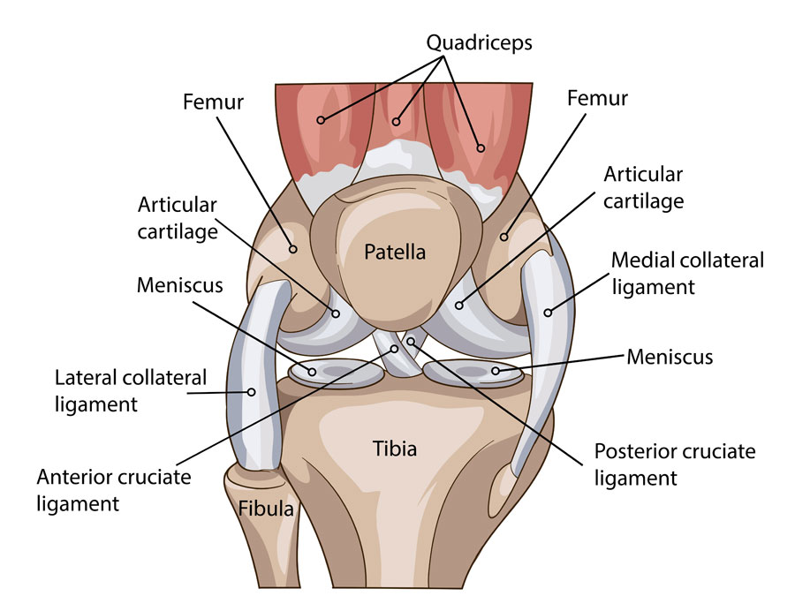
Knee Anatomy

Slide 9
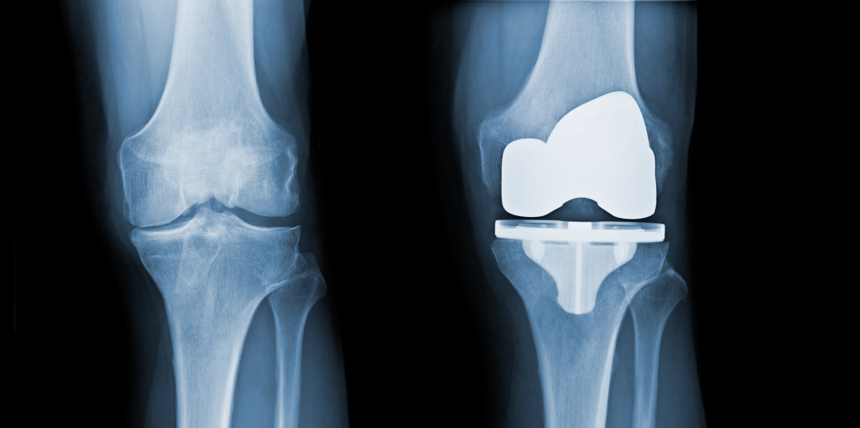
Total Knee what it looks like

Slide 10
Unicompartmental Total Knee
Either the medial Or lateral compartment of a knee are reshaped, and a prosthesis implanted in a patient who has damage to either compartments.

Slide 11
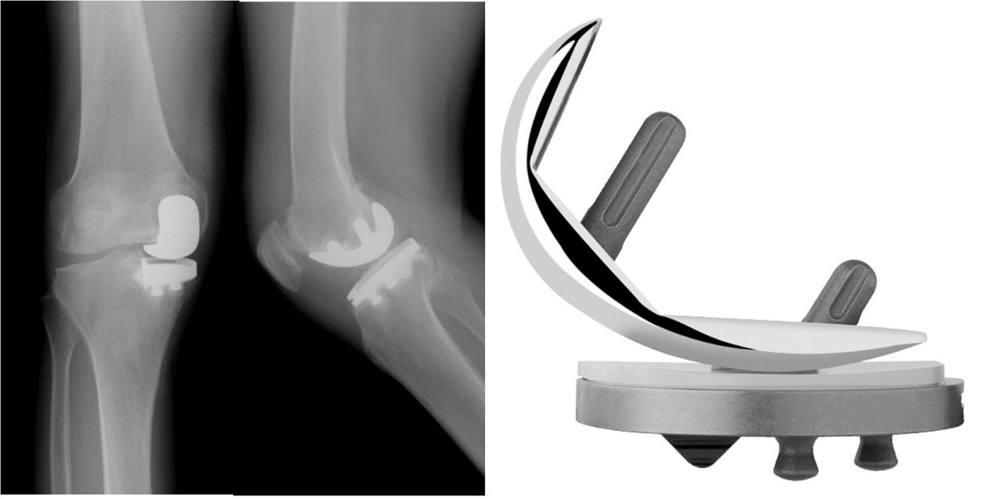
Unicompartmental Total Knees

Slide 12
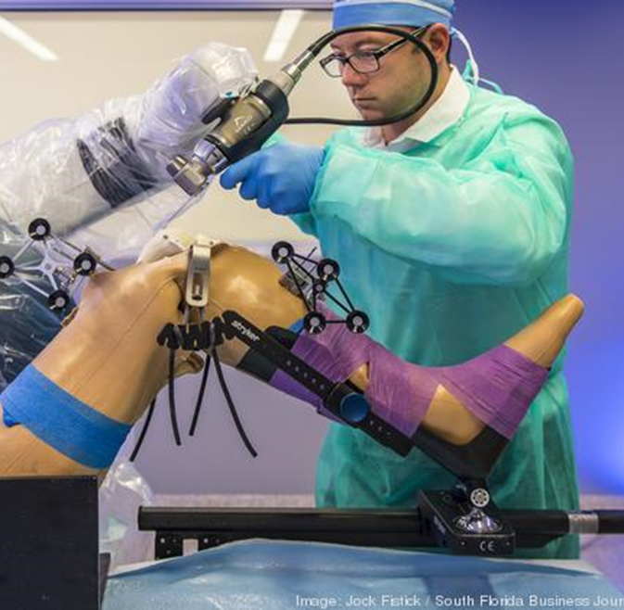
Robotic Total Knee Replacements

Slide 13
Coding for these
27447-Arthroplasty, knee, condyle and plateau; medial AND lateral compartments with or without patella resurfacing
27446-Arthroplasty, knee, condyle and plateau; medial OR lateral compartment
27486-Revision of total knee arthroplasty, with or without allograft; 1 component
27487-Revision of total knee arthroplasty, with or without allograft; femoral and entire tibial component (Also Conversion to TKA)
Mako 20985- Computer-assisted surgical navigational procedure for musculoskeletal procedures, image-less
Preoperative scans 0054T Fluoro, 0055T CT/MRI
27488- Removal of prosthesis, including total knee prosthesis, methylmethacrylate with or without insertion of spacer, knee

Slide 14

Recovery times for a Total Knee
Most patients will take up to 3 months to return to most activities and likely 6 months to one year to fully recover to maximal strength and endurance following a total knee replacement. This is highly dependent on preoperative conditioning, additional medical problems, and patient expectations.

Slide 15
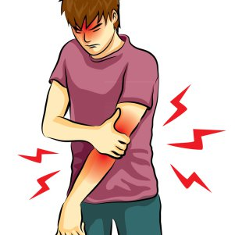
Part 2 The Elbow

Slide 16
Total Elbows and why we do them
The elbow joint brings together three bones called the humerus, ulna and radius. At the ends of these bones where they come together, they are covered by a specialized structure called cartilage. Cartilage provides a smooth surface on which the bones can glide against one another. Damage to the bones or cartilage can cause chronic (long-term) pain, swelling and stiffness of the joint.
Doctors perform elbow replacement surgery to relieve pain and increase range of motion in people with chronic elbow pain. This surgery often improves people’s quality of life when medications or physical do not ease their pain adequately.
Conditions that may lead to elbow replacement surgery include:
Injury: A broken bone in the elbow.
Osteoarthritis: Worn-down cartilage in the joints.
Rheumatoid arthritis: An autoimmune disorder involving inflammation (swelling) of the joints.

Slide 17
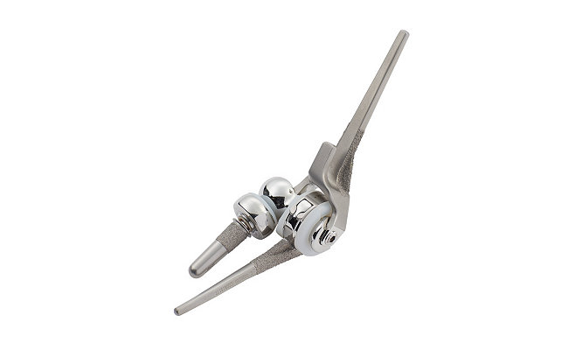
Total Elbow Prosthesis

Slide 18
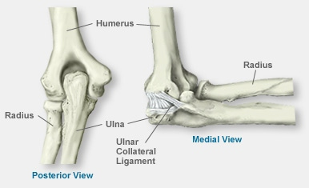
Elbow Anatomy

Slide 19
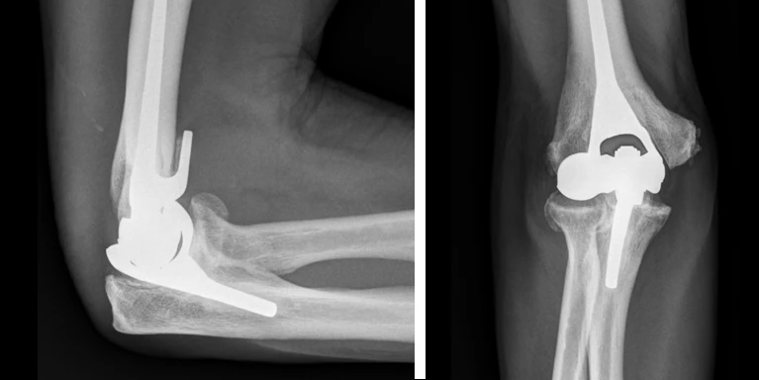
Total Elbow

Slide 20
Coding Total Elbows
24363 - Arthroplasty, elbow with distal humerus and proximal ulnar prosthetic replacement
24370- Revision of total elbow arthroplasty, including allograft when performed; humeral or ulnar component
24371 - Revision of total elbow arthroplasty, including allograft when performed humeral and ulnar component
24160-Removal of prosthesis, includes debridement and synovectomy when performed; humeral and ulnar components

Slide 21

Recovery Time for A Total Elbow
Some people can start to use their new elbow as soon as 12 weeks after surgery. Complete recovery can take up to a year. There will be limits to how much weight you can lift. Lifting too heavy of a load can break the replacement elbow or loosen the parts.

Slide 22

Part 3 Shoulder

Slide 23
Total shoulder and why we do them
The shoulder joint can be replaced by an artificial shoulder or shoulder replacement for pain caused by arthritis or when the shoulder is severely fractured or broken. Arthritis is when the cartilage on the ends of the bones is gone and there is bone rubbing on bone in the joint. Arthritis can be caused by fractures, rheumatoid disease, torn rotator cuff tendons or just by wear and tear over time.

Slide 24
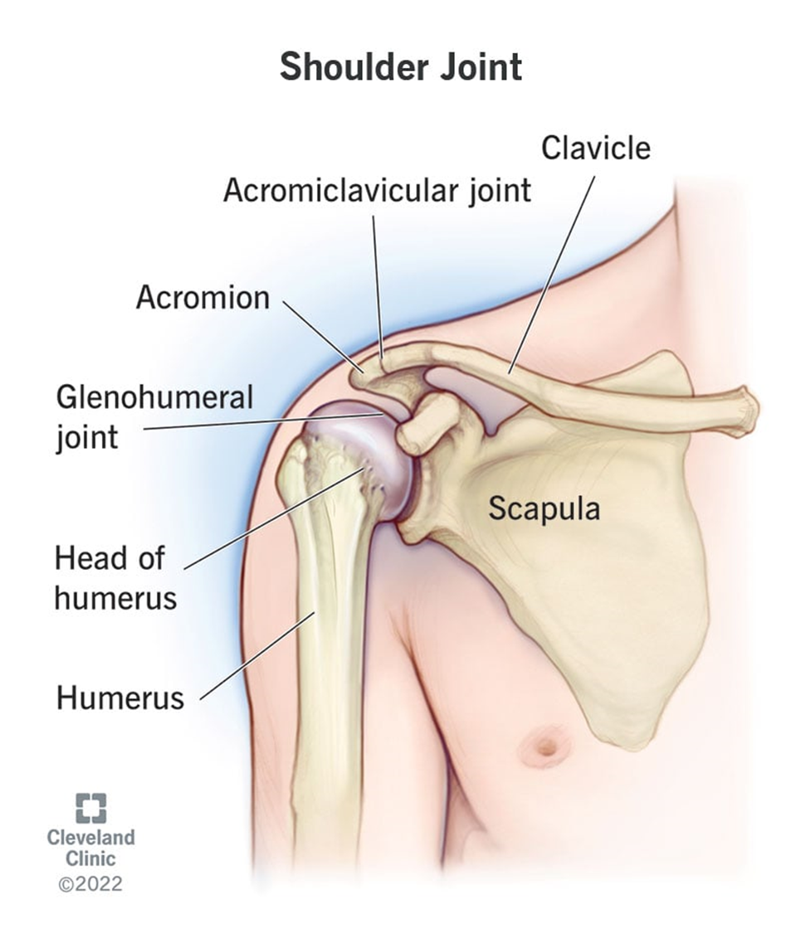
Shoulder Anatomy

Slide 25
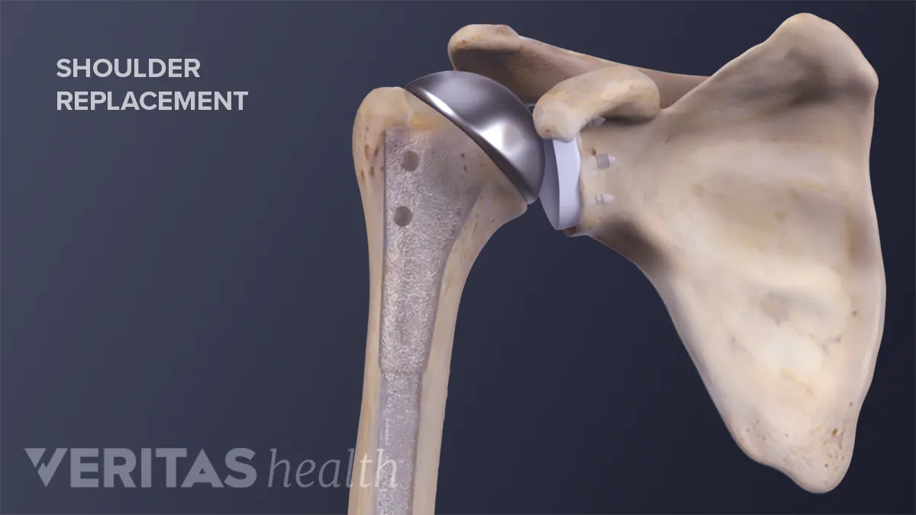
Total Shoulder Arthroplasty

Slide 26
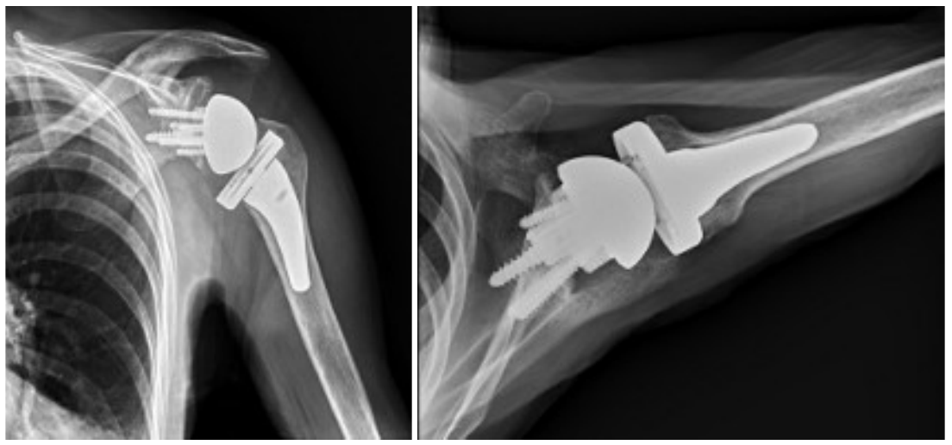
Reverse Total Shoulder

Slide 27
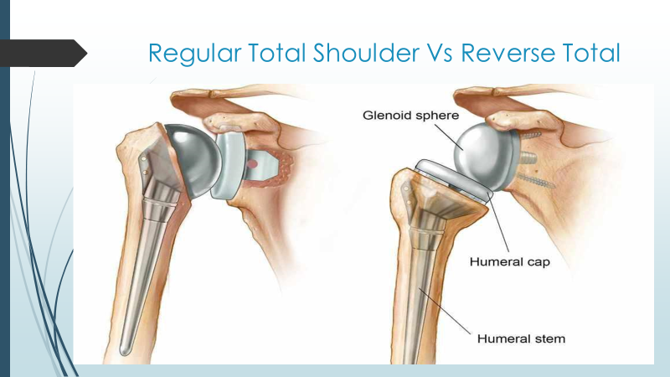
Total Shoulder Side by Side

Slide 28
Coding Total Shoulder
23472-Arthroplasty, glenohumeral joint; total shoulder (glenoid and proximal humeral replacement
23473- Revision of total shoulder arthroplasty, including allograft when performed; humeral or glenoid component
23474-Revision of total shoulder arthroplasty, including allograft when performed; humeral and glenoid component
23334-Removal of prosthesis, includes debridement and synovectomy when performed; humeral or glenoid component
23335-Removal of prosthesis, includes debridement and synovectomy when performed; humeral and glenoid components

Slide 29

Recovery Time From a total Shoulder
The recovery period varies from person to person and also depends on the type of surgery you had. Typically, you should use your arm for waist-level activities on day one following surgery. You should dress and feed yourself within the first week. Be careful with driving. Only resume driving when you’re certain that you can do so safely. But expect at least 6 weeks.

Slide 30
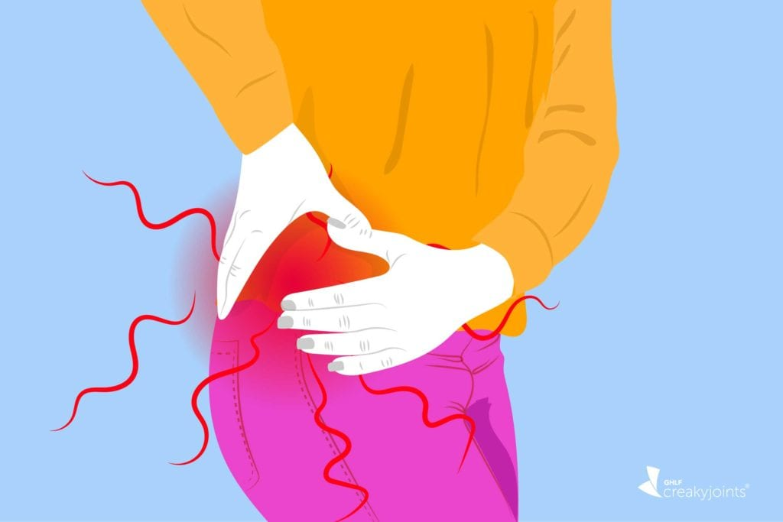
Part 4 The Hip

Slide 31
Why we do total hips
Conditions that can damage the hip joint, sometimes making hip replacement surgery necessary, include:
Osteoarthritis. Commonly known as wear-and-tear arthritis, osteoarthritis damages the slick cartilage that covers the ends of bones and helps joints move smoothly.
Rheumatoid arthritis. Caused by an overactive immune system, rheumatoid arthritis produces a type of inflammation that can erode cartilage and occasionally underlying bone, resulting in damaged and deformed joints.
Osteonecrosis. If there isn't enough blood supplied to the ball portion of the hip joint, such as might result from a dislocation or fracture, the bone might collapse and deform.

Slide 32
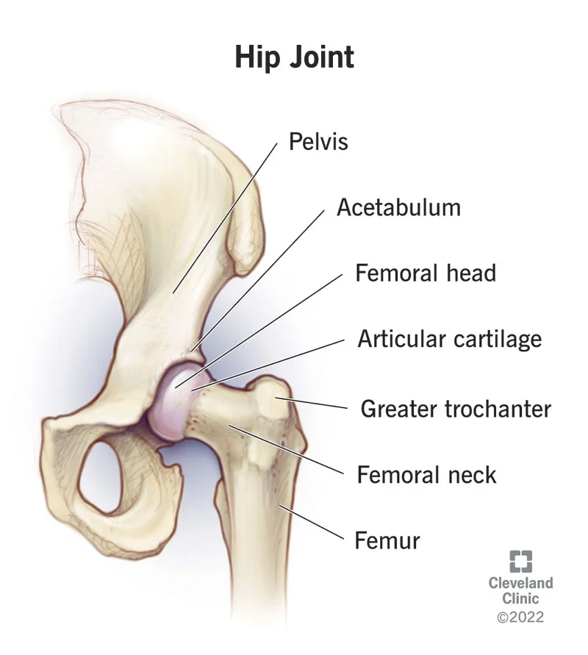
Total Hip Arthroplasty

Slide 33
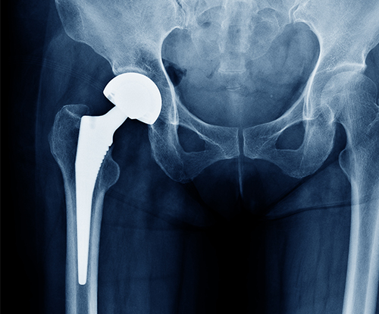
Total Hip Arthroplasty

Slide 34
Total Hip Arthroplasty
27130-Arthroplasty, acetabular and proximal femoral prosthetic replacement (total hip arthroplasty), with or without autograft or allograft
27132- Conversion of previous hip surgery to total hip arthroplasty, with or without autograft or allograft
27125- Hemiarthroplasty, hip, partial (eg, femoral stem prosthesis, bipolar arthroplasty)
27134-Revision of total hip arthroplasty; both components, with or without autograft or allograft
27137-Revision of total hip arthroplasty; both components, with or without autograft or allograft
27138-Revision of total hip arthroplasty; femoral component only, with or without allograft
27091-Removal of hip prosthesis; complicated, including total hip prosthesis, methylmethacrylate with or without insertion of spacer

Slide 35

Recovery time for a total hip
After about 14 days, most patients are usually feeling better. Somewhere around 2-6 weeks, people really turn a corner after a hip replacement. A full recovery usually takes up to a year, but after 2-3 months, most patients are doing pretty well.

Slide 36

Part 5 The Ankle

Slide 37
Why we do total ankles
Total ankle replacement, or ankle arthroplasty, treats ankle arthritis. The surgery can help reduce ankle pain, increase joint stability and improve overall mobility. Healthcare providers only recommend ankle replacement when other treatments can’t relieve the symptoms of ankle arthritis.

Slide 38
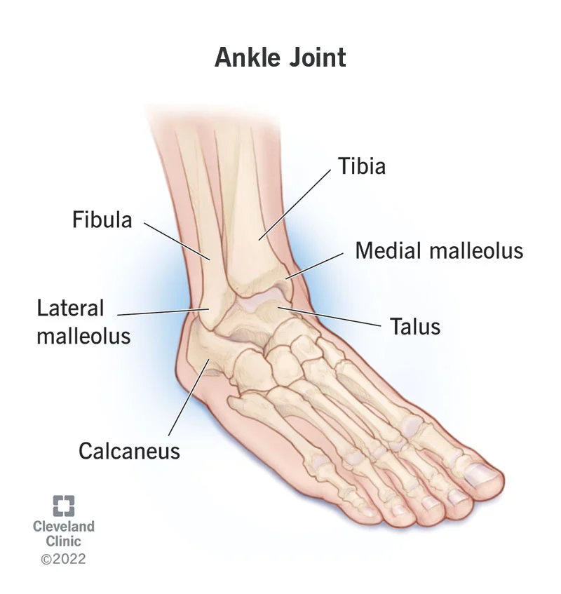
Total Ankle Arthroplasty

Slide 39
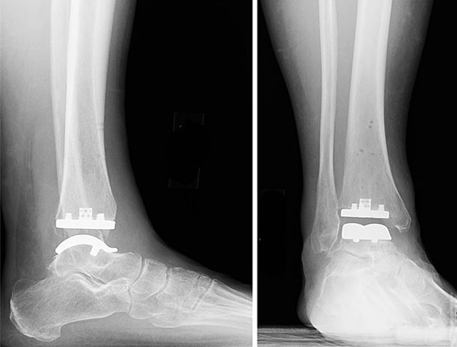
Total Ankle Arthroplasty

Slide 40
Coding Total Ankles
27702- Arthroplasty, ankle; with implant (total ankle
27703- Arthroplasty, ankle; revision, total ankle
27704- Removal of ankle implant

Slide 41

Recovery Time for Total Ankle
You will need to keep weight off of the foot for 10 to 12 weeks. Recovery can take 3 to 6 months.

Slide 42

Complications

Slide 43
Periprosthetic Fractures
Periprosthetic fractures are fractures that occur in association with an orthopaedic implant, most often used for joint arthroplasty or fracture fixation. They are associated with significant morbidity and increased mortality in some cases.

Slide 44
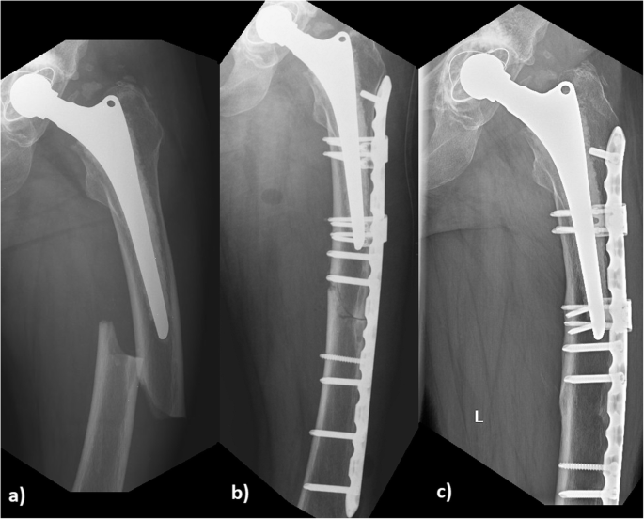
Periprosthetic Hip Fracture

Slide 45
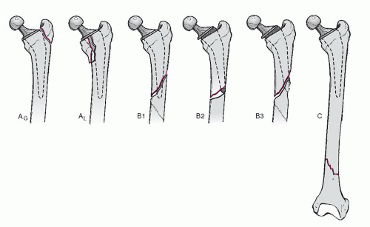
More Periprosthetic fractures

Slide 46
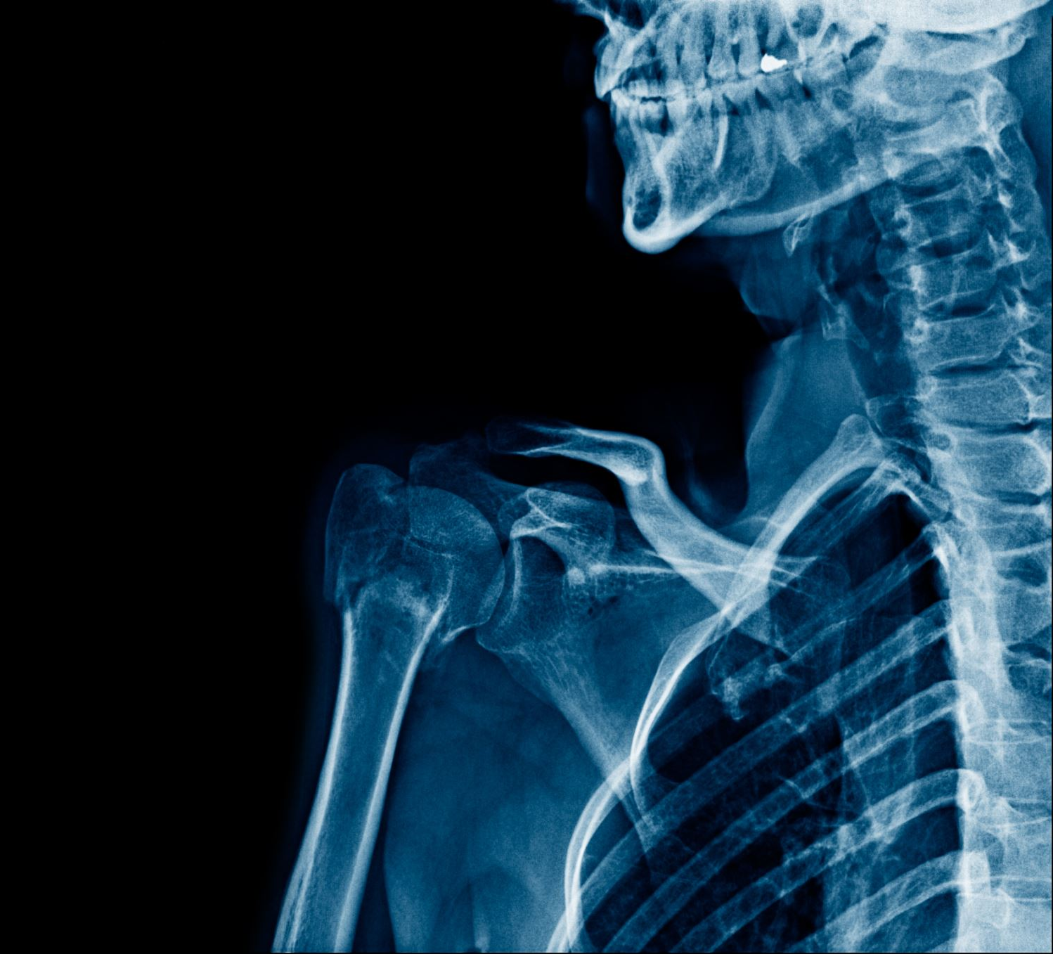
Treating Periprosthetic Hip Fractures
The General Approaches to treating periprosthetic hip fractures include:
Open reduction and internal fixation.
Revision of the total arthroplasty with an exchange of some or all of the implants.
A combination of both.

