Slide 1
Take a Break from Fracture Coding
Branden Chavez, CPC, COSC
04/16/2024

Slide 2
Who Am I

Slide 3
7TH Character Extensions the normal ones
A=initial encounter for closed fracture
D=subsequent encounter for closed fracture with routine healing
S=sequela

Slide 4
The Rest
B=initial encounter for open fracture type I or II
C=initial encounter for open fracture type IIIA, IIIB, or IIIC
E=subsequent encounter for open fracture type I or II with routine healing
F=subsequent encounter for open fracture type IIIA, IIIB, or IIIC with routine healing
G=subsequent encounter for closed fracture with delayed healing=initial encounter for open fracture type IIIA, IIIB, or IIIC

Slide 5
The Rest Cont.
H=subsequent encounter for open fracture type I or II with delayed healing
J=subsequent encounter for open fracture type IIIA, IIIB, or IIIC with delayed healing
K=subsequent encounter for closed fracture with nonunion
M=subsequent encounter for open fracture type I or II with nonunion
N=subsequent encounter for open fracture type IIIA, IIIB, or IIIC with nonunion

Slide 6
Seriously The Rest
P=subsequent encounter for closed fracture with malunion
Q=subsequent encounter for open fracture type I or II with malunion
R=subsequent encounter for open fracture type IIIA, IIIB, or IIIC with malunion

Slide 7
What does Type 1, 2, 3a,3b,3c Mean?
They categorized open injuries into the familiar three categories, based on wound size, level of contamination, and osseous injury, as follows:
Type I = an open fracture with a wound less than 1 cm long and clean;
Type II = an open fracture with a laceration greater than 1 cm long without extensive soft tissue damage, flaps, or avulsions
Type III = either an open segmental fracture, an open fracture with extensive soft tissue damage, or a traumatic amputation. Special categories in Type III were gunshot injuries, any open fracture caused by a farm injury, and any open fracture with accompanying vascular injury requiring repair

Slide 8
Famous Ortho Cases Through the Ages

Slide 9
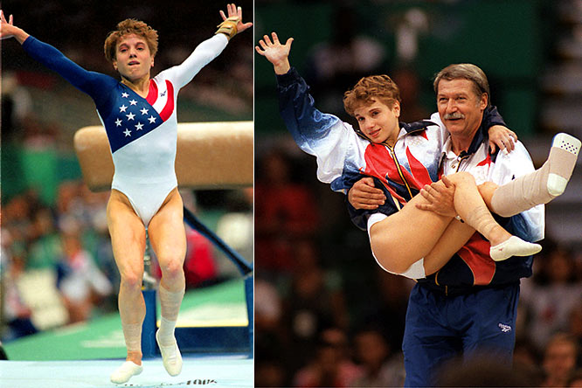

Slide 10
Kerri Strug 1996 Gold Medalist
Tore Two Ligaments In her ankle during the vault In the 1996 Summer Olympics.
She Had to stick this vault to win Gold for the US

Slide 12
Bo Jackson- Oakland Raiders/Kansas City Royals
Dislocated his Hip in the AFC Championship in 1991
Later found to have avascular necrosis in the hip and had to have a THA

Slide 13
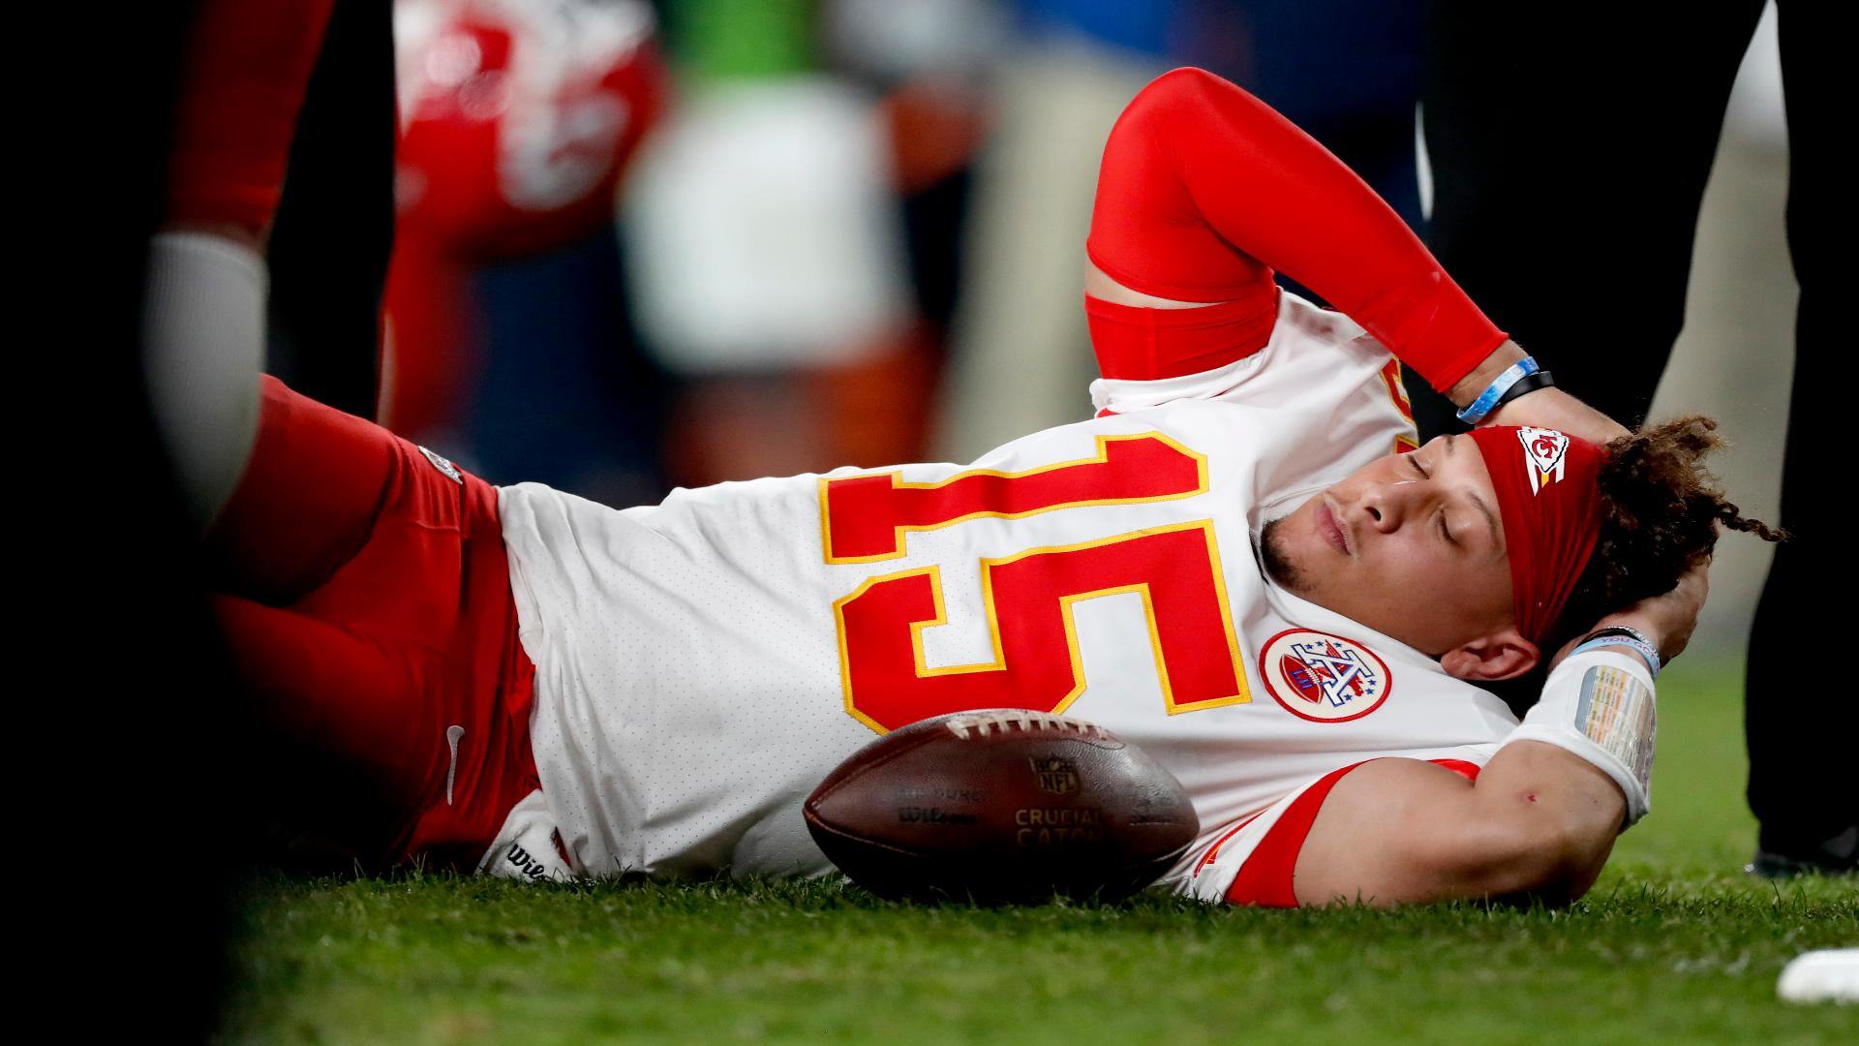

Slide 14
Patrick Mahomes- Kansas City Chiefs
Dislocated his patella vs THE DENVER BRONCOS Oct 17, 2019

Slide 15
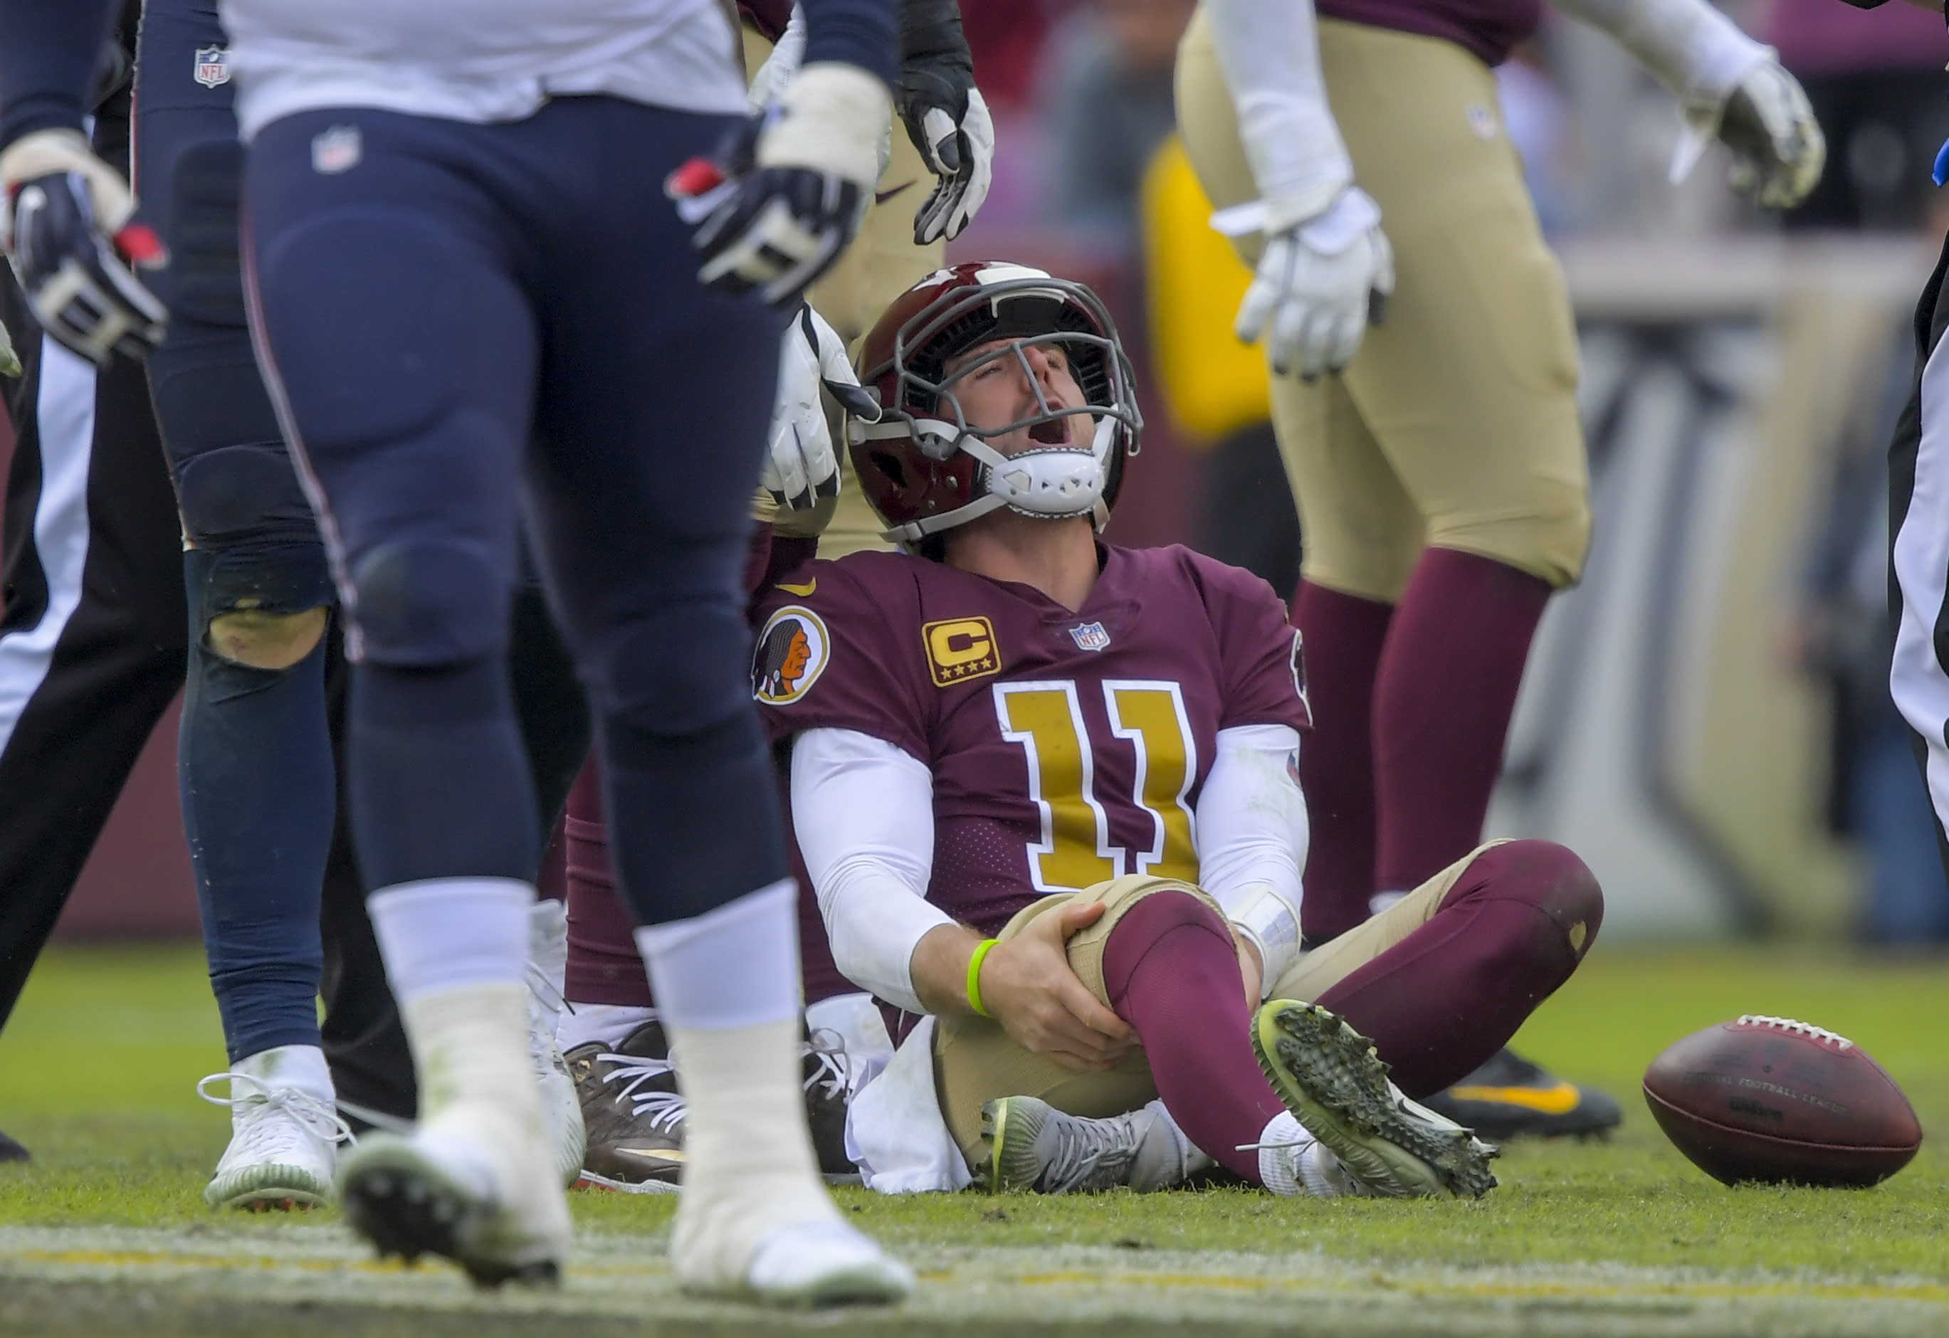

Slide 16
Alex Smith-Washington Redskins
Alex Smith Suffered a Compound fracture of both his Tibia and Fibula on 11/18/2018. His recovery was prolonged due to a flesh-eating bacteria and Sepsis. He would go on to have 17 surgeries in total and wear an external fixator for over 18 months. Surprisingly, he did play again in the NFL.

Slide 18
Salvador Perez- Kansas City Royals
Salvador Perez tore his Ulnar Collateral Ligament in the 2019 season. He would miss that entire year due to having Tommy John Surgery (Reconstruction Ulnar Collateral Ligament)

Slide 19
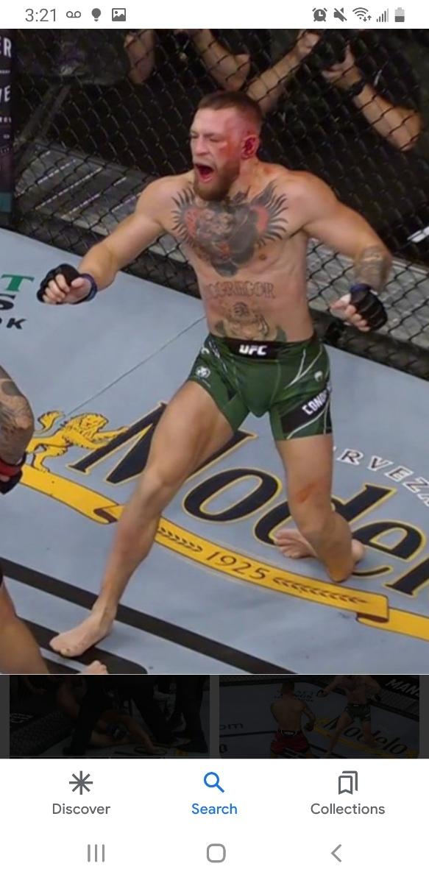

Slide 20
Conor McGregor-UFC
Conor McGregor broke his Tibia and Fibula during a match with Poirier. Less extensive than Alex Smith but still gruesome looking.

Slide 22
Aaron Rodgers-NFL
tore his Achilles on the 4th snap of his first season as a NYJ. His recovery was well televised, and his quick recovery was attributed to the speed bridge technique which is offered by Arthex although he didn’t play in the same season again it was reported he could. Which would have been a first in NFL history.

Slide 23
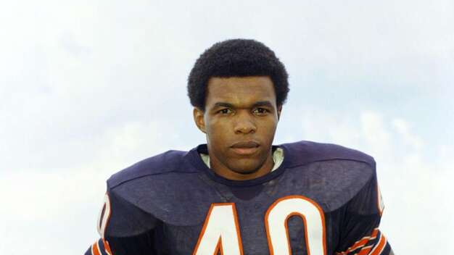

Slide 24
Gale Sayers Chicago Bears 1965-1971
Gale was a very dynamic Running Back in the Late 60’s and Early 70’s his highlight reels remind me a lot of Reggie Bush at USC just a lot better.
He tore Both of his ACL’s One in the 1968 season and the other in 1970.

Slide 25
Types of Injuries we see in Sports Medicine/Trauma

Slide 26
Degloving Injury
A degloving injury is a traumatic injury that results in the top layers of skin and tissue being torn away from the underlying muscle, connective tissue or bone. They most commonly affect the arms, legs, and hands and are frequently associated with underlying fractures. These are classified as Avulsion injuries and are hard to code in ICD-10.

Slide 27
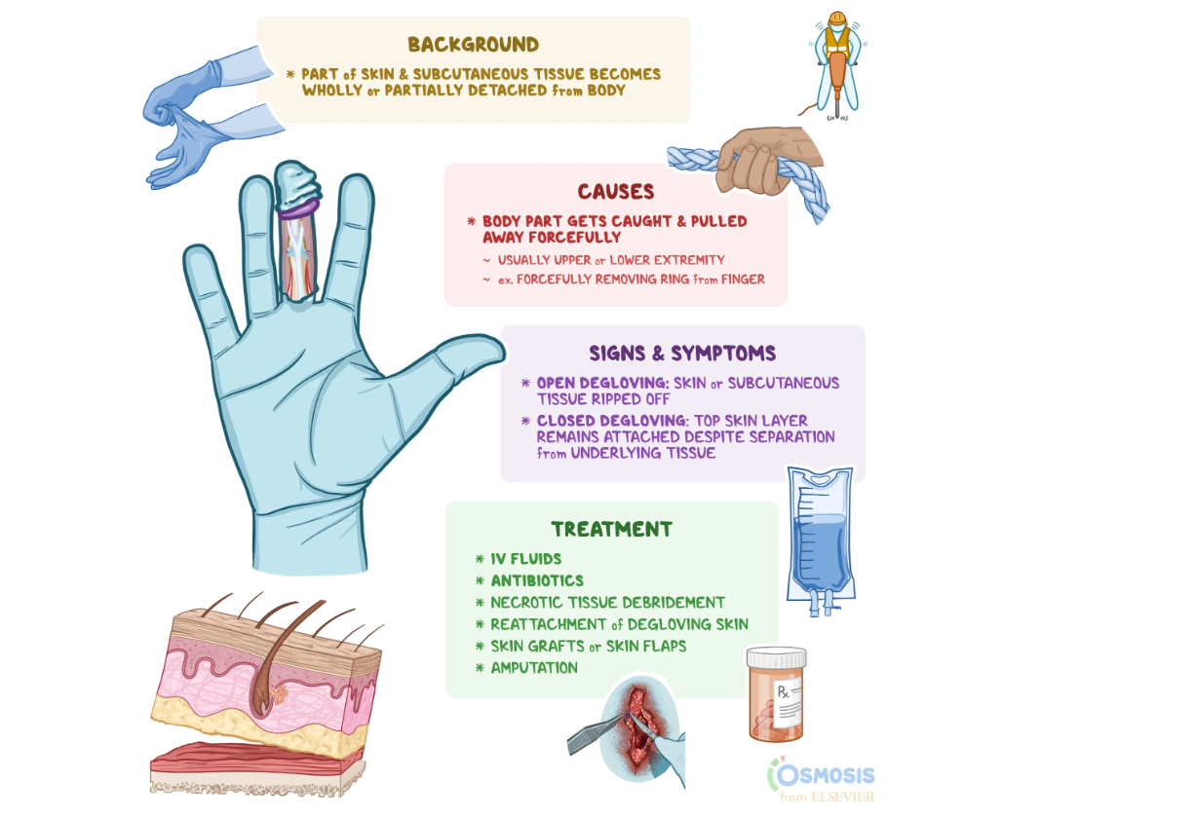

Slide 28
Sprains
A sprain is an injury to the ligaments around a joint. Ligaments are strong, flexible fibers that hold bones together. When a ligament is stretched too far or tears, the area around the joint will become painful and swell.
Any joint supported by ligaments can be sprained. Most commonly sprained joints are
Ankle sprains (including high ankle sprains).
Wrist sprains.
Knee sprains.
Finger sprains (sometimes called jammed fingers).
Thumb sprains.
Notes:
ACL, PCL, MCL, LCL,

Slide 29
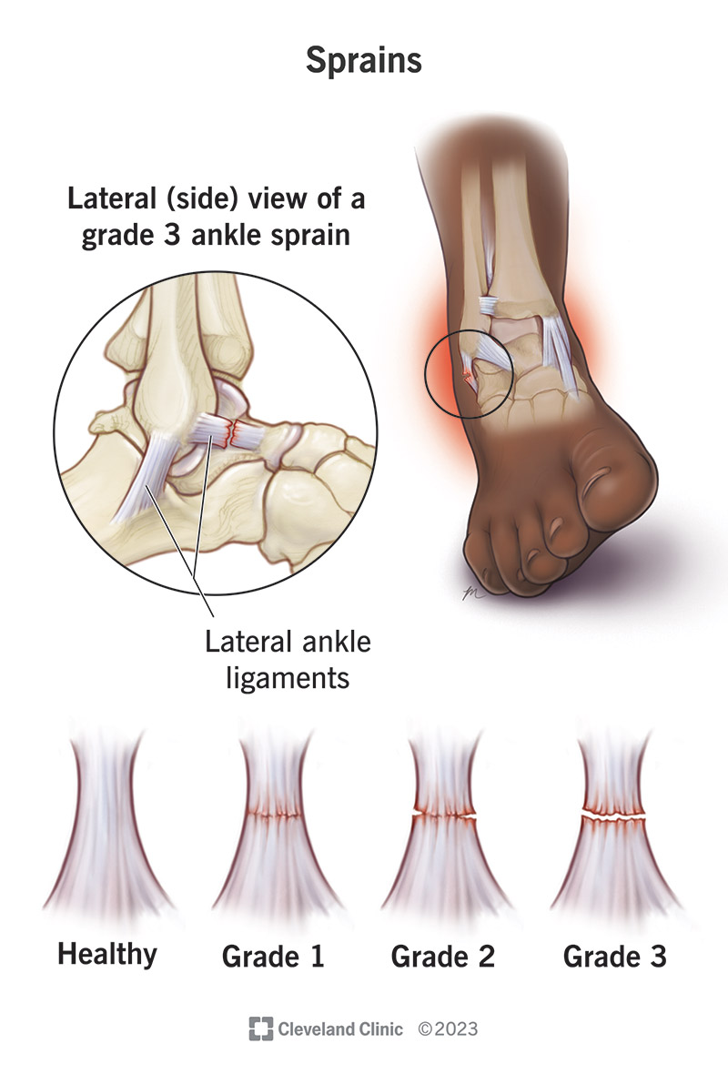
Notes:
It’s rare to need surgery after a sprain. You may need surgery for a severe sprain or other injuries like a broken bone or dislocation. Some people need surgery if they’ve sprained the same joint multiple times

Slide 30
Strains
A strain is when a muscle is stretched too much and part of it tears. It is also called a pulled muscle. A strain is a painful injury. It can be caused by an accident, overusing a muscle, or using a muscle in the wrong way.
Initial treatment includes rest, ice, compression and elevation. Mild strains can be successfully treated at home. Severe strains sometimes require surgical repair.
Notes:
Biceps, Triceps, Hamstring, Quadriceps Gluteus’s

Slide 31
Posterolateral Corner
Posterolateral corner (PLC) injuries are traumatic knee injuries that are associated with lateral knee instability and usually present with a concomitant cruciate ligament injury ACL, PCL
Specific components of the posterolateral corner that can be identified on MRI, albeit with some variability, are the biceps femoris tendon, the fibular collateral ligament, the popliteus musculotendinous complex including the popliteofibular ligament, the fabellofibular ligament, and the arcuate ligament.

Slide 32
Fractures
A fracture is a partial or complete break in the bone. There are many different types of fractures. Bone fractures are often caused by falls, trauma, or as a result of a direct blow or kick to the body. Overuse or repetitive motions can cause stress fractures.
Notes:
Segmental fractures happen when your bone is broken in two different places and a section of your bone has separated from the rest of it because of the fracture. Comminuted fractures mean your bone is broken in three or more places. This means some segmental fractures can be comminuted, and some are not

Slide 33
What about Open Fractures
An open fracture (or compound fracture) refers to a broken bone that causes an open wound or break in the skin. This type of traumatic injury requires emergency treatment to set the bone and prevent infection in the wound.
Treating Simple Open Fractures: Treating any open fracture involves setting the broken bone, cleaning the wound, and closing it to prevent contamination. Orthopaedic trauma teams will use these procedures to care for less severe open fractures
Treating Complex Open Fractures: Some open fractures cause a large wound, significant skin or soft tissue loss, and a bone that’s broken in multiple places. For these injuries, we take extra steps to repair damage and reduce the risk of infection. In addition to debridement and irrigation, you may have

Slide 34
Treating Complex Open Fractures in addition to debridement procedures.
External fixation
Skin Grafts
Free Flap
Temporary Dressings
Local Flaps

Slide 35
Most Common Fractures We See
Finger Fractures
Carpal Fractures
Radius Fractures( Head, Neck, Shaft, Distal, Intra or Extra articular)
Ulna Fractures(Shaft, Styloid)
Humerus Fracture(Proximal, Greater Tuberosity, Shaft, Supra or Trans Condylar)
Clavicle
Scapula
Femur(Head, Neck, intertrochanteric, subtrochanteric, shaft, distal)

Slide 36
Most Common Fractures We See Cont.
Acetabulum( Posterior, Anterior, Column, Wall)
Pelvic(SI fractures, Sacrum Fractures)
Patella
Tibia(Proximal, Plateau, Shaft, Pilon, Malleolus)
Fibula(Proximal, Shaft, Malleolus)
Tarsal Bones
Toes

Slide 37
Hemiarthroplasty
CPT code 27236 should be used in these instances of Fractures this would be for traumatic or nontraumatic fractures.
CPT code 27125 should never be used for fractures, this would be used for arthritis or any other disorder or condition other than a fracture.

Slide 38
Fracture Care Coding
Dependent on whether definitive or restorative care has been done. Can be Itemized or globally billed. CMS says Itemized cannot exceed global billing.

Slide 39
Fracture Care Coding
Restorative Treatment What is restorative treatment.
A 70-year-old female presents after a fall on an outstretched arm. An x-ray shows a dorsally displaced distal radius fracture, a Colles’ fracture. The physician performs a hematoma block and reduces the fracture. The physician has performed a manipulation (restorative care). In this case, you would report the code for closed treatment with manipulation of a distal radius fracture (CPT 25605).

Slide 40
Fracture Care Coding
Definitive Care what is it.
A 28-year-old male runs into a coffee table hitting his great toe. An x-ray reveals a fracture. The Provider treats the patient’s pain, buddy tapes the toe and reviews the expected progression of symptoms, healing, and potential for complications. The patient is ultimately discharged with a prescription for narcotics. The emergency physician did not perform a manipulation of the bones; therefore, a manipulation code would be inappropriate. Since the care provided was the same care that a specialist would have given, the case should be reported with the code for closed treatment of fracture of great toe (CPT 28490).

Slide 41
Now Onto the actual coding for some of this.

Slide 42
NCCI policy Rules for Debridement
With the exception of the knee and shoulder, arthroscopic debridement shall not be reported separately with a surgical arthroscopy procedure when performed on. the same joint at the same patient encounter.

Slide 43
Femoroacetabular Impingement
What is femoroacetabular impingement? FAI a condition in which one or both bones of the hip joint are irregularly shaped, causing them to rub against one another. The friction between these bones can cause tears in the labrum and damage the articular cartilage, which may increase the risk for osteoarthritis.

Slide 44
Arthroscopic FAI (Continued)
CPT lays out specific bundling rules that must be followed with these codes.
Do not report code 29916 with codes 29915, 29862 or 29863. This set of procedure codes also address the articular cartilage and/or labrum (the soft tissue ring or rim that surrounds the hip joint socket).
Do not assign 29914-29915 with codes 29862 or 29863. This set of codes also address the articular cartilage and/or labrum (the soft tissue ring or rim that surrounds the hip joint socket).

Slide 45
Arthroscopic FAI
29914 Arthroscopy, hip, surgical; with femoroplasty (i.e., treatment of cam lesion)
29915 Arthroscopy, hip, surgical; with acetabuloplasty (i.e., treatment of pincer lesion)
29916 Arthroscopy, hip, surgical; with labral repair

Slide 46
Knee Arthroscopes
The Knee is separated into three compartments
Medial
Lateral
Patellofemoral
The Medical Record must describe which compartment is being worked on.

Slide 47
CCI 2017 23.0
CPT codes 29874 Arthroscopy, knee, surgical; for removal of loose body or foreign body (e.g., osteochondritis dissecans fragmentation, chondral fragmentation) and 29877 Arthroscopy, knee, surgical; debridement/shaving of articular cartilage (chondroplasty) should not be reported with other knee arthroscopy codes (29866-29889)

Slide 48
29875
29875 Arthroscopy, knee, surgical; synovectomy, limited (eg, plica or shelf resection) (separate procedure). A synovectomy to “clean up” a joint on which another more extensive procedure is performed is not separately reportable. CPT code 29875 should never be reported with another arthroscopic knee procedure on the ipsilateral knee.
29876 Arthroscopy, knee, surgical; synovectomy, major, 2 or more compartments (eg, medial or lateral)

Slide 49
29876
29876 Arthroscopy, knee, surgical; synovectomy, major, 2 or more compartments (e.g., medial or lateral) CPT code 29876 may be reported for a medically reasonable and necessary synovectomy with another arthroscopic knee procedure on the ipsilateral knee if the synovectomy is performed in two compartments on which another arthroscopic procedure is not performed.
For example, CPT code 29876 should never be reported for a major synovectomy with CPT code 29880 on the ipsilateral knee since knee arthroscopic procedures other than synovectomy are performed in two of the three knee compartments.

Slide 50
29879
29879-Arthroscopy, knee, surgical; abrasion arthroplasty (includes chondroplasty where necessary) or multiple drilling or microfracture
Debriding down to bleeding bone
Includes: Chondroplasty AND lysis of adhesions AND Synovectomy in same compartment
Excludes: Removal of loose bodies IF greater than 5mm and/or thru separate incision AND Meniscectomy and/or repair meniscus.
Document, Document, Document

Slide 51
29888
29888 Arthroscopically aided anterior cruciate ligament repair/augmentation or reconstruction.
Code 29888 excludes meniscectomy, meniscal repair, removal of loose knee joint bodies, chondroplasty of a separate knee "compartment," and abrasion arthroplasty. It also excludes nonlocal graft harvesting. Payer guidelines prevail.
Do not assign 29888 for "thermal shrinkage" or "thermal tightening" of the ACL; instead, assign code 29999 for Unlisted procedure, arthroscopy. Payer guidelines may stipulate submission of a complete operative report when code 29999 is used.

Slide 52
What are the issues?
Limited Vs. Extensive Debridement
29822 Limited 1 or 2 discrete structures
29823 Extensive 3 or more discrete structures
29826: Acrominoplasty
Must be documented to be billable.
29807: Slap
Top Half Of Labrum
29806 Capsulorrhaphy
Bottom half of Labrum
Rotator cuff interval

Slide 53
Shoulder Arthroscopes
The AAOS Coding, Coverage and Reimbursement Committee recognizes three areas or regions of the shoulder: the glenohumeral joint, the acromioclavicular joint and the subacromial bursal space These areas are clearly separate; procedures done in one area should not influence coding in a different area.
Notes:
In my experience shoulders can be some of the hardest procedures to code if your physician isn’t specific which compartment he is in, If a physician doesn’t tell me if he is on the top half of the labrum or bottom half, or he just says extensively debrided the shoulder without giving any more detail. This and the multiple rules in the shoulder make it the most complicated section. I couldn’t find through CMS how many compartments they recognize in the shoulder. Once you have this information make sure you follow it.

Slide 54
29826: Acrominoplasty+
29826: Arthroscopy, shoulder, surgical; decompression of subacromial space with partial acromioplasty, with coracoacromial ligament (i.e., arch) release, when performed (list separately in addition to code for primary procedure)
Can only be billed with CPT codes 29806-29825 , 29827, 29828
Notes:
Federal Register states “CPT code 29826 was identified by the AMA RUC Relativity Assessment Workgroup found that these codes were reported 75 percent or More of the time together. This service is commonly performed with CPT codes 29824, 29827 and 29828.

Slide 55
29826 Cont.
In order to bill for the 29826 there must be mention of an acromioplasty or, a change in morphology in the acromion. If the physician just does a subacromial decompression, with a coracoacromial ligament release, this is considered a debridement and must be reported with 29822/29823.
There are four types of acromion Type I (flat), Type II (curved) , Type III (Hooked) Type IV (Convex). CDI recommends that physicians use these when documenting the change in morphology. For example; Type III to Type II.
Notes:
If it is unclear if your physician did one or not I would query him/her.

Slide 56
During open procedures
Sometimes providers will do a 29826 and then convert the procedure into an open procedure. How do I bill this?
29826 should not be reported with any procedure other than those identified as appropriate parent codes. It is not an add on code to 23410 or 23412. An unlisted code should not be reported to reflect this work. Instead depending on what the practice decides, append modifier 22 or report 29822 or 29823.

Slide 57
Slap Vs Capsulorrhaphy
These are the two most common procedures for Slap tears, vs repairing the capsule of the shoulder. The most common way to determine where we are and which is which is the faces of the clock method.

Slide 58
Just remember faces on the clock

Slide 59
Clock Cont.
Pt had a tear of the labrum from 11 o’clock to 2 o’clock, with anchors/sutures placed at 11 o’clock, 12 o’clock and 2 o’clock
This clearly supports upper half of the labrum.
If the physician is not documenting this way, explain to him/her that this format is easier for coding and appealing if denials occur.

Slide 60
Crossover sections
For those that bridge the gap, so to speak, the AAOS says that adding code 29807 for repair of a slap lesion is never appropriate unless there is a capsular defect in an area different than the Slap.
Even if a staple or device goes through the capsule to repair a the SLAP, capsulorraphy should not be coded separately.
Notes:
This is if a patient has a slap tear that starts at 11 or 1 that extends to 6 or 7. unless the patient has a capsular defect.

Slide 61
Confusion in Code selection
When these codes were created in 2002, the intention was to split the glenoid into a top half and a bottom half. Work on the top half is a SLAP (29807), and work on the bottom is a capsulorraphy (29806).
If the work is greater than the normal service (anterior to posterior capsulorraphy) then use the 22 modifier.

Slide 62
Coding for the Rotator Cuff
Rotator Cuff Repair
Open Acute
23410
Young Patients
Chronic
23412
Older patients; Degenerative tears
Reconstruction
23420
Fascial grafting
Arthroscopic
29827
With excision distal clavicle and acromioplasty 29827 29824 29826
Notes:
Young patients go into the Acute because these are more than likely caused by injuries, soccer, football really any sport. Older Patients fall under chronic is generally a degenerative thing that has just become symptomatic. Additionally failed reconstructions or re-repairs fall into this category.

Slide 63
Total Knee Arthroplasty
Both the medial and lateral compartments of a knee are reshaped and a prosthesis implanted in a patient who has damage to both compartments.
Menisectomy, synovectomy, debridement, and release of the lateral retinacula, ligament or capsule are all included.
The Patella can be replaced and isn’t billed separately.

Slide 64
Total Knee Arthroplasty

Slide 65
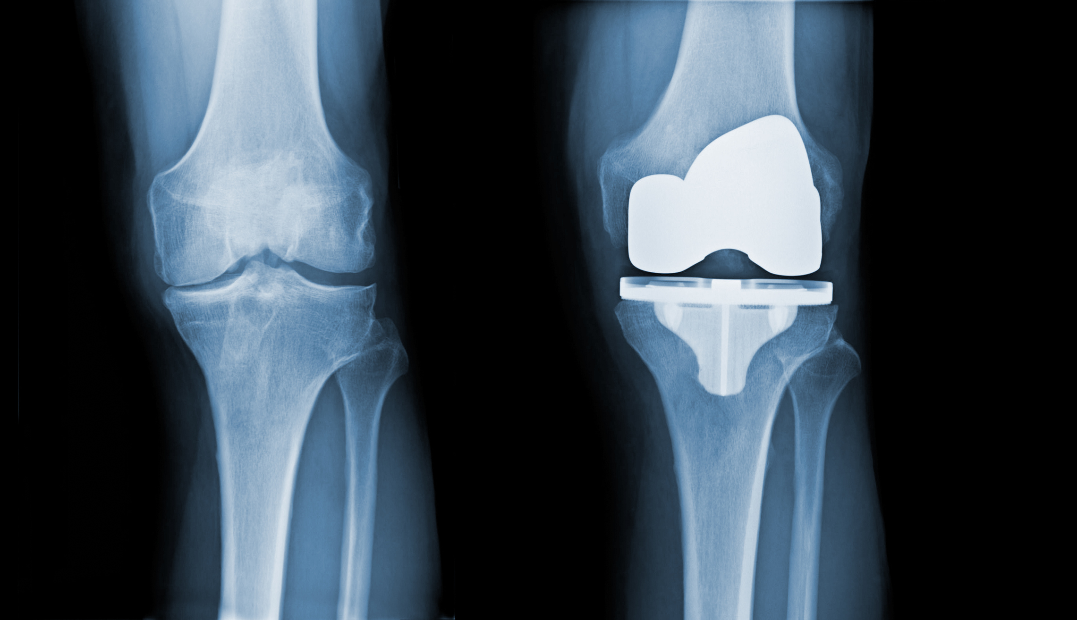
Total Knee what it looks like

Slide 66
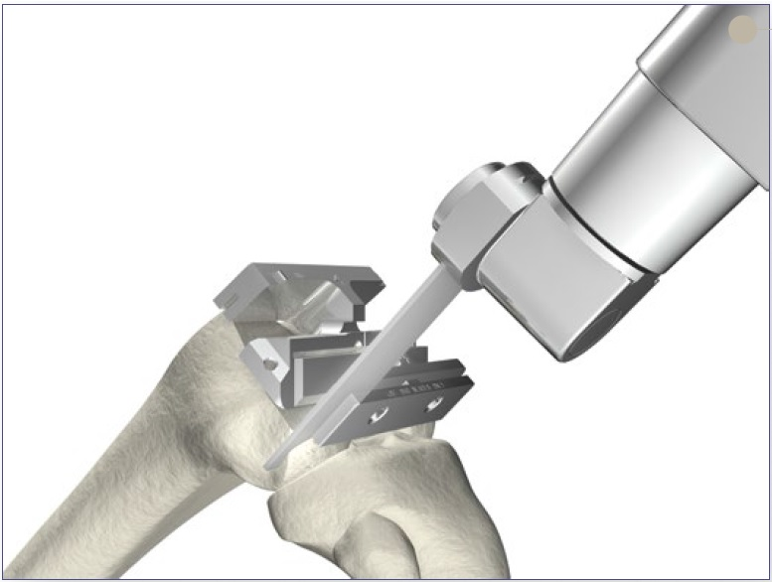

Slide 67
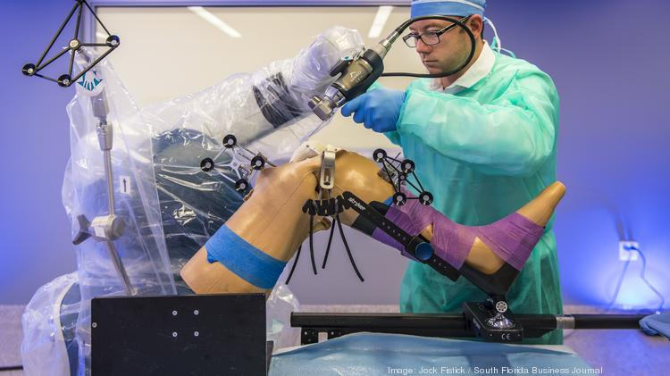

Slide 68
Total Knee Coding
27447 Arthroplasty, knee, condyle and plateau; medial AND lateral compartments with or without patella resurfacing (total knee arthroplasty)
27486 Revision of total knee arthroplasty, with or without allograft; 1 component
27487 Revision of total knee arthroplasty, with or without allograft; femoral and entire tibial component

Slide 69
Total Shoulder Arthroplasty

Slide 70
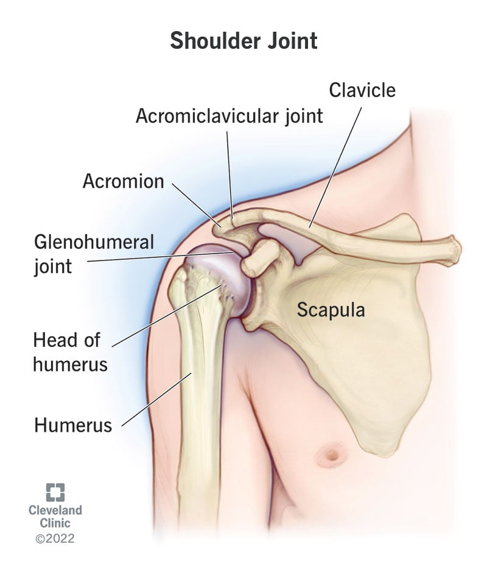

Slide 71
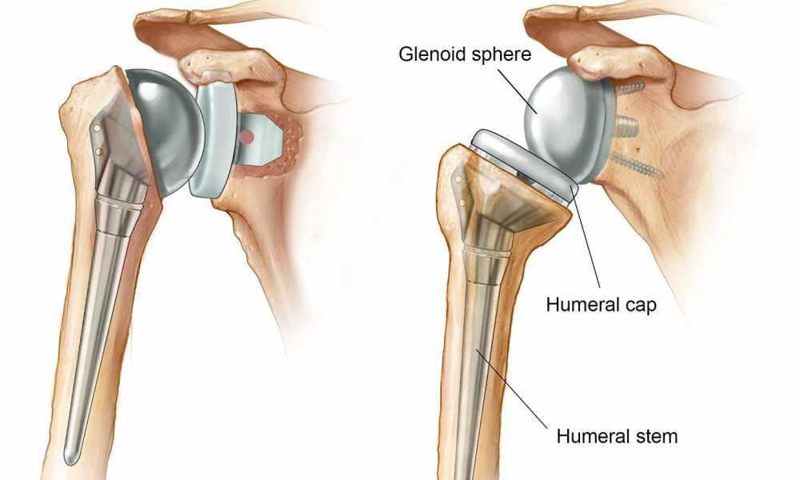
Regular Total Shoulder Vs Reverse Total

Slide 72
Total Shoulder Coding
23472 Arthroplasty, glenohumeral joint; total shoulder
23473 Revision of total shoulder arthroplasty, including allograft when performed; humeral or glenoid component
23474 Revision of total shoulder arthroplasty, including allograft when performed; humeral and glenoid component

Slide 73
Total Hip Arthroplasty

Slide 74
Total Hip Arthroplasty

Slide 75
Total Hip Arthroplasty

Slide 76
Total Hip Arthroplasty
THA- 27130
Conversion- 27132 (Is IP only)
27134 Revision of total hip arthroplasty; both components, with or without autograft or allograft
27137 Revision of total hip arthroplasty; acetabular component only, with or without autograft or allograft
27138 Revision of total hip arthroplasty; femoral component only, with or without allograft

Slide 77
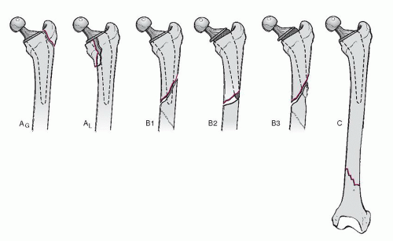
Periprosthetic Fracture
Periprosthetic fractures are fractures that occur in association with an orthopedic implant, most often used for joint arthroplasty or fracture fixation.

Slide 78
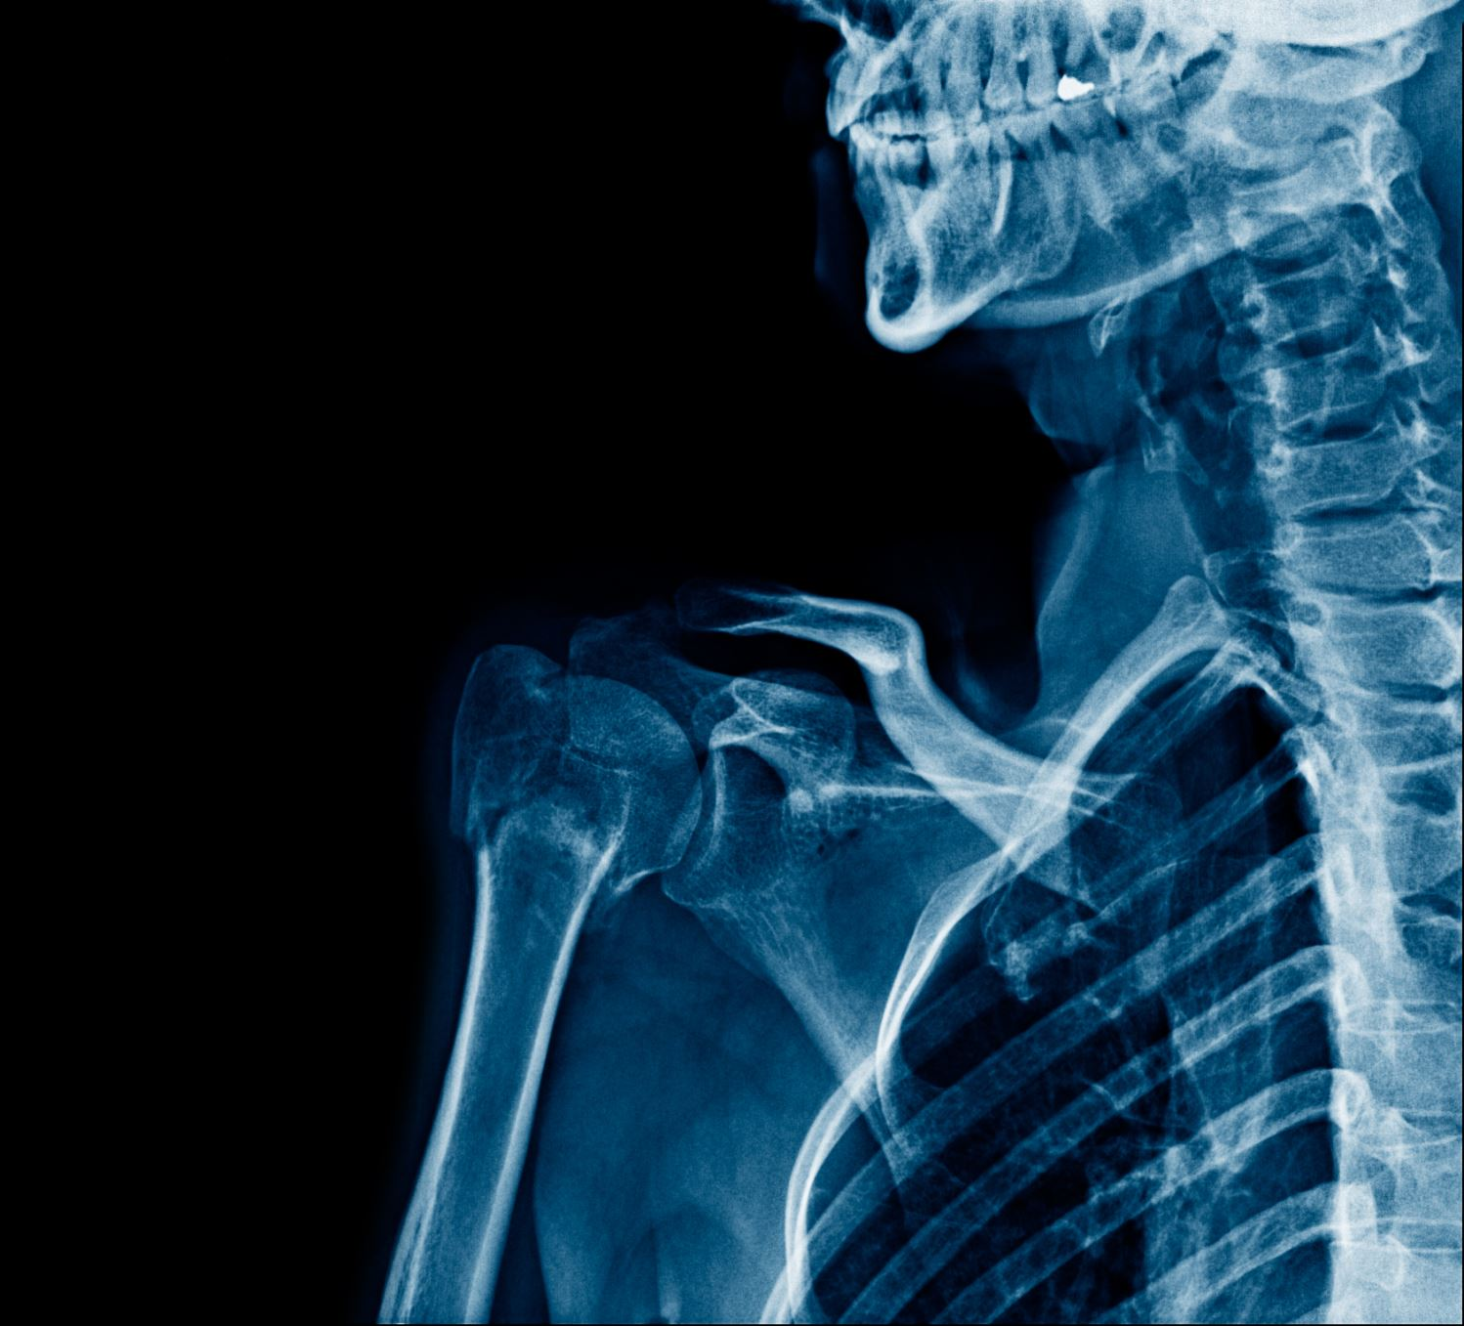
Treating Periprosthetic Hip Fractures
The General Approaches to treating periprosthetic hip fractures include:
Open reduction and internal fixation.
Revision of the total arthroplasty with an exchange of some or all of the implants.
A combination of both.

Slide 79
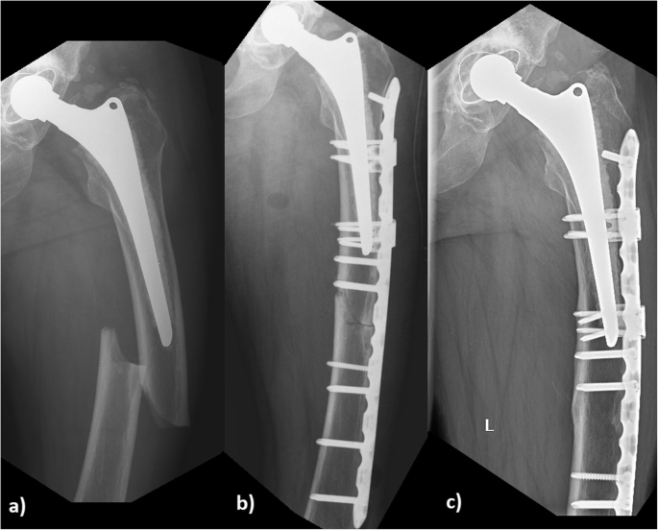

Slide 80
Thank you
Branden Chavez, CPC, COSC
Revenue Cycle Manager
Orthopedic Surgeons PA
bchavez@osikc.com

