Slide 1

AAPC of KC MAC Education Day
March 14, 2024

Slide 2

Your Presenter – Mary E. Muchow

Slide 3
Disclaimer
We prepared this education as a tool to assist the provider community. Medicare rules change often. They are in the relevant laws, regulations and rulings on the Centers for Medicare & Medicaid Services (CMS) website.
We will provide responses to questions based on the facts given, but the Medicare rules will determine final coverage.
CMS prohibits recording of the presentation for profit-making purposes.

Slide 4

Agenda

Slide 5
Behavioral Health/Mental Health

Slide 6
WPS GHA Local Coverage Determinations (LCDs)
Medicare policies define medical necessity
  Consider presenting your patient with an Advance Beneficiary Notice of Noncoverage (ABN)
    Use of the ABN provides financial protection for both the provider and the patient
L34616 – Psychiatry and Psychology Services
L34646 – Psychological and Neuropsychological Testing
Links to Billing and Coding articles appear near end of LCDs
  Includes Coding Information

Slide 7
Documentation for Psychiatry and Psychology Services
Refer to L34616 – Psychiatry and Psychology Services
  Found in Coverage Guidance (specific to psychotherapy)
  Found in General Information
Medicare & Mental Health Coverage (CMS MLN1986542 May 2023)
CERT C3HUB website
  Choose Document Request Listing from left menu
  Choose from list based on provider/billing type
    Example – Part B/Psychiatric Services including Clinical Psychologist Services (Provider Specialty 26, 62, 68, 80, 89)

Slide 8
Most Common Mental Health Questions
Psychiatric Diagnostic Interview Examination 90791/90792
  Can be conducted once, at the onset of an illness or suspected illness
  Same provider may repeat it for same patient
    If an extended break in treatment occurs (six months from last time the patient was seen or treated for their psychiatric condition)
    If patient requires admission to an inpatient status for psychiatric illness
    For significant change in mental status requiring further assessment
Can an enrolled Clinical Social Worker (CSW) bill for incident to services?
  No, an enrolled CSW may render an incident to service, but he or she cannot bill an incident to service

Slide 9
Incident to Reminders
Incident to is “problem-centric”
  If new problem results in a change in the plan of treatment, it’s not incident to
Must be evident in record that reflects billing provider’s continuing active participation in and management of course of treatment
General supervision now required for behavioral health services for
  Diagnosis, evaluation, or treatment of a mental disorder
  Substance use disorder (SUD) with co-occurring mental health disorder
Only a medical doctor, doctor of osteopathy, clinical psychologist, physician assistant, nurse practitioner, clinical nurse specialist and certified nurse midwife can bill for incident to services

Slide 10
Targeted Probe & Educate (TPE) for Group Therapy
CMS authorizes WPS GHA to conduct the TPE process
  Medicare Program Integrity Manual, Chapter 3, Verifying Potential Errors and Taking Corrective Actions
Data analysis indicates potential aberrancies related to group psychotherapy services, CPT code 90853
Refer to Group Pscyhotherapy (90853) for
  Documentation guidance for a successful review of group psychotherapy
  Group psychotherapy resources

Slide 11
90853 TPE Findings for Past Year
About half denied for no documentation submission
Denial trends for remaining reviews:
  Multiple group therapy sessions for a single date of service
  Documentation missing:
    Intended benefit of group psychotherapy
    Estimated duration treatment
    Periodic summary of goals, progress toward goals, and an updated treatment plan
    Number of participants in the group
    Evidence the patient is benefiting from group therapy
    Evidence the patient demonstrated improvement in target symptoms
    Evidence the patient made progress toward their goals
    Evidence the patient actively participated in group Pscyhotherapy sessions

Slide 12
Mental Health Telehealth Reminders
Rules for telehealth differ for
  Diagnosis, evaluation, or treatment of a mental disorder
  Substance use disorder (SUD) with co-occurring mental health disorder
Permanent changes
  Telehealth can be delivered using audio-only communication platforms
  No geographic restriction for originating site
  Medicare patients can receive services in their home
  Requires general supervision, not direct supervision
After May 11, 2023
  Report only place of service 02 or 10
  Do not report modifier 95
    May report modifier FQ or 93 or both

Slide 13
New Specialties Effective January 1, 2024
Marriage and Family Therapy (MFT) – specialty code E1
Mental Health Counselor (MHC) – specialty code E2
Provider Specialty Codes
CMS Marriage and Family Therapists & Mental Health Counselors web page
CMS Become a Medicare Provider or Supplier web page
CMS MFT and MHC Provider Enrollment FAQs (September 2023)

Slide 14
Can enrolled MFT and MHC providers bill incident to services?
No, MFTs and MHCs may not bill (submit claim under own Medicare provider number) for incident to services
  Regardless of whether Medicare enrolled, MFTs and MHCs can render incident to services based on their state scope of practice

Slide 15
CMS Behavioral Health Campaign
CMS released Change Request 13389 in response to sections 4123, 4128, and 4129 of the Consolidated Appropriations Act, 2023.
Requires
  Mass mailing to conduct outreach to physician and appropriate non-physician practitioners on three services:
    Behavioral Health Integration (BHI)
    Psychotherapy for Crisis
    Opioid Use Disorder Treatment (OUD) Treatment
  Tracking all topic related provider outreach and education
  Tracking all topic related Customer Service inquiries

Slide 16
WPS GHA Education in Response to CR 13389
Webinars (past and future)
  View Encore Presentations (webinar recordings) on the WPS GHA YouTube Channel
Partner events
YouTube videos
News items and website carousel messages on WPS GHA website
Link to Timely Topics on Live Events web page
More to come
  Share your ideas!

Slide 17
CMS Campaign Behavioral Health Resources
MLN Booklet (MLN919432) – Behavioral Health Integration Services
Psychotherapy for Crisis web page
  Use link to view CY 2024 Physician Fee Schedule (PFS)
Opioid Use Disorder Screening & Treatment web page

Slide 18
KS – Medicare Claims Denials Dashboard Specialty 26 – Psychiatrist
Submission dates 08/01/23 – 02/01/24 refreshed on 02/12/24
  Top rejections by reason
    Denied invalid/incorrect ICD-9 code. Resubmit as a new claim – 93
    Claim lacks information needed for adjudication – 88
  Top five rejections by CPT/HCPCS code
    99232, 99213, 99214, 90868, 90792
  Top denials by reason
    Collection of fee-for-service during periods of managed care – 288
    Expenses incurred after coverage termination – 157
  Top five denials by CPT/HCPCS code
    99232, 99214, 99233, 99215, 90792

Slide 19
MO – Medicare Claims Denials Dashboard Specialty 26 – Psychiatrist
Submission dates 08/01/23 – 02/01/24 refreshed on 02/12/24
  Top rejections by reason
    Denied rendering physician # invalid/missing – 249
    Claim lacks information needed for adjudication – 172
  Top five rejections by CPT/HCPCS code
    99214, 99232, 90833, 99213, 99348
  Top denials by reason
    This physician (supplier) is not eligible to receive payments – 712
    One visit/consult per doctor per day, do not bill patient – 513
  Top denials by CPT/HCPCS code
    99214, 99232, 99308, 90792, 99213

Slide 20
KS – Medicare Claims Denials Dashboard
Specialty 80 – CSW
Submission dates 08/01/23 – 02/01/24 refreshed on 02/12/24
  Top rejections by reason
    Claim lacks information needed for adjudication – 166
    Denied – Field 11 of HCFA 1500 must be completed – 88
  Top five rejections by CPT/HCPCS code
    90837, 90834, 90832. 90791, 90839
  Top denials by reason
    Collection of fee-for service during periods of managed care – 549
    This physician (supplier) is not eligible to receive payments – 284
    Duplicate charge paid ?002XX on Claim ?001XXXXXXXXXX – 137
  Top five denials by CPT/HCPCS code
    90837, 90832, 90834, 90791, 90853

Slide 21
MO – Medicare Claims Denials Dashboard
Specialty 80 – CSW
Submission dates 07/01/23 – 01/01/24 refreshed on 01/28/24
  Top rejections by reason
    Claim lacks information needed for adjudication – 177
    Denied – field 11 of HCFA 1500 must be completed – 102
  Top five rejections by CPT/HCPCS code
    90837, 90834, 90832, 90791, 90853
  Top denials by reason
    Duplicate charge of claim 001XXXXXXXXXX now being processed – 366
    Duplicate charge paid ?002XX on Claim ?001XXXXXXXXXX – 236
    Medicare will not pay for this service for this condition – 174
  Top five denials by CPT/HCPCS code
    90837, 90834, 90832, 90853, 90791

Slide 22
Questions?
Submission dates 07/01/23 – 01/01/24 refreshed on 01/28/24
  Top rejections by reason
    Claim lacks information needed for adjudication – 177
    Denied – field 11 of HCFA 1500 must be completed – 102
  Top five rejections by CPT/HCPCS code
    90837, 90834, 90832, 90791, 90853
  Top denials by reason
    Duplicate charge of claim 001XXXXXXXXXX now being processed – 366
    Duplicate charge paid ?002XX on Claim ?001XXXXXXXXXX – 236
    Medicare will not pay for this service for this condition – 174
  Top five denials by CPT/HCPCS code
    90837, 90834, 90832, 90853, 90791

Slide 23
Rejections and Denials

Slide 24
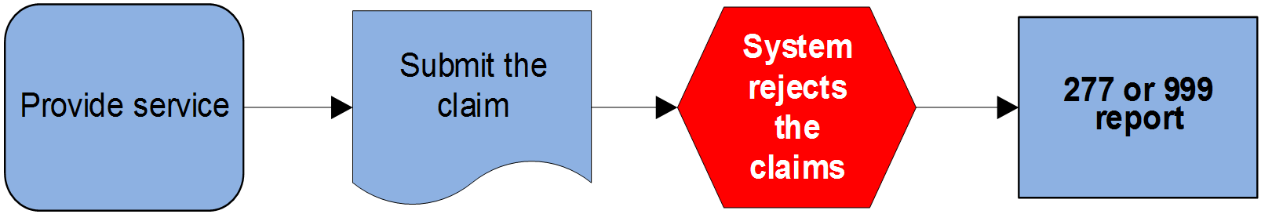
Batch Rejection

Slide 25
Claim Submission
Submit electronically
Use 999 report to confirm claim receipt
Use 277 report for more specific information
  Find information in the Medicare 276/277 Companion Guide
  Correct or resubmit

Slide 26

Unprocessable Rejection

Slide 27
Rejection
Unprocessable
Returned on front end
Missing or incorrect format, invalid, illogical
No appeal rights
MA130/CO16 on Remittance Advice
Patient not liable for payment

Slide 28
Processed

Slide 29
Website Resources - Rejections
How to Correct a Rejected Claim explains how to identify and correct an unprocessable claim
  Listed by remark codes
CMS Internet-Only Manual (IOM) Publication 100-04, Medicare Claims Processing Manual, Chapter 26 – Completing and Processing Form CMS-1500 Data Set
CMS 1500 to ANSI 837 5010 Crosswalk

Slide 30
Denial
Adjudicated
Fails to meet payment criteria
  Statutory requirements
  Medical necessity/frequency
  Eligibility
Appeal rights available
MA01
Liability for payment determined

Slide 31
Remittance Advice (RA)
Provides claim information to provider
Two formats
  Electronic Remittance Advice (ERA)
  Standard Paper Remittance (SPR)
Includes
  Information about adjustments
  Denials
  Missing information
  Refunds
  Offsets

Slide 32
Claim Reason and Remark Codes
Claim Adjustment Reason Codes (CARCs) explain why a claim paid differently than billed
Remittance Advice Remark Codes (RARCs) provide more details about an adjustment described by a CARC

Slide 33
Claim Adjustment Group Codes
Assign financial liability for unpaid portion of claim balance
  CO – Contractual Obligation
    Provider liable
  PR – Patient Responsibility

Slide 34
Code Maintenance
Washington Publishing Company (WPC) maintains codes for CMS
Find link to code lists on WPC website

Slide 35
Potential Actions to Choose
Rejection
  Fix the errors, resubmit the service
Denial
  Fix the errors, resubmit the service, when available
  Clerical Error Reopening (CER)
    Use portal when available
  Request a redetermination (appeal)
    Use portal when available

Slide 36
Clerical Error Reopening (CER)
Process to correct human or mechanical errors
Limited to only certain acceptable clerical error submissions
Use portal or submit request via telephone or fax
Submit within one year of RA receipt date
How to Request a Clerical Error Reopening (CER)

Slide 37
Appeals
Five levels
  Only level one appeals are rendered by MAC
    Known as Redetermination
All levels have time limits to file the request
Contractors have time limits to complete
Amount in controversy (AIC) threshold applies only for
  Level three (Administrative Law Judge (ALJ) Hearing)
  Level five (Federal Court Review)

Slide 38
Appeals How-to
How to Appeal a Claim Determination
CMS Fee-for-Service (FFS) Appeals Process Flowchart
  Updated annually

Slide 39

Data Dashboard
Jurisdiction 5
Part B
Johnson County, KS and Jackson County MO
All specialties
Submission dates 08/01/23 through 02/01/24
  Last refreshed 02/12/24

Slide 40
Jackson County, MO Rejections by Reason
Claim must be submitted to RRB – 1,958
Claim lacks information needed for adjudication – 1,674
Missing/incomplete/invalid provider – 1,198
Denied – invalid or missing modifier – 569
Missing/incomplete/invalid ordering primary identifier – 389
Patient/insured HICN and name do not match - 276
Place of service conflicts with procedure code – 228
PA, NP, or CNS not internally associated with billing provider – 202

Slide 41
Jackson County, MO Rejections by CPT/HCPCS Codes
99232 – 415
99214 – 380
99349 – 348
G0439 – 285
99309 – 277
99308 – 210
97110 – 176
71045 – 172

Slide 42
Jackson County, MO Denials by Reason
Duplicate charge paid ?0002XX on claim ?001XXXXXXXXXX – 5,568
The procedure code submitted is a non-covered service – 3,685
Duplicate charge of claim ?001XXXXXXXXX now being processed – 3,379
This physician (supplier) is not eligible to receive payment – 3,247
This service by a chiropractor is not covered by Medicare – 3,051
These services are denied because the patient is in a Part A stay – 2,302
Claim must be sent to EGHP first – 2, 236
The time limit for filing your claim has expired no appeal rights – 1,994

Slide 43
Jackson County, MO Denials by CPT/HCPCS Codes
99232 – 2,576
99214 – 2,324
92015 – 2,285
A0425 – 1,922
93010 – 1,439
99233 – 1,423
99213 – 1,178
97012 – 1,045

Slide 44
Johnson County, MO Rejections by Reason
Claim lacks information needed for adjudication – 10,665
Claim must be submitted to RRB – 6,677
Claim must be submitted to another contractor – 1,833
Denied – rendering physician # invalid/missing – 1,232
Missing/incomplete/invalid provider identifier – 1,230
Patient/insured HICN and name do not match – 1,207
Denied – field 11 of HCFA 1500 must be completed – 1,166
Procedure inconsistent with mod used or required – 1,120

Slide 45
Johnson County, KS Rejections by CPT/HCPCS Codes
36415 – 1,794
80053 – 1,429
85025 – 1,256
80061 – 930
84443 – 924
96125 – 707
83036 – 640
88305 – 583

Slide 46
More Johnson County, KS Rejections by CPT/HCPCS Codes
11719 – 546
99214 – 394
99232 – 369
92134 – 362
97530 – 301
99213 – 246

Slide 47
Johnson County, KS Denials by Reason
Duplicate charge paid ?002XXX on claim 001XXXXXXXXXX – 7,968
Claim must be sent to EHGP first – 6,646
Duplicate charge of claim ?001XXXXXXXXX now being processed – 6,391
The procedure code submitted is a non-covered services – 5,508
This service by a chiropractor is not covered by Medicare – 5,303
The referring provider is not eligible to refer this services – 4,920
Separate payment not made for this service – 3,860
Theses services are denied because the patient is in a Part A stay – 3,777

Slide 48
Johnson County, KS Denials by CPT/HCPCS Codes
99232 – 2,576
99214 – 2,324
92015 – 2,285
A0425 – 1,922
93010 – 1,439
99233 – 1,423
99213 – 1,178
97012 – 1,045

Slide 49

Tools

Slide 50
Interactive Voice Response (IVR) System
Log in to check eligibility, claim status, and details
  24 hours a day, 7 days a week
    Limited functionality outside normal business hours
Use voice or keypad
  Instruction in IVR Operating Guide

Slide 51
WPS GHA Portal
Log in to check eligibility, claim status, and details
  24 hours a day, 7 days a week
    Limited functionality outside normal business hours
Use More Info button on claim details to view greater details
Instructions in Portal User Manual

Slide 52

Resources

Slide 53
CMS Resources – Avoid Rejections and Denials
Medicare Coverage Database (MCD) Search
  National searchable depository of national and local coverage determinations, articles, and more
How to Use the Medicare Coverage Database MLN educational tool
Beneficiary Notices Initiative (BNI) web page
  Download Advance Beneficiary Notice of Noncoverage (ABN) form instructions

Slide 54
Resources - Rejections
How to Correct a Rejected Claim explains how to identify and correct an unprocessable claim
  Listed by remark codes
CMS Internet-Only Manual (IOM) Publication 100-04, Medicare Claims Processing Manual, Chapter 26 – Completing and Processing Form CMS-1500 Data Set
CMS 1500 to ANSI 837 5010 Crosswalk

Slide 55
Resources - Denials
Common Claim Denials suggests actions to take to avoid common reasons for denials
  Listed by reason and remark codes for these categories
    Bundling
    Duplicate claim/service
    Global surgery rules
    Entitlement denials
    Payer/Contractor denials
    Provider number denials

Slide 56
Resources - Other
Provider Enrollment Guides and Resources
Timely Filing of Claims

Slide 57
Bundling

Slide 58
National Correct Coding Initiative (NCCI)
Implemented by CMS to reduce improper payments for Part B claims
CMS posts changes to each of its published NCCI files on a quarterly basis, including
  Additions
  Deletions
  Revisions

Slide 59
Medicare NCCI Policy Manual
Tool for correct coding
Explains rationale for NCCI edits
CMS updates this once a year
  Most current manual effective 01/01/24, posted on 12/01/23
  Additions and revisions appear in red font
  Find prior versions in Medicare NCCI Policy Manual Archive

Slide 60
Using the Medicare NCCI Policy Manual
Chapters correspond to separate sections of CPT Manual, except
  Chapter 1 has general correct coding policies
  Chapter 12 discusses HPCCS Level 2 codes
  Chapter 14 discusses Category III CPT

Slide 61
Types of Procedure-to-Procedure (PTP) Edit Files
Hospital PTP Edits
  Applied to claims submitted for services that are paid under the outpatient prospective payment system (OPPS)
  Arranged by code range, numeric, then alpha
Practitioner PTP Edits
  Applied to claims submitted for practitioner services
  Arranged by code range, numeric, then alpha
Find links in Medicare NCCI Procedure to Procedure (PTP) Edits

Slide 62
PTP Code Pair Tables
Column2 code is usually part of the more comprehensive Column 1 code, but in some edits, the PTP code pair edit consists of 2 codes you shouldn't report together unless you use the proper modifier

Slide 63
Content of PTP Coding Edit Table
Column A shows the payable (Column 1) code
Column B shows a Column 2 code that isn’t payable with this Column 1 code, unless an NCCI-associated modifier is permitted and submitted
Column C shows the edit status before 1996
Column D shows the effective date of the edit
Column E shows the deselection date of the edit
Column F shows if you can use a modifier.
  This number is the modifier indicator for the edit
Column G provides the category of the rationale for each PTP edit

Slide 64
Correct Coding Modifier Indicators
0 – No modifiers associated with NCCI allow you to uses this PTP code pair
  Only the Column 1 code will be paid for same patient on same day
1 – You can use NCCI-associated modifiers with this PTP code pair when appropriate
    Check documentation
3 – There is no active edit for this PTP code pair

Slide 65
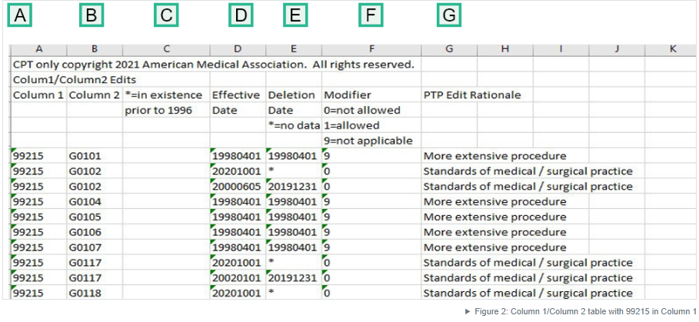
A Closer Look

Slide 66
Filtering the PTP Data Tables
Fasted and most accurate way to search edit tables for a particular value
Instructions found in online How to Use the Medicare Correct Coding Initiative (NCCI) Tools MLN educational tool
  Use jump links at top of page

Slide 67
NCCI Associated Modifiers
Use under appropriate clinical circumstance to bypass an NCCI PTP edit
  Anatomic modifiers
    E1-E4, FA, F1-F9, TA T1-T9, LT, RT, LC, LD, RC LM, RI
  Global surgery modifiers
    24, 25, 57, 58, 78, 79
  Other modifiers
    27, 59, 91, XE, XS, XP, XU
Find NCCI Modifiers in the Medicare NCCI FAQ Library

Slide 68
Modifier Resources
MLN Fact Sheet (MLN1783722 March 2023) – Proper Use of Modifiers 59, XE, XP, XS, and XS
WPS GHA Modifiers Guides and Resources
  Includes links to general modifier information and modifier fact sheets

Slide 69
Liability for Denials
Services denied based on PTP edits may not be billed to the patient
Use of the Advance Beneficiary Notice of Noncoverage (ABN) not allowed

Slide 70
Medicare NCCI FAQ Library
Includes
  Billing and coding advice
  NCCI Policy Manual
  Medically Unlikely Edits (MUEs)
  Procedure-to-Procedure (MUEs) Edits
  NCCI modifiers
  Published PTP and MUE files

Slide 71
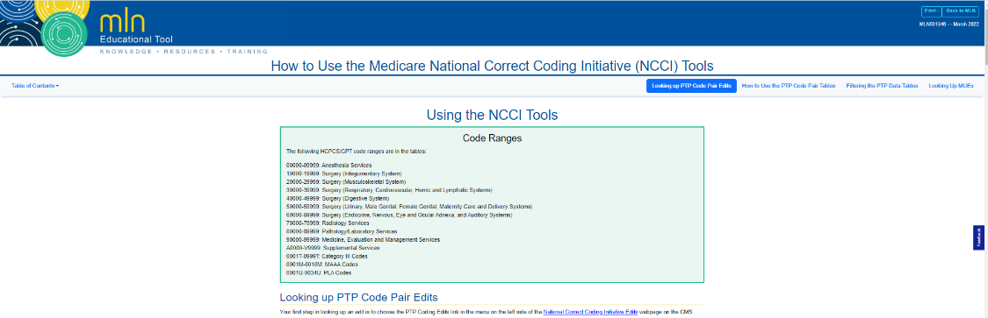
MLN Educational Tool
How to Use the Medicare National Correct Coding Initiative (NCCI) Tools

Slide 72
WPS GHA Education Resources

Slide 73
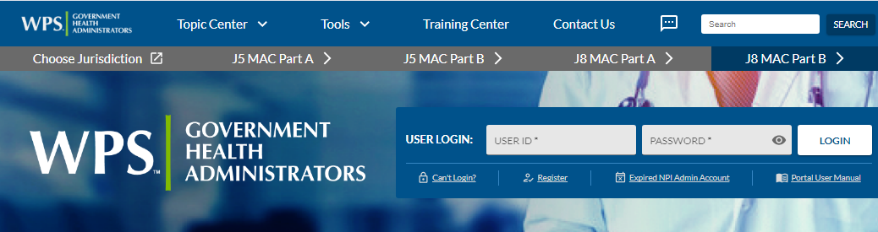
WPS GHA Website
www.wpsgha.com
Quick Links – Topic Center – Training Center

Slide 74

Portal
Stage 2 of website redevelopment
Anticipate completion by end of Spring 2024

Slide 75

Facebook – WPS GHA Provider Page
https://www.facebook.com/WPSGHAProviderPage

Slide 76

WPS GHA
YouTube Channel
https://www.youtube.com/channel/UCscLmgYJDEJ8Zh2_r_SivUw
Videos - Encore Presentations - 43 Playlists

Slide 77
Timely Topics
Find link on Live Events web page
Stay up to date by viewing this document, updated quarterly

Slide 78
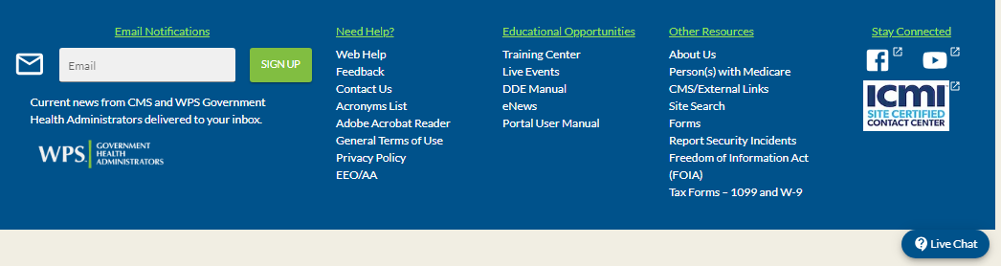
WPS GHA eNews/Live Chat
Sign up and read eNews
  Sign up on any WPS GHA web page
Check out Live Chat
  Presents at bottom of web page when available

Slide 79
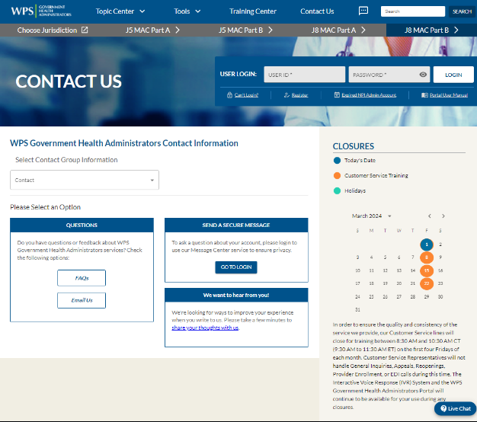
Contact Us
Chose Contact Us from the blue box at the bottom of any WPS GHA web page

Slide 80
Questions

Slide 81
Survey

Slide 82
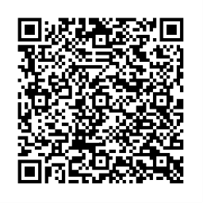
Follow Up Questions
Submit presentation-related questions to aapc.kansascity@gmail.com
  Send by 03/24/24 at noon Central Time
Direct claim specific or provider specific questions to Customer Service

Slide 83

Thank You

