Slide 1
Hospice Modifiers: GW, GV and Condition Code 07 Kansas City Chapter AAPC
March 2024

Slide 2
Disclaimer
We prepared this education as a tool to assist the provider community. Medicare rules change often. They are in the relevant laws, regulations and rulings on the Centers for Medicare & Medicaid Services (CMS) website.
We will provide responses to questions based on the facts given, but the Medicare rules will determine final coverage.
CMS prohibits recording of the presentation for profit-making purposes.

Slide 3
Acronyms
MAC – Medicare Administrative Contractor
NOE – Notice of Election

Slide 4
Agenda

Slide 5
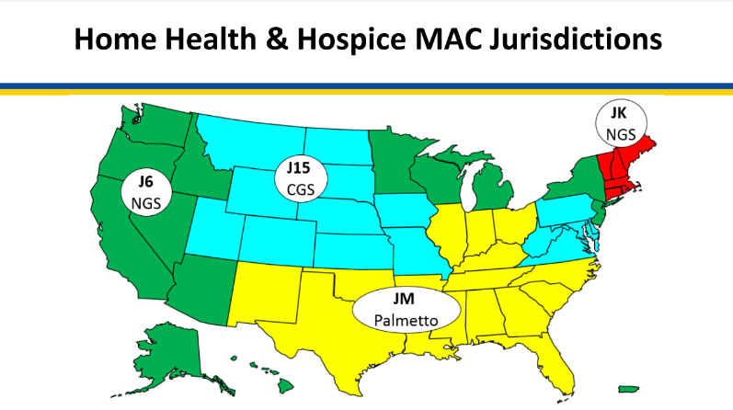
Home Health and Hospice MACs

Slide 6
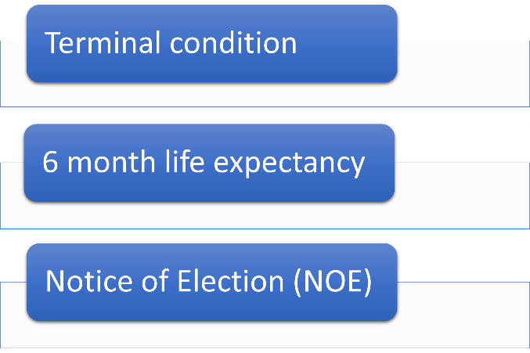
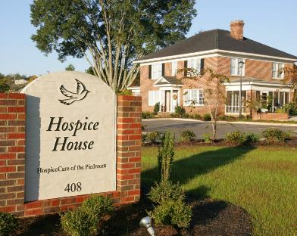
Hospice Election

Slide 7
Notice of Election (NOE)
Identify hospice agency
Acknowledgment of understanding
Hospice care
Waiver of benefits
Election effective date
Attending physician designation
Disclosures
Signature

Slide 8
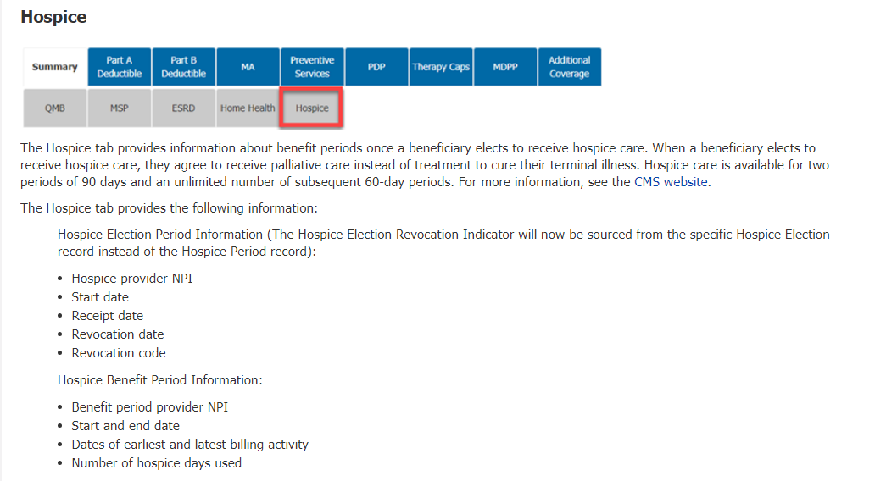
Hospice Eligibility

Slide 9
Coverage

Slide 10
Attending Physician Services
Designated by beneficiary
Physician
Nurse Practitioner
Physician Assistant
Hospice employed— Part A
Not employed — Part B

Slide 11
GV Modifier
Attending not employed by Hospice
Not arranged by hospice
Attending Physician employed by hospice
Paid under arrangement
Appropriate
Inappropriate

Slide 12
Unrelated Service
Professional = GW Modifier
Institutional = Condition Code 07

Slide 13
Questions

Slide 14
WPS Resources
WPS:
Billing Services During a Hospice Election
WPS GHA Secure Portal User Manual, Eligibility-Check

Slide 15
CMS Resources
Home Health and Hospice MAC Jurisdictions
MLN6922507 Hospice Payment System and Coverage
Publication 100-04, Medicare Claims Processing Manual, Chapter 11 – Processing Hospice Claims, sections 30, 40, and 50
Publication 100-02, Medicare Benefit Policy Manual, Chapter 9 – Coverage of Hospice Services Under Hospital Insurance

Slide 16
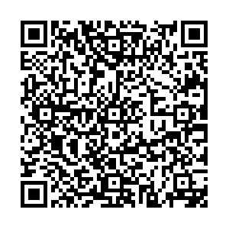
Closing
Follow-up Questions
Send to aapc.kansascity@gmail.com
Submit by 03/24/2024 at 12:00 P.M. CT
Send claim specific questions to Customer Service

Slide 17
Thank you

