Slide 1
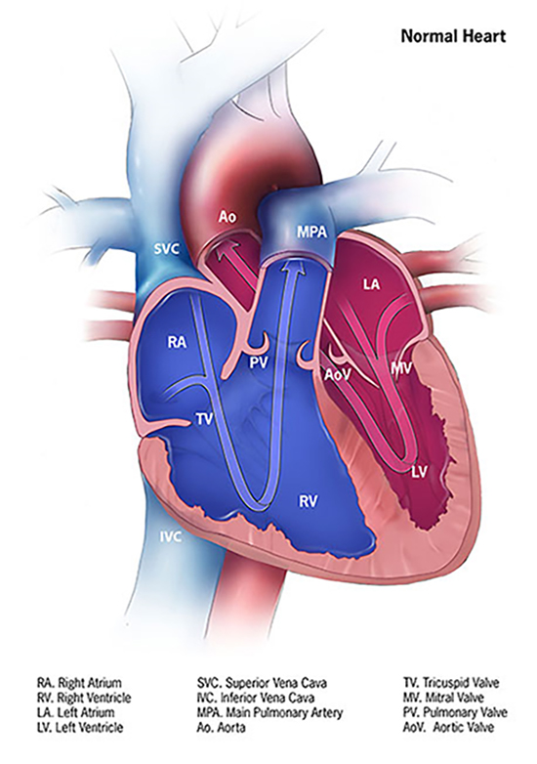
Congenital Cardiac Catheterization Coding
Doris V. Branker, CHC, CPC, CPC-I, CPMA, CIRCC, CANPC, CEMC
Principal Consultant
DB Healthcare Consulting & Education

Slide 2
Doris V. Branker CHC, CPC, CIRCC, CPMA, CPC-I, CANPC, CEMC
A multi-specialty coding, reimbursement, practice management and compliance consultant. She is the principal consultant of DB Healthcare Consulting & Education. Doris’ specialty areas include evaluation and management, anesthesia, pain management, critical care medicine, interventional radiology and cardiology.
Doris is also a consultant with the American Society of Anesthesiology. In her spare time, she shares free educational content in her specialty areas on her YouTube page Doris TheCoder

Slide 3
Objectives
Review anatomy and hemodynamic cardiac flow
Provide an overview of common pathophysiologic conditions and treatments
Provide coding and guidance rules
Provide a sneak peak of the congenital catheterization codes for 2024

Slide 4
Terminology
Abnormal connections
Subpulmonic
Morphologic
Systemic (subaortic)
Central shunt
Notes:
A central shunt is an anastomosis between the ascending aorta and the main pulmonary artery made of PTFE.

Slide 5
Blood Flow in Normal Anatomy
Right
Left
Pulmonary Veins
Left Atrium
Mitral Valve
Left ventricle
Aortic valve
Aorta
Vena Cavae
Right Atrium
Tricuspid Valve
Right Ventricle
Pulmonary valve
Pulmonary Arteries

Slide 6
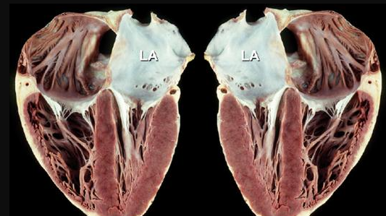
Gross Anatomy (Internal View)

Slide 7
Base Codes
CPT | Description
93593 | Right heart catheterization for congenital heart defect(s) including imaging guidance by the proceduralist to advance the catheter to the target zone; normal native connections
93594 | Right heart catheterization for congenital heart defect(s) including imaging guidance by the proceduralist to advance the catheter to the target zone; abnormal native connections
93595 | Left heart catheterization for congenital heart defect(s) including imaging guidance by the proceduralist to advance the catheter to the target zone, normal or abnormal native connections
93596 | Right and left heart catheterization for congenital heart defect(s) including imaging guidance by the proceduralist to advance the catheter to the target zone(s); normal native connections
93597 | Right and left heart catheterization for congenital heart defect(s) including imaging guidance by the proceduralist to advance the catheter to the target zone(s); abnormal native connections

Slide 8
Add-on Codes
CPT | Description
93563 | Injection procedure during cardiac catheterization including imaging supervision, interpretation, and report; for selective coronary angiography during congenital heart catheterization (List separately in addition to code for primary procedure)
93564 | ; for selective opacification of aortocoronary venous or arterial bypass graft(s) (eg, aortocoronary saphenous vein, free radial artery, or free mammary artery graft) to one or more coronary arteries and in situ arterial conduits (eg, internal mammary), whether native or used for bypass to one or more coronary arteries during congenital heart catheterization, when performed
93565 | ; for selective left ventricular or left atrial angiography (List separately in addition to code for primary procedure)
93566 | ; for selective right ventricular or right atrial angiography (List separately in addition to code for primary procedure)
93567 | ; for supravalvular aortography (List separately in addition to code for primary procedure)

Slide 9
Add-on Codes
CPT | Description
93568 | Injection procedure during cardiac catheterization including imaging supervision, interpretation, and report; for nonselective pulmonary arterial angiography (List separately in addition to code for primary procedure)
93569 | Injection procedure during cardiac catheterization including imaging supervision, interpretation, and report; for selective pulmonary arterial angiography, unilateral (List separately in addition to code for primary procedure)
93573 | Injection procedure during cardiac catheterization including imaging supervision, interpretation, and report; for selective pulmonary arterial angiography, bilateral (List separately in addition to code for primary procedure)
93574 | Injection procedure during cardiac catheterization including imaging supervision, interpretation, and report; for selective pulmonary venous angiography of each distinct pulmonary vein during cardiac catheterization (List separately in addition to code for primary procedure)
93575 | Injection procedure during cardiac catheterization including imaging supervision, interpretation, and report; for selective pulmonary angiography of major aortopulmonary collateral arteries (MAPCAs) arising off the aorta or its systemic branches, during cardiac catheterization for congenital heart defects, each distinct vessel (List separately in addition to code for primary procedure)

Slide 10
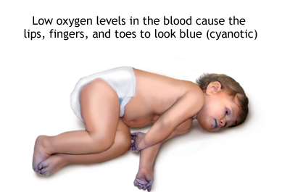
Cyanotic Heart Diseases
Abnormal Native Connections

Slide 11
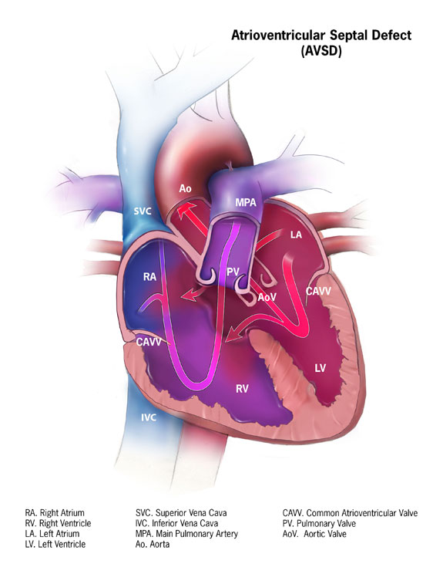
Atrioventricular Septal Defect

Slide 12
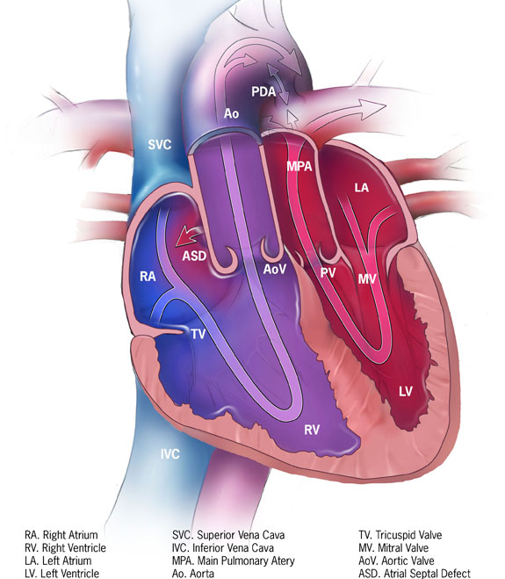
Transposition of the Great Vessels
Notes:
Tx- Arterial Switch or Baffle

Slide 13
Congenitally Corrected Transposition of the Great Arteries
Notes:
PA Banding to strengthen the LV then later Double switch
Often associated w/other positions

Slide 14
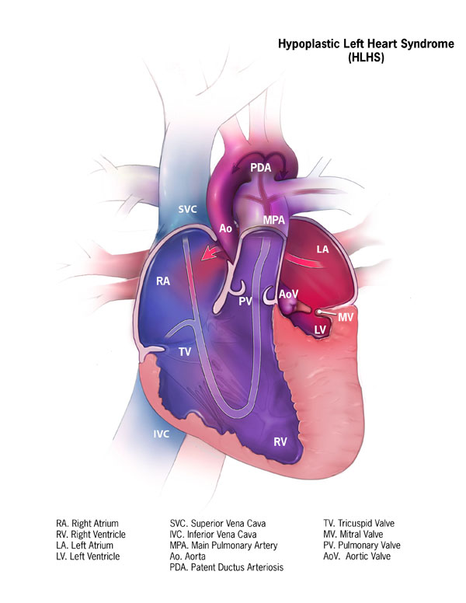
Hypoplastic Left Heart Syndrome
Notes:
Norwood Procedure This surgery usually is done within the first 2 weeks of a baby’s life. Surgeons create a “new” aorta and connect it to the right ventricle. They also place a tube from either the aorta or the right ventricle to the vessels supplying the lungs (pulmonary arteries). Thus, the right ventricle can pump blood to both the lungs and the rest of the body. This can be a very challenging surgery. After this procedure, an infant’s skin still might look bluish because oxygen-rich and oxygen-poor blood still mix in the heart.
Bi-directional Glenn Shunt Procedure This usually is performed when an infant is 4 to 6 months of age. This procedure creates a direct connection between the pulmonary artery and the vessel (the superior vena cava) returning oxygen-poor blood from the upper part of the body to the heart. This reduces the work the right ventricle has to do by allowing blood returning from the body to flow directly to the lungs.
Fontan Procedure This procedure usually is done sometime during the period when an infant is 18 months to 3 years of age. Doctors connect the pulmonary artery and the vessel (the inferior vena cava) returning oxygen-poor blood from the lower part of the body to the heart, allowing the rest of the blood coming back from the body to go to the lungs. Once this procedure is complete, oxygen-rich and oxygen-poor blood no longer mix in the heart and an infant’s skin will no longer look bluish.

Slide 15
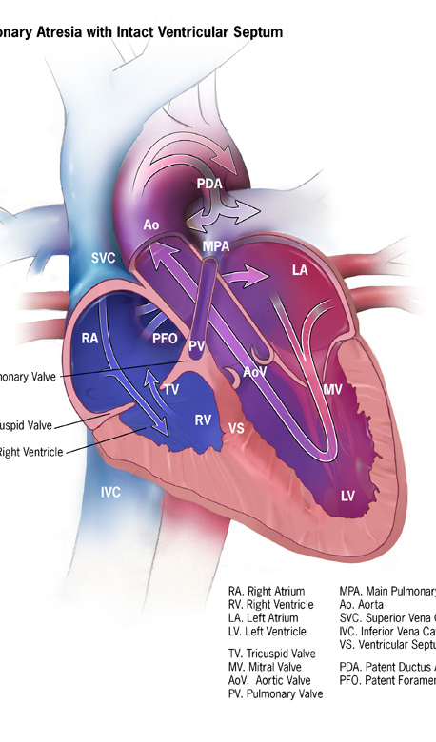
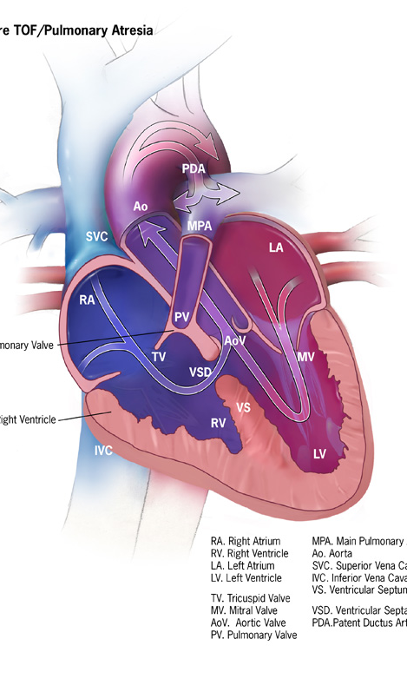
Pulmonary Atresia
Notes:
Treatment for pulmonary atresia depends on its severity.
In some cases, blood flow can be improved by using cardiac catheterization (inserting a thin tube into a blood vessel and guiding it to the heart). During this procedure, doctors can expand the valve using a balloon or they may need to place a stent (a small tube) to keep the ductus arteriosus open.
In most cases of pulmonary atresia, a baby may need surgery soon after birth. During surgery, doctors widen or replace the pulmonary valve and enlarge the passage to the pulmonary artery. If a baby has a ventricular septal defect, the doctor also will place a patch over the ventricular septal defect to close the hole between the two lower chambers of the heart. These actions will improve blood flow to the lungs and the rest of the body. If a baby with pulmonary atresia has an underdeveloped right ventricle, he or she might need staged surgical procedures, similar to surgical repairs for hypoplastic left heart syndrome.

Slide 16
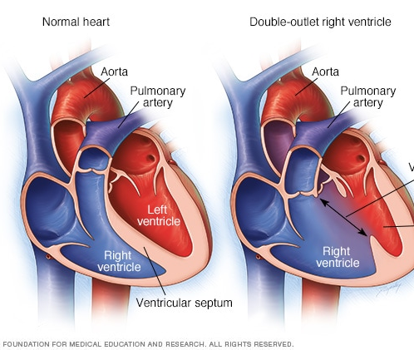
Double Outlet Right Ventricle
Notes:
Treatment for pulmonary atresia depends on its severity.
In some cases, blood flow can be improved by using cardiac catheterization (inserting a thin tube into a blood vessel and guiding it to the heart). During this procedure, doctors can expand the valve using a balloon or they may need to place a stent (a small tube) to keep the ductus arteriosus open.
In most cases of pulmonary atresia, a baby may need surgery soon after birth. During surgery, doctors widen or replace the pulmonary valve and enlarge the passage to the pulmonary artery. If a baby has a ventricular septal defect, the doctor also will place a patch over the ventricular septal defect to close the hole between the two lower chambers of the heart. These actions will improve blood flow to the lungs and the rest of the body. If a baby with pulmonary atresia has an underdeveloped right ventricle, he or she might need staged surgical procedures, similar to surgical repairs for hypoplastic left heart syndrome.

Slide 17
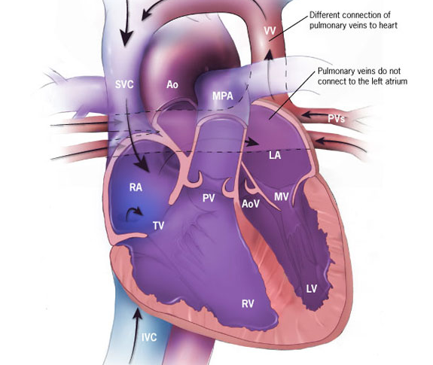
Anomalous Pulmonary Venous Return
Notes:
There are different types of TAPVR, based on where the pulmonary veins connect:
Supracardiac– In supracardiac TAPVR, the pulmonary veins come together and form an abnormal connection above the heart to the superior vena cava, which is a main blood vessel that brings oxygen-poor blood from the upper part of the body to the heart. In this type of TAPVR, a mixture of oxygen-poor and oxygen-rich blood returns to the right atrium through the superior vena cava.
Cardiac – In cardiac TAPVR, the pulmonary veins meet behind the heart and connect to the right atrium. The coronary sinus, which is a vein that helps bring oxygen-poor blood from the heart muscle back to the heart, helps connect the pulmonary veins to the right atrium in this type of TAPVR.
Infracardiac – In infracardiac TAPVR, the pulmonary veins come together and form abnormal connections below the heart. A mixture of oxygen-poor blood and oxygen-rich blood returns to the right atrium from the veins of the liver and the inferior vena cava, which is the main blood vessel that brings oxygen-poor blood from the lower part of the body to the heart.
Treatment
Supplemental oxygen or a machine that helps your baby breathe (ventilator).
Prostaglandin therapy. This medicine keeps the ductus arteriosus open and lets blood flow through the heart. ...
Different medicine to support the function of the heart.
ECMO (extracorporeal membrane oxygenation).

Slide 18
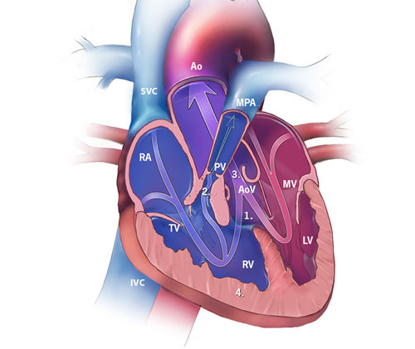
Tetralogy of Fallot
Notes:
Tetralogy of Fallot is made up of the following four defects of the heart and its blood vessels: (Biology of Fallot)
A hole in the wall between the two lower chambers―or ventricles―of the heart. This condition also is called a ventricular septal defect. VSD closure
A narrowing of the pulmonary valve and main pulmonary artery. This condition also is called pulmonary stenosis. Pulmonary angioplasty or valvuloplasty
The aortic valve, which opens to the aorta, is enlarged and seems to open from both ventricles, rather than from the left ventricle only, as in a normal heart. In this defect, the aortic valve sits directly on top of the ventricular septal defect.
The muscular wall of the lower right chamber of the heart (right ventricle) is thicker than normal. This also is called ventricular hypertrophy.

Slide 19
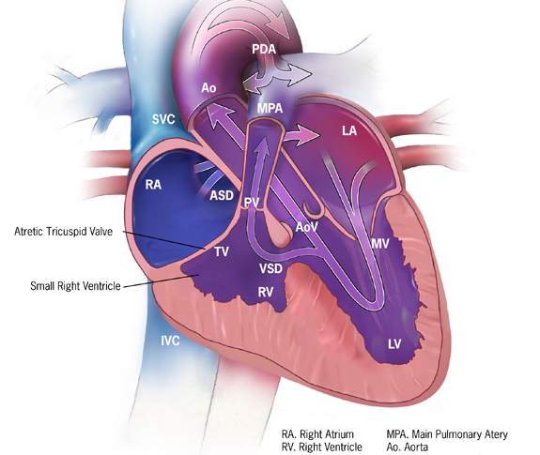
Tricuspid Atresia
Notes:
Septostomy- A septostomy may be done within the first few days or weeks of a baby’s life, and creates or enlarges the atrial septal defect, the hole between the right and left upper chambers (atria). This is done so that more oxygen-poor blood can mix with oxygen-rich blood, so that more oxygen-rich blood can get to the body.
Banding- If the baby has other heart defects along with tricuspid atresia, sometimes there is too much blood flowing to the lungs and not enough going out to the rest of the body. Too much blood in the lungs can damage them. If this is the problem, surgery may be done within the first few weeks of a baby’s life to place a band around the artery going to the lungs (main pulmonary artery) to control the blood flow to the lungs. This banding is a temporary procedure and will likely be removed.
Shunt Procedure- This surgery usually is done within the first 2 weeks of a baby’s life. Surgeons create a bypass (shunt) from the aorta to the main pulmonary artery, allowing blood to get to the lungs. If the aorta is small, as occurs when the baby also has transposition of the great arteries, the surgeon will also enlarge the aorta at this time. After this procedure, an infant’s skin still might look bluish because oxygen-rich and oxygen-poor blood still mix in the heart.
Bi-directional Glenn Procedure- This usually is performed when an infant is 4 to 6 months of age. This procedure creates a direct connection between the main pulmonary artery and the superior vena cava, the vessel returning oxygen-poor blood from the upper part of the body to the heart. This allows blood returning from the body to flow directly to the lungs and bypass the heart.
Fontan Procedure- This procedure usually is done sometime around 2 years of age. Doctors connect the main pulmonary artery and the inferior vena cava, the vessel returning oxygen-poor blood from the lower part of the body to the heart, allowing the rest of the blood coming back from the body to go to the lungs. Once this procedure is complete, oxygen-rich and oxygen-poor blood no longer mix in the heart and an infant’s skin will no longer look bluish.

Slide 20
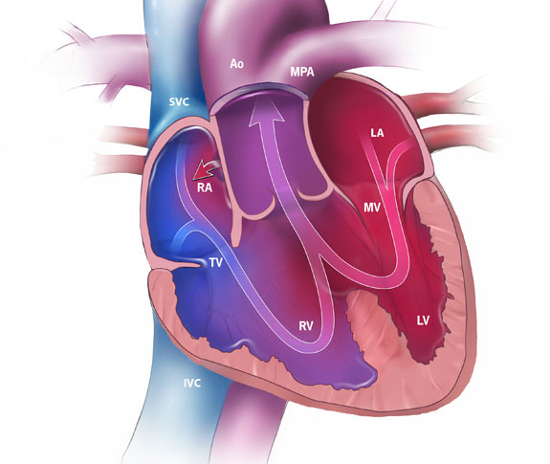
Truncus Arteriosus

Slide 21
Acyanotic Heart Disorders
Normal Native Connections

Slide 22
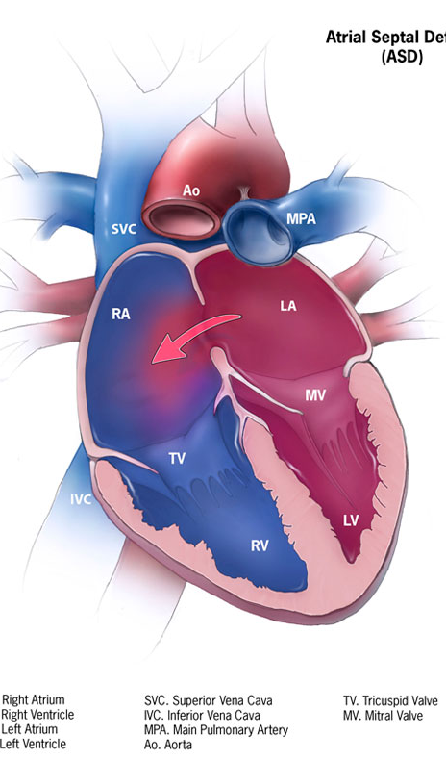
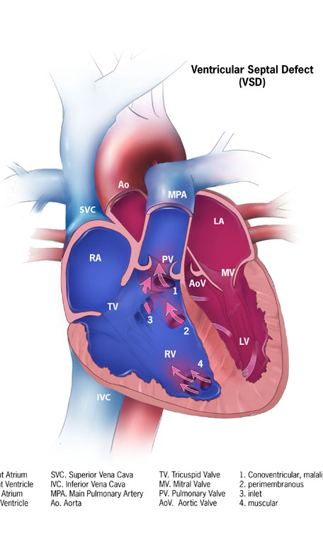
Septal Defects

Slide 23
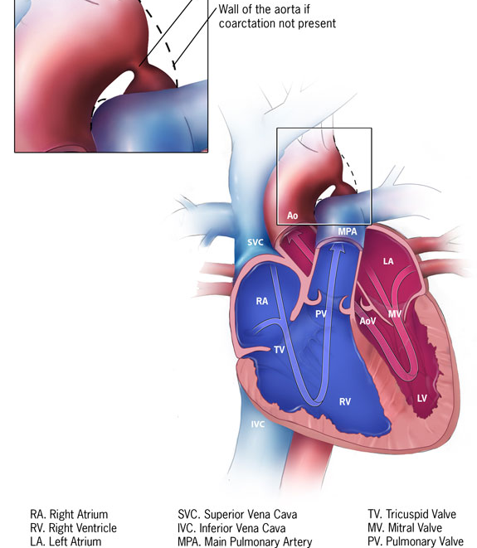
Coarctation of the Aorta

Slide 24
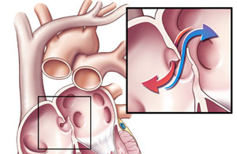
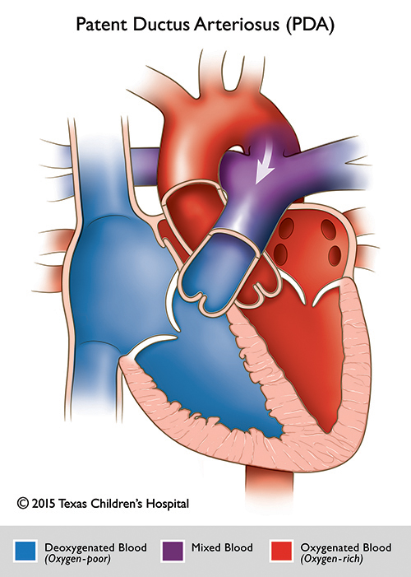
Defects of Closure

Slide 25
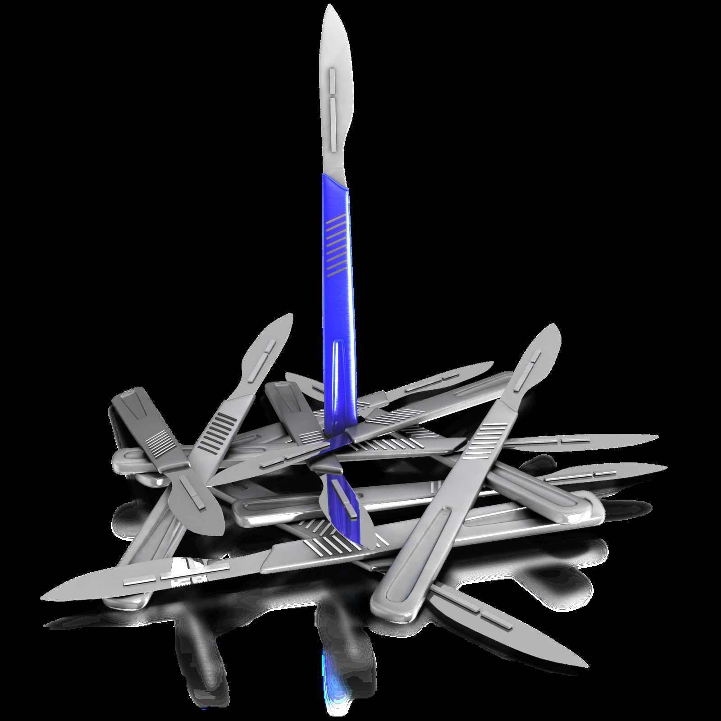
Surgical Interventions for Congenital Heart Disease
Anastomoses and Shunts
Notes:
Most of these procedures are palliative. They do not cure

Slide 26
Blalock-Taussig-Thomas Shunt (aka BTT or BT Shunt)
Subclavian to pulmonary artery anastomosis (original)
Use of artificial tubing to connect subclavian or carotid to aorta
Notes:
When the PA is underdeveloped connecting an artery w/oxygen rich blood increases the pressure and flow to the artery, thus development PAs

Slide 27
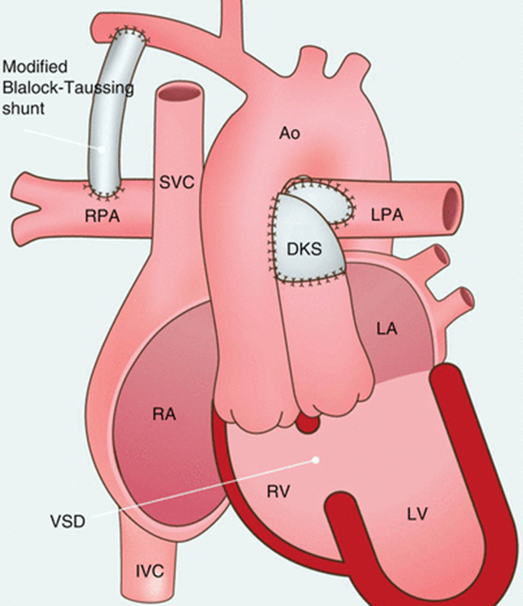
Damus-Kaye Stansel Procedure (DKS)
Direct PA to ascending aortic anastomosis
Seen in single ventricle disease
DILV
Tricuspid Atresia
Other single ventricle disorders

Slide 28
Fontan
Cavopulmonary connection (inferior)
May be fully or partially done
SVC only = Classic Glenn or Hemi-Fontan
Used as palliation for
HLHS
Single ventricle disorders
Tricuspid atresia

Slide 29
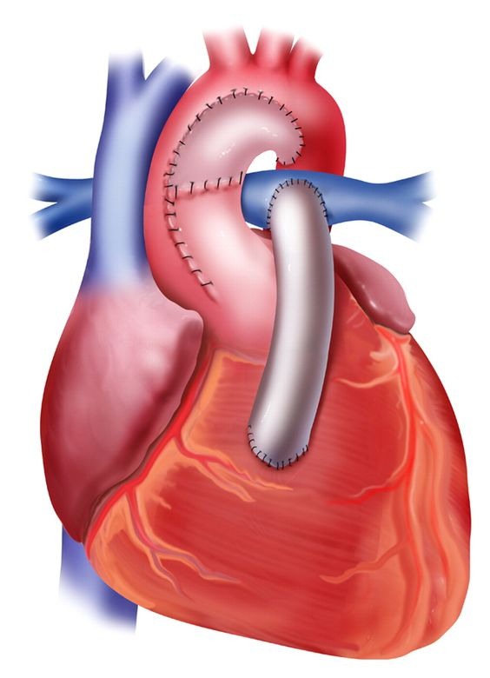
Sano Shunt (Norwood)
Right ventricle to pulmonary artery shunt
Done as an alternative to BTT Shunt
Done for single ventricle disease or HLHS
Notes:
Rv-PA conduit= in cases of PA or stenosis

Slide 30
Other Shunts
Pott’s Shunt- Anastomosis of descending aorta to left pulmonary artery
Waterston-Cooley Shunt- Anastomosis of ascending aorta to the right pulmonary artery

Slide 31
Arterial Switch
Repositioning of congenitally malpositioned pulmonary artery and aorta
Aka arterial switch
Seen in patients with transposition of the great arteries (tGA)

Slide 32
Mustard & Senning Procedure
Atrial switch procedures using a baffle to re-route anomalous blood flow
Mustard- synthetic material
Senning- patient’s own tissue
Done to treat d-TGA

Slide 33
Tip
Many of these procedures are for palliation, not curative of the disorder
Diagnosis may still be reported
Additional diagnosis for the presence of shunt or complication of the shunt(s) may be appropriate
The only definitive treatment for most of the cyanotic conditions is a heart transplant so procedure codes may be reported until that time

Slide 34
Coding Guidelines

Slide 35
Cardiac Catheterization Coding Rules
Access is immaterial for new congenital catheterization codes
Statement without supportive documentation does not warrant reporting (i.e, pressures, saturations, and angiography findings)
Ensure documentation supports code choice
Many of the add-on codes use are limited to once per session
Notes:
Many not all

Slide 36
Cardiac Catheterization Coding Rules
Choose cath code based on type of heart structure
Code based on what the chamber is doing, not the location
Single ventricle disorders are always coded as left heart structure (DORV, DILV,) since it provides systemic circulation.
Use additional codes from surgery and radiology, as needed for all procedures performed

Slide 37
Cardiac Catheterization and Coronary Angiography
Right chamber angiography is reported with 93566, irrespective of position
Left chamber angiography is reported with 93565, irrespective of position
Thermodilution is additionally reportable with congenital catheterization codes

Slide 38
Cardiac Catheterization and Coronary Angiography
Use add-on code 93462 for transeptal puncture for congenital and non-congenital cath codes
Abnormal anatomy may impact data captured during cardiac catheterization
Apply CPT guidelines for proper use to two code sets
Notes:
Do NOT undercode when surgical or medical history explain the reason for missing elements (Fontan, Glenn, Valve atresia, etc.,)
Don’t lean to heavily on your dx to support congenital. Williams (outside of cardiac) and DiGeorge D82.1 and I42.8 Congenital cardiomyopathy
Use diagnosis code to communicate post-surgical states (Fontan/Baffles/ RV-PA conduit

Slide 39
New Add-on Codes (2024)
CPT | Description
+93584 | Venography for congenital heart defect(s), including catheter placement, and radiological supervision and interpretation; anomalous or persistent superior vena cava (SVC) when it exists as a second contralateral SVC, with native drainage to the heart
+93585 | ; azygous/hemiazygos venous system
+93586 | ; coronary sinus
+93587 | ; venous collaterals originating at or above the heart (eg, from innominate vein)
+93588 | ; venovenous collaterals originating below the heart (eg, from the inferior vena cava)

Slide 40
Mission Accomplished?
How do you feel now?
Anatomy and hemodynamic cardiac flow
Common pathophysiologic conditions and treatments
Interpret and apply the coding guidance and rules
Know what’s behind the door for congenital catheterization codes in 2024

Slide 41
DB Healthcare Consulting & Education, LLC Phone (954)288-6381 doris@brankercodingcamps.com LinkedIn: Doris Branker YouTube: Doris TheCoder
THANK YOU

Slide 42
Resources
My YouTube: https://www.youtube.com/channel/UCPTJRTlVLbecYHlWDcwcqAQ
Images courtesy of:
CDC: https://www.cdc.gov/ncbddd/heartdefects/specificdefects.html
Mayo Clinic https://www.mayoclinic.org/diseases-conditions/double-outlet-right-ventricle/cdc-20389537

Slide 43
Guidelines
Evaluation of anomalous coronary arteries arising from the pulmonary arterial system is reported with the cardiac catheterization for congenital heart defects codes.
Right heart catheterization for congenital heart defects (93593, 93594, 93596, 93597): includes catheter placement in one or more right-sided cardiac chamber(s) or structures (ie, the right atrium, right ventricle, pulmonary artery, pulmonary wedge), obtaining blood samples for measurement of blood gases, and Fick cardiac output measurements, when performed. While the morphologic right atrium and morphologic right ventricle are typically the right heart structures supplying blood flow to the pulmonary artery, in congenital heart disease the subpulmonic ventricle may be a morphologic left ventricle and the subpulmonic atrium may be a morphologic left atrium. For reporting purposes, when the morphologic left ventricle or left atrium is in a subpulmonic position due to congenital heart disease, catheter placement in either of these structures is considered part of right heart catheterization and does not constitute left heart catheterization.
Notes:
Pg. 775 1st

Slide 44
Guidelines
Normal native connections exist when the pathway of blood flow follows the expected course through the right and left heart chambers and great vessels (ie, superior vena cava/inferior vena cava to right atrium, then right ventricle, then pulmonary arteries for the right heart; left atrium to left ventricle, then aorta for the left heart). Examples of congenital heart defects with normal connections would include acyanotic defects such as isolated atrial septal defect, ventricular septal defect, or patent ductus arteriosus. Services including right heart catheterization for congenital cardiac anomalies with normal connections are reported with 93593, 93596.

Slide 45
Guidelines
Abnormal native connections exist when there are alternative connections for the pathway of blood flow through the heart and great vessels. Abnormal connections are typically present in patients with cyanotic congenital heart defects, any variation of single ventricle anatomy (eg, hypoplastic right or left heart, double outlet right ventricle), unbalanced atrioventricular canal (endocardial cushion) defect, transposition of the great arteries, valvular atresia, tetralogy of Fallot with or without major aortopulmonary collateral arteries (MAPCAs), total anomalous pulmonary veins, truncus arteriosus, and any lesions with heterotaxia and/or dextrocardia.

Slide 46
Guidelines
Examples of right heart catheterization through abnormal connections include accessing the pulmonary arteries via surgical shunts, accessing the pulmonary circulation from the aorta via MAPCAs, or accessing isolated pulmonary arteries through a patent ductus arteriosus. Other examples would include right heart catheterization through cavopulmonary anastomoses, Fontan conduits, atrial switch conduits (Mustard/Senning), or any variations of single ventricle anatomy/physiology.

Slide 47
Guidelines
Left heart catheterization for congenital heart defects (93595, 93596, 93597):involves catheter placement in a left-sided (systemic) cardiac chamber(s) (ventricle or atrium). The systemic chambers channel oxygenated blood to the aorta. In normal physiology, the systemic chambers include the morphologic left atrium and left ventricle. In congenital heart disease, the systemic chambers may include a morphologic right atrium or morphologic right ventricle which is connected to the aorta due to transposition or other congenital anomaly. These may be termed subaortic chambers. For the purposes of reporting, the term left ventricle or left atrium is meant to describe the systemic (subaortic) ventricle or atrium.

