Slide 1

Benchmarking for Practice Success
Tracy Bird, FACMPE, CPC, CPMA, CPC-I, CEMC
Medical Practice Advisors, LLC
tbird@medicalpracticeadvisors.com

Slide 2
“Something that can be used as a way to judge the quality or level of other, similar things”
Source: Merriam-Webster

Slide 3
Why Should We Benchmark?
Benchmarking helps you understand where you are and define where you want to go and how you will get there
The dynamics of healthcare management dictate enhanced methods of measurement, analysis, comparison, and improvement
Benchmarking improves a practice’s ability to identify, predict, and adjust to challenges.
Notes:
We all know healthcare is very complex and getting more so as the years go by.
Fortunately or maybe that is hopefully your practice is taking advantage of more sophisticated methods of measurement, analysis and comparison and ways to improve.

Slide 4
Two Key Principles (Pearls) of Benchmarking
If you don’t measure it, you can’t manage it
If you don’t value it, you won’t change it
Notes:
That second principle is important to note.
Getting things to change in a practice is very difficult and affects every member of the organization. As we know with change, many don’t like it, and will try to sabotage measures to change, therefore as managers if we are going to be successful at change the value of that change has to outweigh the status quo.
Measuring and benchmarking enabels the process to evolve toward action

Slide 5
Benchmarking- More Than Numbers
Begins with a comparison of data
Understanding the current state of your practice
Any metric deemed important can be benchmarked !
Barriers, limitations, strengths, goals, areas of concern
Numbers, patients, clicks, visits, procedures …
Notes:
Benchmarking is really more than just the numbers. I had a boss several years ago that always said he could manage a practice just by looking at the numbers, but I believe a successful practice requires more than just evaluating the numbers. People are a big part of the picture. Not only do we deal with staff, but we are in the business of treating patients.
It’s a comparison on the numbers but more than that it is understanding the state of your practice
Read the slide.
Know the barriers, limitations, strengths and goals.

Slide 6

How to Begin to Benchmark
Decide what is most important to the success of your organization
Identify metrics that are critical factors
Find an internal and external source of benchmarking data
Measure your practice’s performance
Compare your data with a benchmark
Decide if action is needed for improvement
Implement new processes
Measure change
Do it all over again

Slide 7
How Do We Do That?
Three Measures to Consider
Operations (Productivity)
Financial (Time and Cost)
Quality
Notes:
When we talk about running a successful medical practice there are some distinct areas to consider:
There are a number of organizational or operational issues that involve processes of patient care: check in, check out, patient flow through the clinical area, etc.
There are financial issues to consider like keeping the accounts receivable healthy, and keeping overhead at a reasonable rate
Quality has always been important in healthcare but has picked up significant importance since entering into reporting of quality measure and outcomes through MIPS, APMs, ACOS, etc. Quality and the patient experience is gaining momentum and in the future, our reimbursement will be based on quality measures
Anything of value can be measured to be managed, but 3 areas in a medical practice that we often try to put context around decision making include
Organizational issues ( producticity
Financial decisions
And quality now becoming more important in our practices

Slide 8
Case Study # 1 (Operations Example)
You are the administrator of a primary care practice with 5 FTE physicians and 2 NPP’s. A recent patient satisfaction survey indicated patients are unhappy with their ability to reach your practice by phone; they cannot schedule appointments when they need them and consequently you have noticed a higher- than- normal no-show rate.

Slide 9
Considerations for What to Measure
Staffing
Staffing ratios per FTE physician
Administrative support staff per FTE physician
Clinical support staff per FTE physician
Telephone Management
Number of phone calls
Types of calls – Reasons for the calls
Patient Demographics
Age and gender of patients
Survey Evaluation
Survey instrument
Questions Asked

Slide 10
Benchmarking – Common Key Performance Indicators
Scheduling
  3rd next available appointment
  No show rates
  Cancellation rates
  Provider service hours
  Visits per provider
Patient Flow
  Average wait time
  Total appointment time
Patient Encounters
  New patients
  Established patients
  Appointment type mix
  Average encounters per day per FTE provider

Slide 11
Staffing Benchmarks
Staffing | My Practice | MGMA
Non- Physician Practitioners | 2.0 | 2.10
Front Office Receptionists- Referrals- Medical records- | 4.5 | 6.65
Clinical Support One per provider Float | 7.0 | 8.0
Total | 13.5 | 16.75
Source: MGMA 2021 Data Dive. Family Medicine per FTE Provider
Notes:
Front office support incudes reception staff
Medical secretaries – referrals,
Medical records
We may be understaffted by approximately 3 FTE’s
In this example we have 2 reception staff
1 secretary doing referrals
1.5 medical records

Slide 12
Receptionist – “Best Practices” Benchmarks
Performance standards:
  Check in 100-130 patients per day if only verifying the registration.
  Check out 60-80 patients per day when performing follow-up scheduling, cashiering, and processing a fee slip.
  Check out 70-90 patients per day when performing follow-up scheduling and cashiering at check-out.
  “Mastering Patient Flow” by Elizabeth Woodcock.

Slide 13
Patient Flow Staff Performance Benchmarks
Practice Operation Task | Workload Range
Surgery Scheduling | 25-30 patients per day
Referrals (inbound and outbound) | 70-90 patients per day
Nurse triage | 75 calls per day
Nurse/MA rooming patients and assisting providers | 22-30 patients per day

Slide 14
Phone Calls | My Practice | Best Practice Data
Appt. scheduling with full registration | 120 | 150
Appt. scheduling with no registration | 180 | 250
Source: Elizabeth Woodcock: Mastering Patient Flow
Notes:
2 reception staff: my staff answer 60 calls per day
Best practice should be able to do 300 per day with full registration
No registration

Slide 15
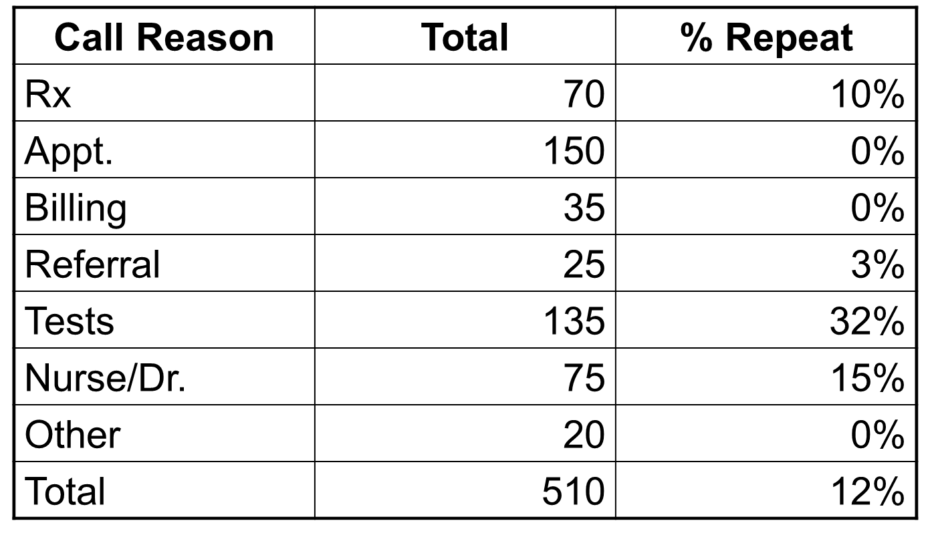

Incoming Call Analysis

Slide 16
Patient Demographics
Series 1: 0-10
Series 2- 11-25
Series 3- 26-40
Series 4- 41-64
Series 5-65+
Notes:
If we are having trouble getting patients in, who is taking up all the appointment slots and what type of patients are we seeing?
Age and gender are the primary demographics most practices should measure to identify the distribution of established patients and predict the characteristics of new patients.
Age and gender helps you identify the types of patients you see.
The 3 0ldest physicians in the practice see mostly Medicare age or nearing medicare age.
We know that population of patients have more chronic problems

Slide 17
Patient Satisfaction Surveys
Qualitative
Quantitative
How satisfied were you with the care you received today?
What could this practice do to improve the care you received today?
Did the provider listen to your concerns?
Would you recommend this practice to your family and friends?
Using the choices below how would you rate the ease of making an appointment by phone?
Circle:
  “1” for poor
  “2” for good
  “3” for excellent
Notes:
Surveys are critical to the practice because you need to know what patients feel and how they perceive your practice.
The most successful practices rank suveys as extremely important because you cannot make things better for your patients unless you ask the right questions.
Surveys should be simple and easy to understand.
Be sure questions focus on one thing, not asking 2 things in one question
There is value in using the same tool with same questions over and over. Over time you will see trends or changes
They also provide valuable feedback right before or right after you have implemented changes

Slide 18
Appointment Availability
Measure number of days to next available new or established patient.
  3NAA (3rd next available appointment) is healthcare standard measure of access to care and tells how long a patient waits to be seen.
  Measure from the same day and same time for every provider.
  Helps determine back log.
  Institute of health sets the goal as zero days for primary care and 2 days for specialists

Slide 19
No Show Rates and Cancellation Rates
No Show Rate
  Number of appointment no-shows
  Number of total scheduled appointments
Cancellation Rates
  Number of cancellations converted to appts
  Total Cancellations

Slide 20
Tracking No Shows
Total “no-show” numbers per provider:
 | A | B | C | D
January | 27 | 86 | 44 | 49
February | 18 | 64 | 36 | 38
March | 27 | 49 | 44 | 18
April | 18 | 59 | 23 | 23
May | 22 | 44 | 25 | 16
June | 21 | 41 | 38 | 22
July | 21 | 46 | 38 | 22
August | 27 | 59 | 38 | 34
September | 29 | 57 | 55 | 36
October | 24 | 82 | 22 | 52
November | 35 | 55 | 59 | 30
December | 27 | 39 | 38 | 28
Totals | 296 | 681 | 460 | 368

Slide 21
Provider Data
Patient encounters per FTE Physician
  Physician ambulatory encounters
  Total FTE Physicians
New patient registrations per FTE Physician
  New patient registrations
  Total FTE Physicians
Physician weeks worked per year
  Total number of weeks worked per year per physician
Clinical service hours worked per week
  How many patient contact hours are available per FTE Phys per week
Appointment duration in minutes
  Total number of clinical service hours per week per physician
  Number of totaled scheduled appointments per physician
Notes:
When you begin to put together the information about types of patients and which doctors are seeing the older chronic conditions, the question then to answer is how are we managing the patients with chronic problems.
Does everyone get an appointment every 3 months to monitor progress and receive refills, or are we managing the co-horts of patients differently depending on the status of their chronic conditions.
Doing so opens slots for more patients to be seen.

Slide 22
Encounter Data
Measure and benchmark monthly encounters per provider
Encounters Per FTE Provider | My Practice | MGMA
Physicians | 225 | 300
Non-Physician Practitioners | 165 | 198
Notes:
You can see that both my practice physicans and NPPs are not as busy as MGMA.
Are we maximizing appointments with the way we use NPP’s ?

Slide 23

Case Study #2 ( Financial Example)
You are the administrator of a primary care practice. Over the last two years you have seen a decrease in revenue and increase in overhead. The physicians are also concerned. They have asked you to identify whether it is a revenue problem?
or an expense problem?
and report back to the board with an improvement plan.

Slide 24
Benchmarking – Common Key Performance Indicators
Revenue KPI’s
  Gross charges
  Gross collection ratio
  Net collection ratio
  Days charges in A/R
  Months charges in A/R
  Aged trial balances- Payer & Patient
  Coding patterns by provider

Slide 25
What To Measure
Revenue
A/R: Charges, payments, adjustments
Payer and patient issues
Expenses
Staff costs
Physician compensation
General operating costs
Notes:
Average cost per patient

Slide 26
Evaluating Revenue
Gross collection ratio
Net FFS revenue or collections
Gross FFS charges
Net collection ratio
Net FFS Collections
Net FFS Charges (Charges less Contractual Adj.)

Slide 27
Evaluating Accounts Receivable
Days in A/R
Outstanding net Accounts Receivable
Average adjusted revenue per day
Months in A/R
Total Accounts Receivable
Annual Adjusted FFS charges * 1/12
**Aged accounts receivable
Goal: ≤ 60 days – 50%-60% of total A/R
≥ 90 days – no more than 15% of total A/R

Slide 28
ABC Clinic
2022 | Charges | Receipts | Adjustments
January | 203,406.00 | 118,291.85 | 48,856.68
February | 231,279.50 | 159,031.74 | 64,110.71
March | 246,268.00 | 168,324.20 | 85,684.13
April | 275,122.00 | 155,707.17 | 67,607.80
May | 264,468.00 | 212,105.19 | 81,512.71
June | 284,359.00 | 208,302.85 | 84,368.05
July | 266,112.00 | 204,925.09 | 84,267.63
August | 341,514.00 | 223,385.43 | 90,705.27
September | 223,898.29 | 199,969.70 | 61,677.46
October | 292,998.75 | 200,563.96 | 81,262.35
November | 292,998.75 | 206,058.25 | 109,334.01
December | 267,414.57 | 164,402.38 | 90,720.21
TOTAL | 3,188,943.45 | 2,221,067.81 | 950,107.01
Monthly Average | 265,745.29 | 185.088.98 | 79,175.58
2021 Monthly Ave. | 197,070,.08 | 141,732.48 | 56,553.11

Slide 29
Tips For Monitoring Charges
Charges should be consistent from month to month
Monitor charges by service line- E&M, Surgery, Lab, Drugs, etc.
Establish internal benchmarks or compare with external benchmarks

Slide 30
Monitoring Charges
Pay attention to outliers:
  Charge posting issues
    Lag time to posting
    Physician issue
    Work- flow in the business office
  Vacations or time off
  Physician not turning in charges consistently
  Implementing or discontinuing a service
  Isolated or unusual incidents such as a spike or lull in demand ( seasonal)

Slide 31

Adjustments/Write-offs
Contractual
Discounts mandated by insurance contracts
Other
Adjustments
Bad debt, courtesy, errors, and other discretionary discounts

Slide 32
Monitoring Adjustments
Adjustments to billed charges is often an under-managed area in medical practices
Monitoring write-offs is a sound internal control procedure
Periodic audits of write-offs protects against employee dishonesty or incompetence

Slide 33
Tips for Monitoring Adjustments
Establish adjustment reason codes for major payers and separate codes for frequently used “Other” write offs:
  Bad debt, courtesy, small balance, timely filing, billing errors
Use Monthly, Year-to-Date and Average Columns to compare to your internal benchmarks
Monitor by major payer to identify trends
Track adjustment percent by provider
Notes:
If you are auto posting the RARC and CARC codes should post automatically giving you the reasons for write offs

Slide 34
Monitoring Adjustments
Adjustments tend to mirror receipts, not charges. In a month with above average receipts, expect above average adjustments
When adjustments appear too low or too high, or do not mirror cash receipts, look for:
Anomalous levels of Medicaid or Medicare postings within the month
Clerical staff not writing off bad debt on a regular and consistent basis
Fallout from claims filing errors
Other posting errors

Slide 35
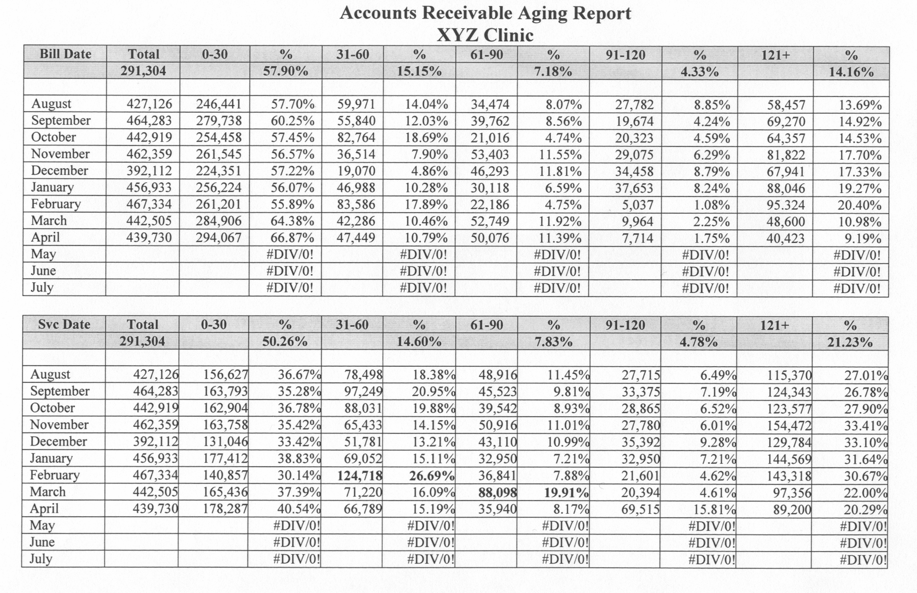

Accounts Receivable Management

Slide 36
Monitoring Receipts
Dr. A Production 2022
Cash Receipts | Jan 22 | Feb 22 | March 22 | April 22 | May 22 | Total 2021 | 2022 YTD Ave/Mo
BCBS | 26,460 | 22,483 | 26,861 | 27,709 | 19,286 | 122,799 | 24,560
Medicare | 2,222 | 2,591 | 3,644 | 4,005 | 1,199 | 13,661 | 2,732
Medicaid | 10,235 | 7,803 | 8,180 | 8,628 | 11,491 | 46,426 | 9,285
Commercial | 60,064 | 45,056 | 57,331 | 42,665 | 44,616 | 249,733 | 49,947
Refunds (negative) | (1,187) | (2,790) | (4,258) | (958) | (1,169) | (10,360) | (2,072)
Cash Receipts | 97,884 | 75,145 | 91,757 | 82,050 | 75,422 | 422,259 | 84,452
Cash Receipts may fluctuate more erratically than charges
It is helpful to monitor receipts by payer as an aid to managing or interpreting fluctuations
Use averages and year to year comparisons to benchmark

Slide 37
Tips for Monitoring Receipts
When Cash Receipts appear unusually low or high look for:
  Unusual charge activity in the previous or current month
  Posting problems - payments not posted regularly
  Un-filed or lost claims, either in the office, or electronically
  A check from a major payer either delayed or lost or a spike from a back-log of claims

Slide 38
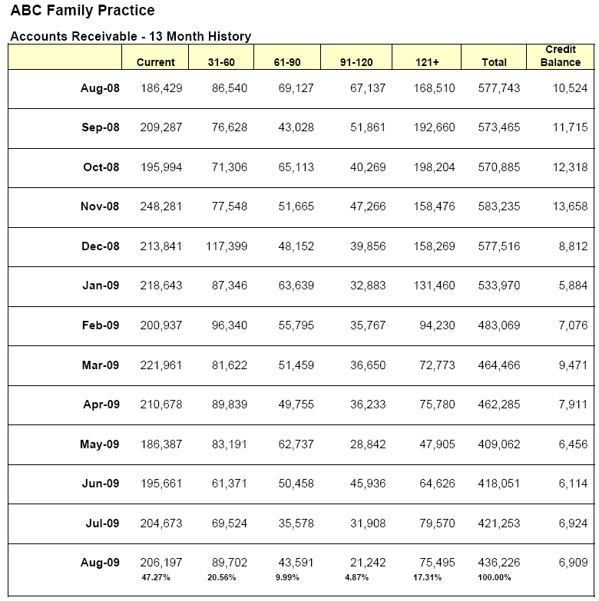
Aged Accounts Receivable
AUG 20
AR balance changes daily – the report is for a single point in time
Best to generate the report at the same point every month, typically at month end
Reports are categorized in 30-day intervals, typically up to 120 days
May include the credit balances

Slide 39
Aged Accounts Receivable
Aug 22
Sept 22
Oct 22
Nov 22
Dec 22
Record the aged categories at the end of each month for month-to-month comparison

Slide 40

Aug 20
Sept 20
Oct 20
Nov 20
Changes in AR can be monitored over time.
Dev 20
Jan 21
Feb 21
Mar 21
AR “bubbles” can be identified and investigated
April 21
Mar 21

Slide 41
Bill date and service date
Trending $ and %
Including MGMA median values

Slide 42

Accounts Receivable Thumb rules
  50% to 70% of AR should be less than 60 days old.
  No more than 15-20% of AR should be aged greater than 90 days.
  Aim for 1 month’s charges in AR.

Slide 43
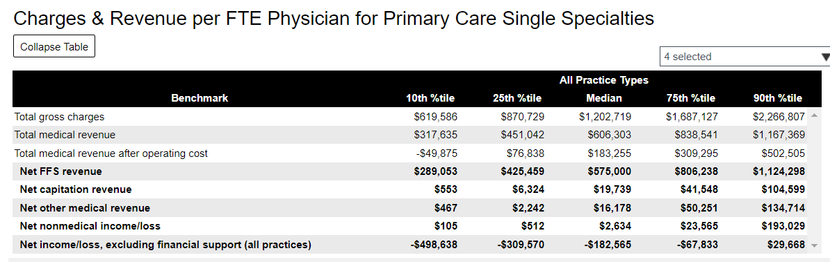
Benchmarking Gross charges and revenue per FTE physician Family Practice
Median Charges: $1,202,719
Median FFS Revenue: $575,000
*Look at 75% and 90% percentiles

Slide 44
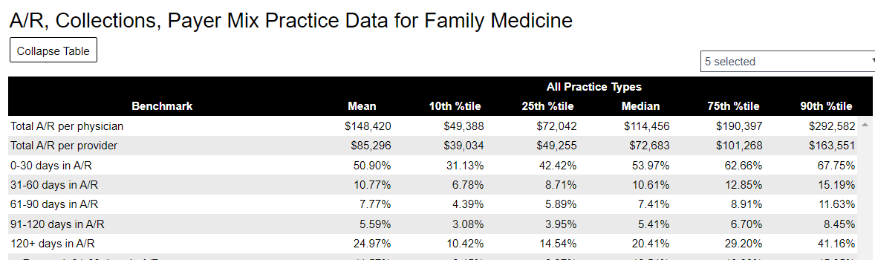
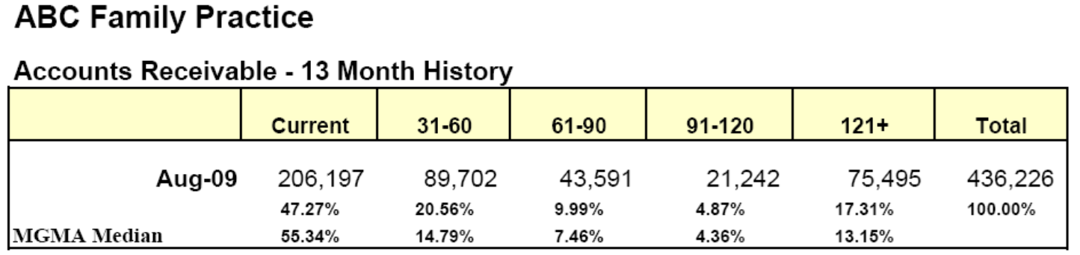

53.97%

Slide 45
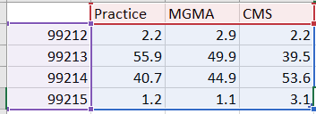

Slide 46
Benchmarks
Billing Function | Expectation | Actual Performance | Benchmarks
Registration | Demos & Ins. |  | 98% accurate
Prior Auth | Determine & get |  | 98% accurate
Time of service collections | Co-pays, co-ins, balances |  | co-pays 98%
Coding | Physicians code |  | 1% error on audit
Claims | Rejection rate |  | < 5%
Charge entry | Lag days |  | 24 hrs ofc/ 48 hrs IP
A/R follow up | Net collection ratio |  | 95% >
Payment posting | Posted & balanced daily |  | 100% accurate
Collections | Patients to collections |  | 110 days
Denials | Due to no referral |  | 2% denial rate
Denials | Due to timely filing |  | 0% denial rate
Notes:
Here are some suggestiions for targets you might want to set in your offrice related to revenue cycle functions.
The benchmarks on the right are merely suggestions. You can create your own benchmarks and then measure the actual performance of these functions.

Slide 47




Two Major Elements of Overhead Expenses
Support Staff Costs
General Overhead
Neither include physician or other provider costs

Slide 48
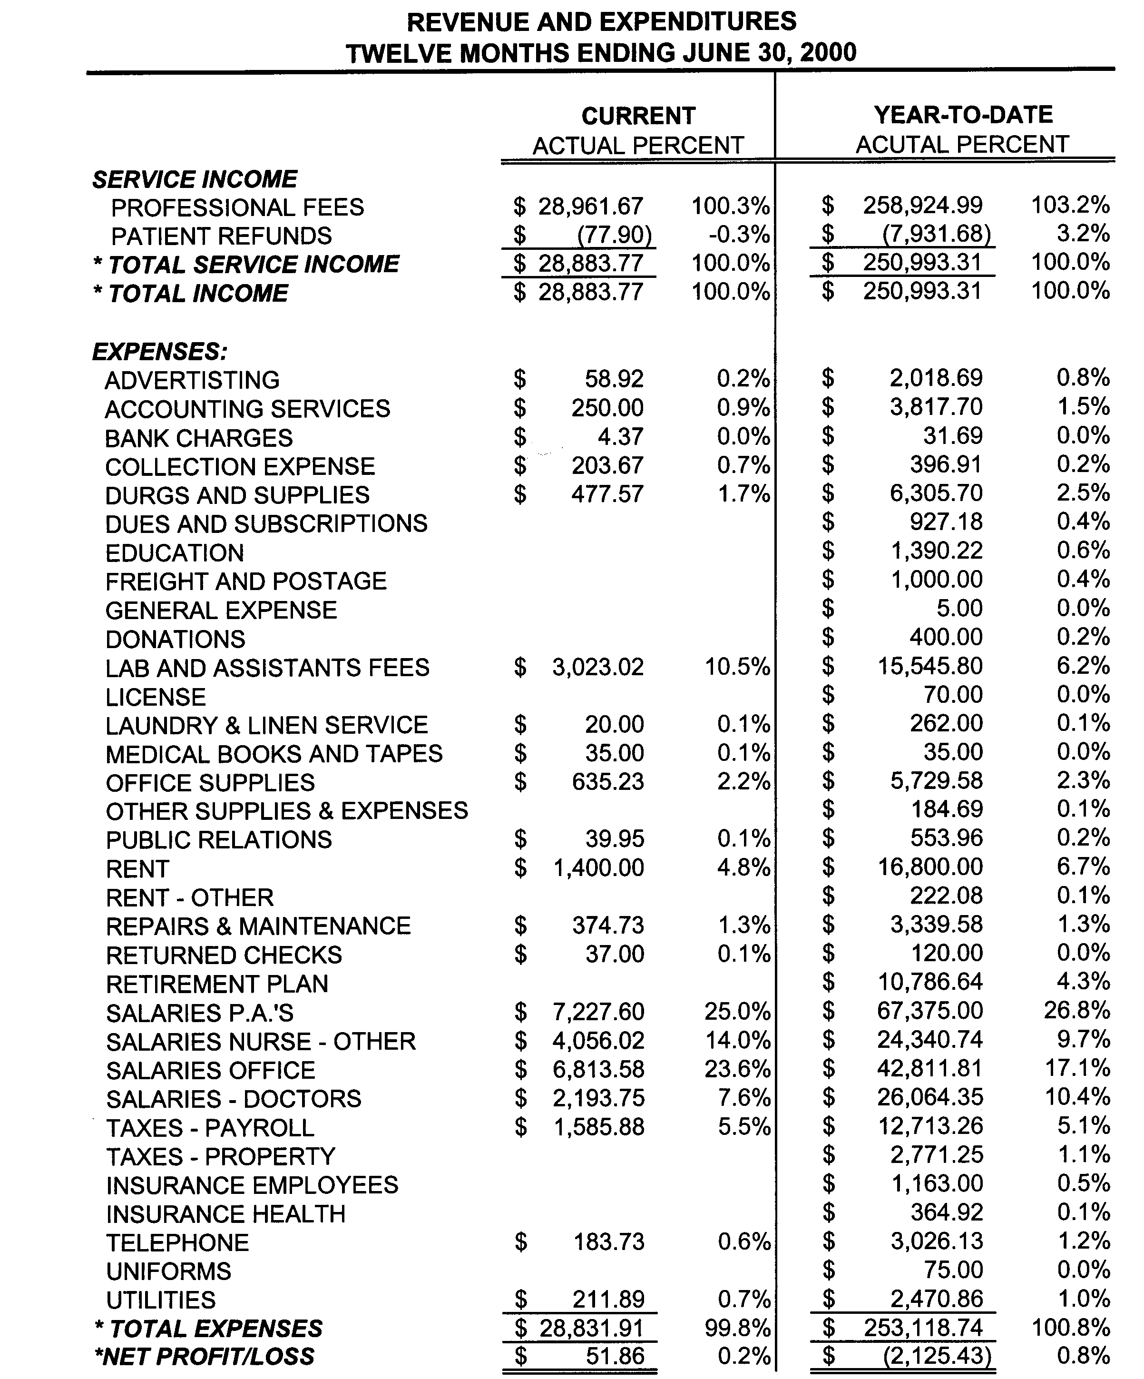
Standard Income Statement
Income
Expenses
Bottom Line

Slide 49
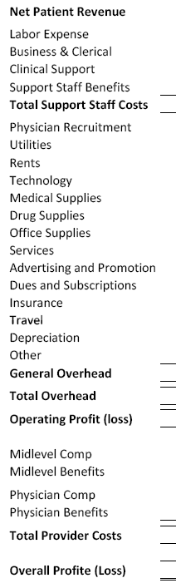
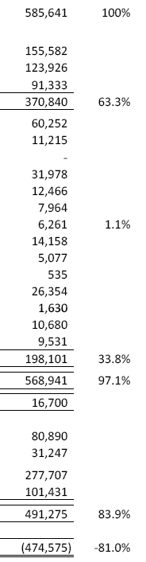




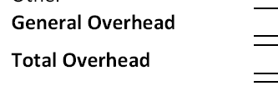
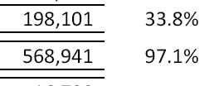
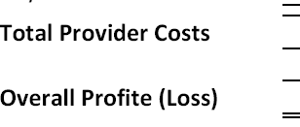
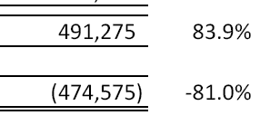
Notes:
Benchmarking: The process of measuring and comparing performance areas:
Against internal standards
Against industry standards
Number of patients
Patient satisfaction
Staffing levels
Revenue
Physician compensation
Operating expenses
Accounts receivable and productivity.
The true value of benchmarking lies in the numbers combined with an understanding of the current state of the practice, calculation of the difference between the current state and a new value or benchmark, knowing the context and background of the practice values when interpreting the results, deciding on a course of action and goal, and determining when the goal is achieved.

Slide 50
Questions to ask:
What is your “Total Support Staff Cost”?
  In $ per physician?
  As a % of Net Medical Revenue?
What is your “General Operating Cost”?
What is the “Cost of Operations” (Overhead)?
Notes:
Some staff costs are higher in clinical areas which supports physicains to see more patients. So the right people doing the right jobs?

Slide 51

In a perfect world…. and depending upon specialty…
Support Staff consumes 30% of revenue
General Overhead consumes 32% of revenue
Thus an “overhead rate” of 62% is excellent!
Notes:
These are the latest numbers for family practice from MGMA.

Slide 52
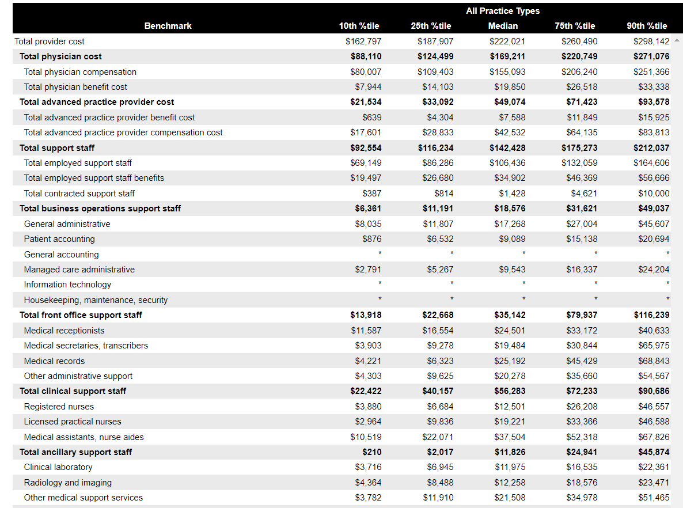
Expenses per FTE Provider for Family Medicine
Notes:
Benchmark support staff cost by dollars by FTE physician.

Slide 53
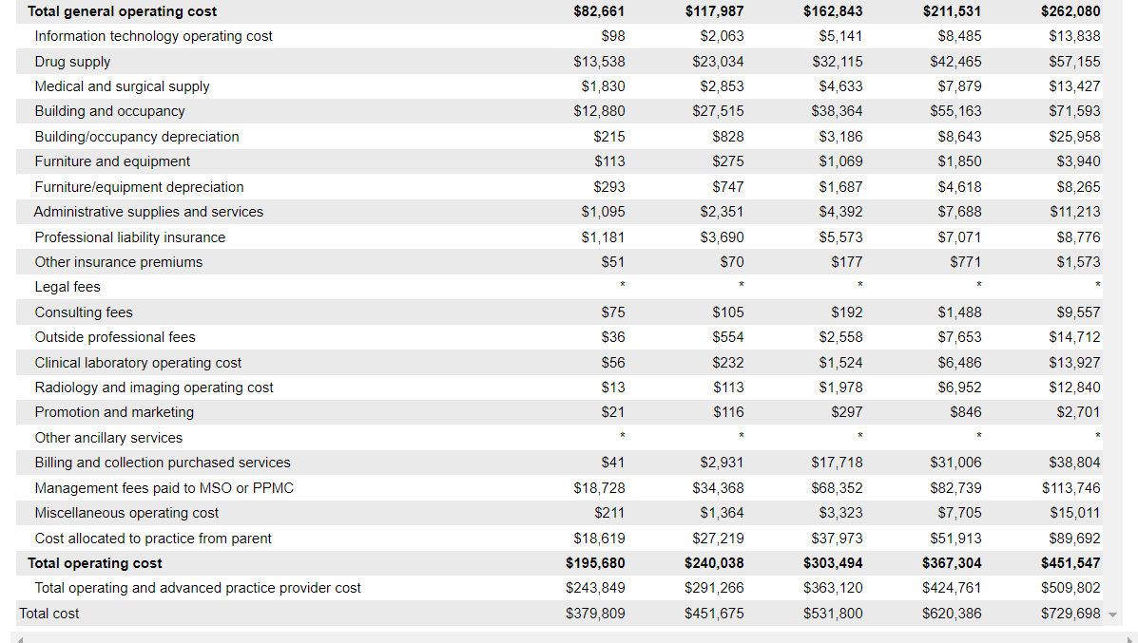

Notes:
Benchmark total operating cost by the percent of revenue consumed.

Slide 54
ABC Family Practice Monthly Expense Comparison

Slide 55
Case Study #3 (Quality Example)
You are the administrator of a primary care practice that has enjoyed modest growth over the last year of 1-2%. 40% of your revenue comes from Medicare. You have participated in all the quality initiatives for Medicare over the years including PQRS, Value based payment modifier, meaningful use, and MIPS. In 2023, the practice will once again choose to report MIPS but will begin looking at options for the MVP pathway as it develops.

Slide 56

The Patient Experience
Perception
Quality
Notes:
There is greater emphasis of late put on the patient experience. Patients assume their providers are competent when they seek care. In fact, it is reported that as many as 60% of patients go to the Internet for information about their health so they are highly informed. The patient is looking for a positive experience with a provider who treats them with respect, and engages them to make healthcare decisions jointly with the providers.
A 2009 Healthcare Leaders Media Patient Experience Survey indicated that 35% of physician executives believed the patient experience was a top priority; and 55% said it was in the top 5 of priorities for their organizations.
Studies have shown that patients rank their healthcare is not associated with the technical quality, but how they feel.

Slide 57
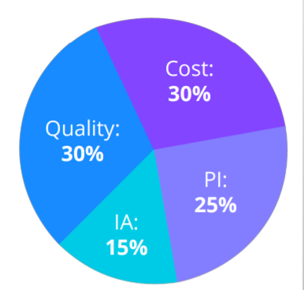
Decision to enter MIPS MVP 2023
Four areas considered:
  Quality performance – 30%
  Cost performance - 30%
  Improvement Activities 15%
  Promoting interoperability 25%
  ________________________________
  Data completeness threshold is 70%
Notes:
We will use the EMR to collect the electronic clinical quality measures ECQMs

Slide 58
Decision Making Steps
Group reporting vs Individual reporting
Selecting Measures
  Quality – 6 measures with 1 outcome or high priority measure
  Cost – CMS will compute
  Improvement Activities- 2 high weighted or 1 high & 2 medium or 4 medium need a total of 40 points
  Promoting Interoperability –data for 4 objectives measures and attest to functionality
Develop a quality plan
  Analytics capture
  Quality manager
  AWV’s, TCM, CCM
  Care Coordinator(s)
Notes:
We have decided to group report. We have a group of 5 physicians considered a small group and all providers are on the same page

Slide 59
Quality Measures
Six Measures Chosen
  001 Diabetes: A1c Poor control (>9%) – High priority measure
  126- Diabetes Mellitus: Diabetic foot and Ankle care, Peripheral neuropathy
  110: Preventive Care and screening: influenza immunization
  111 – Preventive care : Pneumococcal vaccination
  236 – Controlling high blood pressure
Notes:
Annual wellness visits will capture
047- Advanced care planning
112- Breast cancer screening
113: colorectal screening
128 – BMI with follow up plan
130 Medication reconciliation
134: Depression screening
182- Functional outcome assessment Pain scale and activites of dailoy living

Slide 60
Quality Measures
047, 112, 113, 128, 130, 134, 182
  047 – Advanced Care Planning
  112- Breast Cancer Screening
  113- Colorectal screening
  128 – BMI with follow up plan
  130 - Medication Reconciliation
  134 - Depression Screening
  182 - Functional Outcome Assessment
  All these measures are captured within the Annual Wellness Visit

Slide 61
Promoting Interoperability
Requirements include:
  Use of an Electronic Health Record that meets certification requirements
  Report measures from 4 objectives for 90 continuous days
    Clinical data registry reporting ( immunizations, cancer registry)
    E-prescribing
    Electronic Case reporting ( Public health agency reporting) e.g – STD’s
    Health Information exchange
    Security Risk Analysis

Slide 62
Improvement Activities
Need 2 high weighted; or 1 high and 2 medium; or 4 medium
Report for 90 days during performance period
  Expanded practice access
  Glycemic management services
Notes:
Expanded practice access is a high weighted.
Provide 24/7 access to your practice
Expanded evening hours
Expanded offerings like telemedicine group visits, home visits, etc. With same day next day access
The goal is to increase patient access to reduce unnecessary emergency room visits. This would include educating patients to call the practice first rather than going to the ER first.
Glycemic management services-
For medicare beneficiearies with Diabetes who are prescribed antidiabetic agents Improve diabetes care by defining and documenting
individualize glycemic control goals
For outpatient Medicare beneficiaries with
diabetes and who are prescribed antidiabetic
agents (e.g., insulin, sulfonylureas), MIPS
eligible clinicians and groups must attest to
having:
For the first performance year, at least 60
percent of medical records with documentation
of an individualized glycemic treatment goal
that:
a) Takes into account patient-specific factors,
including, at least 1) age, 2) comorbidities, and
3) risk for hypoglycemia, and b) Is reassessed
at least annually.
The performance threshold will increase to 75

Slide 63
Cost Measures
Cost is measured for each measure that is met or exceeds the case minimum.
Achievement points are calculated by comparing performance on a measure to a benchmark. Benchmarks are established using performance data from the performance period ( against other reporters)
The practice must meet the case minimum and be scored on at least one measure to receive a cost category score.

Slide 64
Putting It All Together
Staffing plan
Technology and data components
Measure outcomes and progress
  Monitor progress via reports
  Teamwork
  Communication
Notes:
Staffing plan:
In a small practice staffing additional MIPS requirements by provider may make the most sense
Map what needs to be done daily, monthly, quarterly
Prioritize your contracts and
Prioiritze revenue generating tasks, such as AWV, TCM, CCM
Who will review Annual wellness visits to ensure all measure aare met
Assign someone responsibility for TCM, tracking discharges
Technology
Idenitfy a technology partner either your EMR or outside reporting vendor who can aggregate your data and provide periodic benchmarks
Identify all areas where data comes from: HIE, PM, EHR, Claims from payers
Use a case management software add on or partner with someone who can provide that
Check coding and documentation so things are not missed, periodic audits help with that.
Outcomes and progress
Constantly review your data- don’t wait until its time to report and hope for the best.

Slide 65
“ If you don’t know where you are going, you might wind up someplace else.”
Yogi Berra

Slide 66

Questions???
Tracy Bird, CPC, CPMA, CEMC, CPC-I, FACMPE
Medical Practice Advisors
913-660-8566
tbird@medicalpracticeadvisors.com

