Slide 1
2023 E/M Auditing
Local Chapter Presentation

Slide 2

PRESENTED BY:
  Stephani E Scott
  CPC, RHIT
  VP AAPC Services
  AAPC Audit Services
AAPC Audit Services provides coding & auditing services to clients across the nation. To learn more, visit our website at aapc.com/business

Slide 3
Agenda
1
E/M Services - MDM
E/M Services - Time
Consultations & Emergency Department
Chart Note Cases
Strategies for Training Providers
2
3
4
5
Notes:
Welcome to our webinar….

Slide 4

“
You can't build a great building on a weak foundation. You must have a solid foundation if you're going to have a strong superstructure.
Gordon B Hinckley
A good education is a foundation for a better future.
Elizabeth Warren
Notes:
I love quotes… READ I often feel like our HIM and compliance teams are superstructures..buildings that keep everyone safe. Another quote that I love is READ So true
THE AMA has an initiative to reduce clinical documentation by 75% by 2025. 2021 EM changes were the first to come as a result of AMA and CMS work groups initiative to lesson the documentation burden. These 2023 changes are the next phase…we can expect more. While these changes simply things…it’s hard to adapt.
One thing we learned with implementing the 2021 guidelines, is that change is hard. It’s hard for coders, auditors and physicians alike to change 27+ years of documenting and coding to a specific set of rules. Read : “When we think, feel, and do things in a particular way over a period of time, habits form, not only in our behavior but in our memory systems.” neuros….muscle
Changing our old documentation and coding habits is not a simple matter of stopping and doing things another way. As coders we must equip our physicians with the knowledge and tools to adapt their way they think, feel and code for evaluation and management services.
The approach we have found to be successful is going back to basics…building a new foundation for EM documentation and coding if you will.. Take the approach or “Forget what you know and learn a new way”. Starting with re-educating. RE TRAIN YOUR BRAIN to not look for key words to check off boxes but rather to understand the patient and clinical work took place during visit and the overall outcome…..put the pieces together of what happened during the visit with the physician to recreate the picture. Lori what are your thoughts…

Slide 5
1
E/M - MDM

Slide 6
Medical Decision Making
3 Key Components – Redefined
  Number and Complexity of Problems Addressed
  Amount and/or Complexity of Data to be Reviewed and Analyzed
  Risk of Complications and/or Morbidity and Mortality of Patient Management
Leveling based on 2 of the 3
FREE AUDIT TOOL:
https://www.aapc.com/business/resources/em-audit-tool-ebrief
Notes:
You are probably familiar since this has been in effect since 2021. Now, all E/M services (basically, there are a couple exceptions) are leveled on MDM or time.
There is now one MDM table for all of these EMs. Same 3 key components: number and complexity of problems addressed, the amount and complexity of data being reviewed and/or analyzed, and then finally the Risk of complications of morbidity or mortality based on patient management.
Still following 2 of 3.

Slide 7
Number & Complexity of Problems Addressed
“The final diagnosis for a condition does not, in and of itself, determine the complexity or risk, as extensive evaluation may be required to reach the conclusion that the signs or symptoms do not represent a highly morbid condition. Therefore, presenting symptoms that are likely to represent a highly morbid condition may “drive” MDM even when the ultimate diagnosis is not highly morbid. The evaluation and/or treatment should be consistent with the likely nature of the condition.”
Notes:
We don’t have time today to review all of the definitions so we thought we would review what has changed from the 2021 guidelines.
These definitions apply to both the office and other outpatient as well as the inpatient, observation and other EM services we mentioned previously.
READ…bolded is the addition to the guidelines. This is great…this addition to the definition of the complexity of a problem addressed takes some of that ‘grey area’ away. We now have it in writing that it’s ok to consider symptoms in our problems addressed IF they are driving the evaluations and decision making…example Chest Pain… no MI

Slide 8
Problem Addressed
“For hospital inpatient and observation care services, the problem addressed is the problem status on the date of the encounter, which may be significantly different than on admission. It is the problem being managed or co-managed by the reporting physician or other qualified health care professional and may not be the cause of admission or continued stay”
Notes:
AMA added this New definition to Problem Addressed. READ
We know how the hospital notes, carry forward all problems….but we should only be considering the problems addressed TODAY.

Slide 9
Stable, Acute Illness
“A problem that is new or recent for which treatment has been initiated. The patient is improved and, while resolution may not be complete, is stable with respect to this condition.”
Notes:
Here is another new definition for stable acute illness. READ

Slide 10
Independent Historian
It does not include translation services. The independent history does not need to be obtained in person but does need to be obtained directly from the historian providing the independent information.
Notes:
Additional clarification to the Independent Historian ….READ

Slide 11
Risk
The risk of patient management criteria applies to the patient management decisions made by the reporting physician or other qualified health care professional as part of the reported encounter.
Notes:
Ok this addition to the definition of RISK (does not include the full definition) had to come out because of the split shared and teaching physician visits that often occur in the hospital….
READ……Makes sense right…if we are leveling on MDM then we would only include the clinical thought process and work of the provider that is billing for the service.

Slide 12
Risk
Risk includes the probability and/or consequences of an event.
For the purposes of calculating medical decision making, level of risk is based upon consequences of the problem(s) addressed at the visit when appropriately treated. Risk also includes medical decision making related to the need to initiate or forego additional testing, treatment and/or hospitalization. The risk of patient management criteria applies to the patient management decisions made by the provider as part of the reported visit.
Notes:
Here is another clarification definition for risk… READ
Inherent risks of surgery, medication, co-morbid conditions (URI in elderly with COPD, high risk to pneumonia, hypoxia)

Slide 13
Drug Monitoring for Toxicity
Examples of monitoring that do not qualify include monitoring glucose levels during insulin therapy, as the primary reason is the therapeutic effect (unless severe hypoglycemia is a current, significant concern); or annual electrolytes and renal function for a patient on a diuretic, as the frequency does not meet the threshold.
Notes:
AMA changed the wording around the monitoring of hypoglycemia. Previously, monitoring insulin for hypoglycemia was specifically excluded….It Now reads….. unless severe hypoglycemia is a current, significant concern…If a patient is admitted for hypoglycemia, it’s likely going to be severe.
As coders sometimes it’s hard to decide what drugs are truly toxic. Some, like chemo drugs are obvious. Others are not. Obviously, all drugs have some inherent toxicity. We are looking for those really high level, very challenging drugs that monitoring by labs must be done frequently.Some drugs, like in this example insulin, aren’t always considered toxic but in certain conditions they can be. Use the internet to research a drug’s risk level. We rely on the provider to tell us when a patient is being monitored for high toxicity.

Slide 14
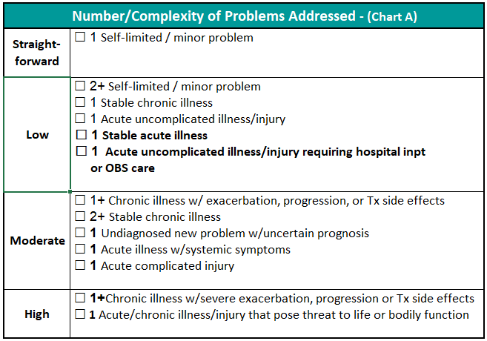
# and Complexity of Problems Addressed
Notes:
Describe
Bolded items are what changed with the addition of hospital services

Slide 15
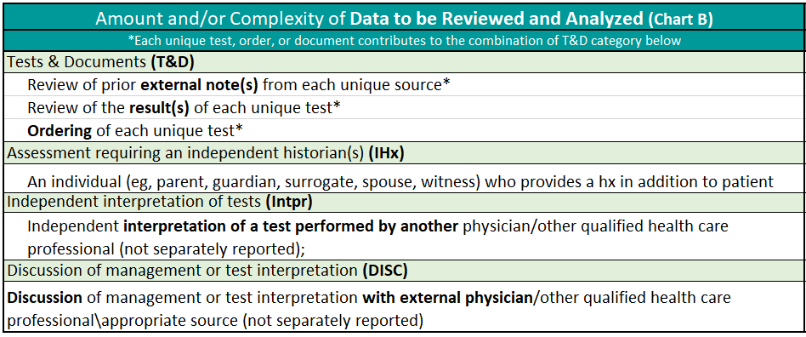
Data Reviewed & Analyzed
Notes:
No changes in 2023 form the 2021 guidelines
For those of you new to this calculation, we will provide a high level overview
Rules:
Points should be calculated for each category
Tests count as 1 point for each and are totaled to = category points.
The more points the higher the data level
For calculations purposes use the below abbreviations:
Tests & Documents = T&D
Assessment requiring an independent historian(s) = Ihx
Independent interpretation of tests = Intpr
Discussion
Points should be calculated for each category
Tests count as 1 point for each CPT code and are totaled to equal category points.
Basically, The more points the higher the data level
You cannot count a test that has an interpretation and component element if you are billing the CPT code. For example, for radiology procedures, the films/scans are interpretated and then a report is written. If you are billing for that test, you cannot double dip and count it towards your data. However, labs such as UA’s don’t really have that – the results are given via the lab machine. Therefore, labs can usually be counted as ordered Or reviewed.
Note that you cannot count both. It’s either order, or review. Even if on a different date. So you if order an A1c to be done in 6 months, you can count the order today but you cannot count the review at the 6 month visit.
Explain:
Assessment requiring an independent historian(s) = Ihx
Independent interpretation of tests = Intpr
Discussion of management or test interpretation = DISC
n of management or test interpretation = DISC

Slide 16
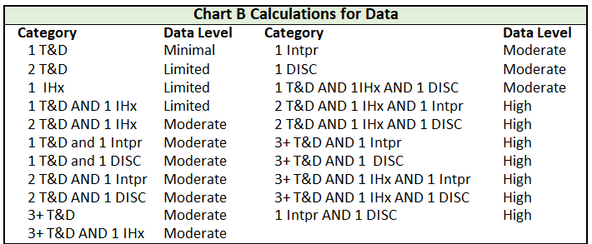
Data Reviewed & Analyzed Calculation
Notes:
Ok so let’s put it together
This table shows the different combinations and the corresponding data level.
We can’t expect our providers to memorize all of them. We have found using the 80/20 rule works well. Train you providers to identify what they most often deal with and know those

Slide 17
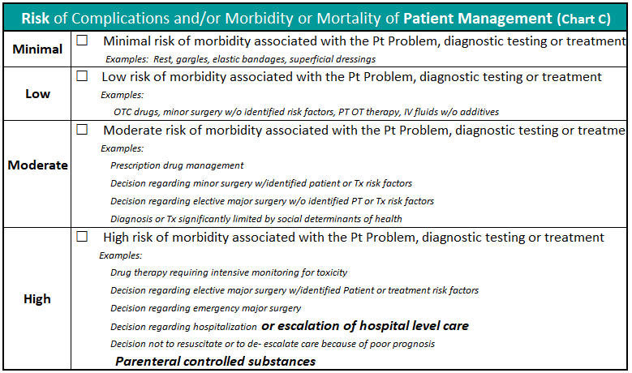
Risk of Complication of Patient Management
Notes:
Describe
Bolded items are what changed in 2023

Slide 18
2
E/M - Time

Slide 19

Guidelines
E/M code categories time-based services (e.g., Critical Care) w/o MDM component do not apply
Total visit time does not apply to ED Services
Total visit time does not need to be consecutive
Total time includes both face-to-face and
non-face-to-face activities
It does not matter the location of the provider
Do not include time spent performing
separately reported services
Notes:
E/M code categories that are time based (e.g., Critical Care) that do not have an MDM component do not apply
Total visit time does not apply to ED Services
Total visit time does not need to consecutive, it can be totaled for the date of the encounter
Total time includes both face-to-face and non-face-to-face activities
It does not matter the location of the provider
Do not include time spent performing separately reported services

Slide 20
Total Time Activities
Preparing to see the patient (review of tests)
Obtaining and/or reviewing separately obtained history
Performing a medically appropriate examination and/or evaluation
Counseling and educating the patient/family/caregiver
Ordering medications, tests, or procedures
Referring and communicating with other health care professionals (when not separately reported)
Documenting clinical information in the electronic or other health record
Independently interpreting results (not separately reported) and communicating results to the patient/ family/caregiver
Care coordination (not separately reported)
Notes:
Total time includes all of these activities. It is not just the time spent face to face with the patient. THIS LIST DID NOT CHANGE WITH 2023

Slide 21
Time Not Counted
Slow Charting
Anything done on a different date
Teaching that is general and not limited to that patient
Travel
ANY OTHER SEPARATELY REPORTABLE SERVICE
Notes:
Discuss proper time statements excluding services separately reported.

Slide 22

Tips for Documenting Time Statements
Update EMR smart phrases and templates
Use caution with templated time statements
Do not document time ranges
Notes:
Switching for >50% counseling coordination time calculation to total visit time proved to be harder than anyone of us thought. Here are a few tips:
With 2021 and now 2023 we see that organizations have forgotten to update their time statements. If >50% is being used, how do we know for sure that the total time includes all of the allowed activities?
We all have a smart phrase that you can use for time statements. BUT remember it must be patient specific. Auditors and payers do not like to see charts that say total time includes, review of history, exam, tests and … when there were not tests and they do not like it when 60 minutes spent on every single patient.
Not everyone understood the definition of total time.. word ‘total time’ means that the exact unit of time must be documented. We still see documentation with time ranges…..not good. When you do see this you must use the lowest time. CMS wants to see total time documented not ranges.

Slide 23
Prolonged Time
Prolonged time is based on 15- minute increments
Prolonged time less than 15 minutes beyond maximum code time is not billable
CMS must meet the maximum of 15 minutes to report
CMS Manual Transmittal 11842, pages 22-27
https://www.cms.gov/files/document/r11842cp.pdf
Notes:
CMS and AMA times are still different and Codes are different.
Many changes for prolonged first had the 2021 guidelines …July 2022 we the proposed rule, in November the final rule very confusing…., then in January announcement with more changes to be effective May 9, 2023
E/M service. It includes combined time with or without direct patient contact on the date of a patient visit. Reported in 15 minute increments beyond the max time code AND must be at least 15 minutes.
For example, Initial hospital visit, 99223 maximum time is 75 minutes. If documentation stated 80 minute cannot bill prolonged. Must meet at least the full 15 beyond the max time of 75 minutes. Once 90 minutes met than can report 99418. and then once another full 15 minutes was supported bill additional units.

Slide 24
Prolonged on Different Date
Codes 99358 and 99359 are used when a prolonged service is provided on a date other than the date of a face-to-face E/M encounter.
Prolonged service of less than 15 minutes beyond the first hour or less than 15 minutes beyond the final 30 minutes is not reported.
99358 – Prolonged E/M service, first hour
99359 – each additional 30 minutes
MEDICARE DOES NOT ALLOW
Notes:
These codes are not new, but were revised due to the new prolonged codes.
There are some payers out there that will pay these but Medicare does not.

Slide 25
Prolonged Office/Outpatient
AMA:
99417 - Prolonged Service With or Without Direct Patient Contact on the Date of an Office or Other Outpatient Service, each 15 minutes
(Do not report for any time unit less than 15 minutes)
CMS:
G2212 - Prolonged office or other outpatient evaluation and management service(s) each additional 15 minutes
G0318 – Prolonged home or residence E/M, each additional 15 minutes.
Notes:
We would continue to use
HCPCS code G2212 as previously finalized in lieu of CPT code 99417. Now we also have G0318 added for home visits. 99417 can be used for home visits.

Slide 26
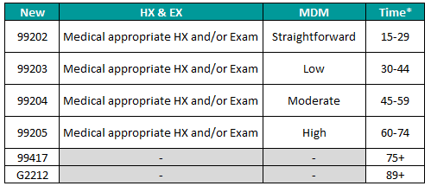
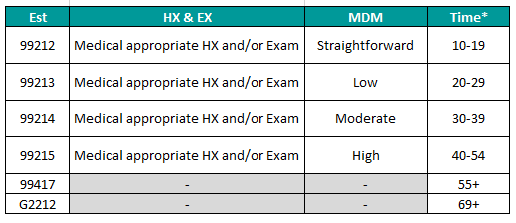
Prolonged
Office /
Outpatient
Notes:
Look at the new times….

Slide 27
Prolonged Inpatient/Observation
AMA
99418 – Prolonged services on the date of an inpatient or observation or nursing facility service, each additional 15 minutes
CMS
G0316 Prolonged inpatient or observation E/M beyond the total time, each additional 15 minutes
G0317 Prolonged nursing facility E/M beyond the total time, each additional 15 minutes
Notes:
If the patient is in IP or OBS, we will use these codes. Again, they are not used for any time unit of less than 15 minutes.

Slide 28
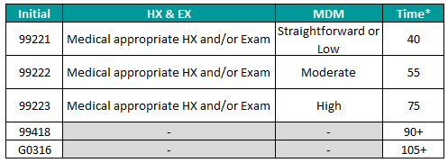
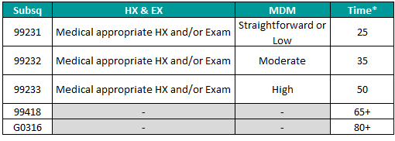
Inpatient
Timetable
Notes:
The rest of the tables can be found on the sheet.

Slide 29
3
Consultations & ED Services

Slide 30
Consultations – AMA Definition
E/M service provided at the request of another physician, other qualified health care professional, or appropriate source (not patient, family or caregiver) to recommend care for a specific condition or problem.
Consultant may initiate diagnostic and/or therapeutic services
The consultant’s opinion and any services that were ordered or performed must be communicated by written report to the requesting physician.
Transfer of care was removed in 2023
Notes:
As part of AMA’s initiative to ‘reduce documentation burden and Quoting Dr Hollmann with the AMA “to make it simple, practical and clinically relevant”
A “consultation” initiated by a patient and/or family, and not requested by a physician, other qualified health care professional, or other appropriate source (eg, non-clinical social worker, educator, lawyer, or insurance company), is not reported using the consultation codes.
request from another health care professional or appropriate source and a written report. Document both of these in the consult note.
The concept of transfer of care is removed from the 2023 CPT book and no longer is a lens with which to evaluate consults. No longer
In the past, if Services that constitute transfer of care are NOT consults.
FU consults should be reported with the appropriate est or subsequent EM service
DOCUMENATION BACK TO THE 3 R’S , REQUEST, RECOMMENDATION, REPORT

Slide 31
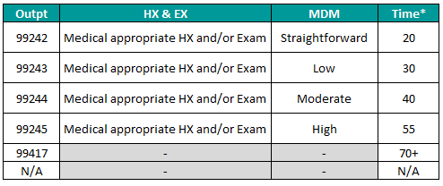
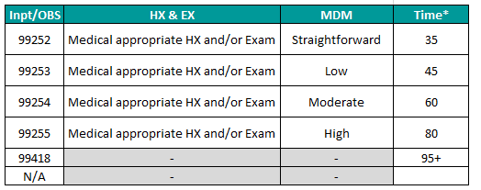
Consultation
Codes
Notes:
No longer includes 99241 or 99251
wanted to point out for outpatient consults we are to use the outpatient Prolonged time code 99417 For Inpatient we use the new 99418 code. Not covered by CMS

Slide 32
Emergency Department E/M Services
An emergency department is defined as an organized hospital-based facility for the provision of unscheduled episodic services to patients who present for immediate medical attention. The facility must be available 24 hours a day
No distinction between new vs. established patient
99281 ED Nurse only visit
Time is not a factor in the ED setting
Notes:
ED definition
AMA feels 99281, just like 99211 is a face 2 service performed by clinical staff so in the ED this code is no longer needed.
Time is not a descriptive component for the emergency department levels of E/M services because emergency department services are typically provided on a variable intensity basis, often involving multiple encounters with several patients over an extended period of time.

Slide 33
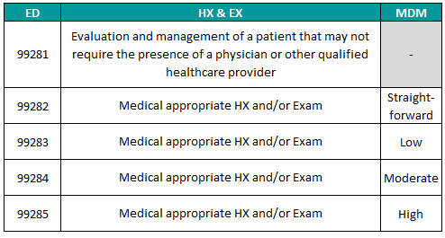
ED
Codes
Notes:
READ 99281 . Again in the spirit of making things simple we no longer have the MDM complexities with hx ex elements driving a lower level. (99283 and 99284 both with moderate MDM.

Slide 34
4
Chart Note Cases

Slide 35
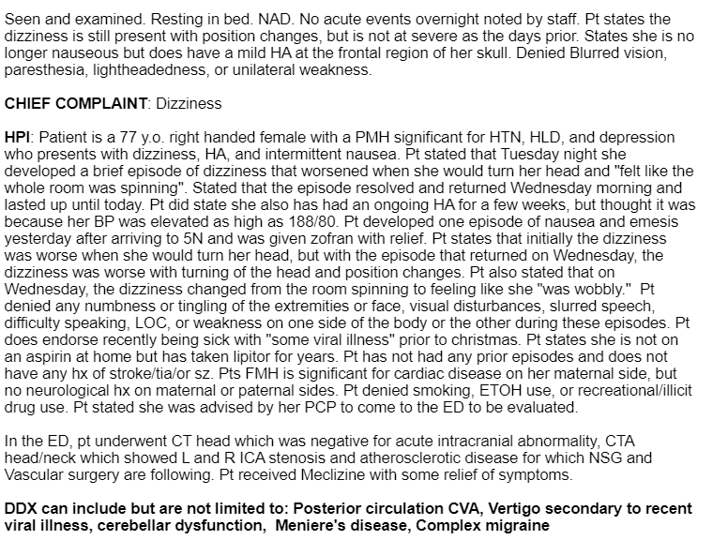
Initial
Inpatient
E/M
Notes:
This is a hospitalist’s Initial Inpatient E/M note

Slide 36
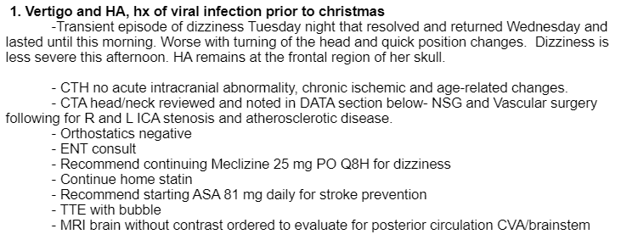

NNP = High - Acute neurological event, poses threat to life
Data = Moderate
Risk = Moderate – Heparin high risk med, but no evidence of monitoring
99222
Notes:
Appropriate History and Examination was documented
Heparin whether given IV, SQ push is always a high risk medication. Documentation does not support MONITORING. aPTT test
Activated Partial Thromboplastin Time (aPTT)
WE KNOW PT WAS BEING MONITIORED BUT IT JUST WAS NOT DOCUMETNED.
Other clinical documentation opportunities? Type of stroke, physician query. AND discussion with another provider….likely occurred with test results.

Slide 37
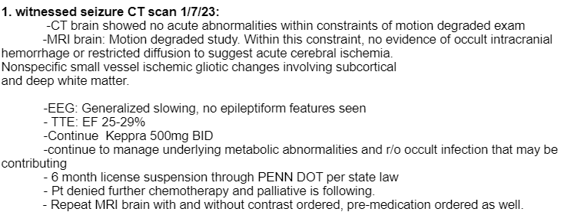
Reported 99231 – Subsequent Visit 99231
Notes:
This is a follow up to a patient with a witnessed seizure. This is a day after the 1/7/2023 admission date. THIS patient also has active cancer being treated with chemo.

Slide 38
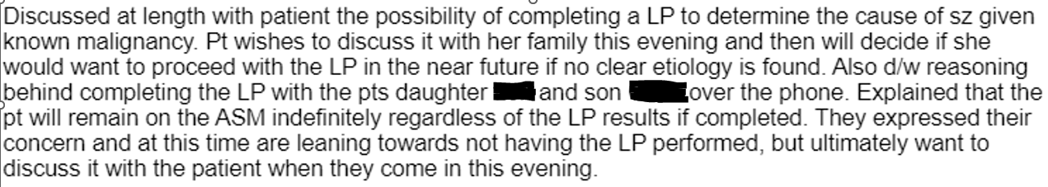
NNP = Moderate – chronic problem not at goal
Data = Minimal
Risk = Moderate – RX
99232
What if included time statement: Total visit time 72 minutes which included time spent reviewing diagnostics tests, evaluating the patient and discussions with patient and multiple family members.
99233 + 99418 must be 80 to report CMS Prolonged
Notes:
NNP – Chronic worsening
Data – assume ordered other tests, but gets credit for FU MRI
Risk – can we consider the LP yes, is LP minor or major? moderate due to RX
Defiantly not a 99231

Slide 39
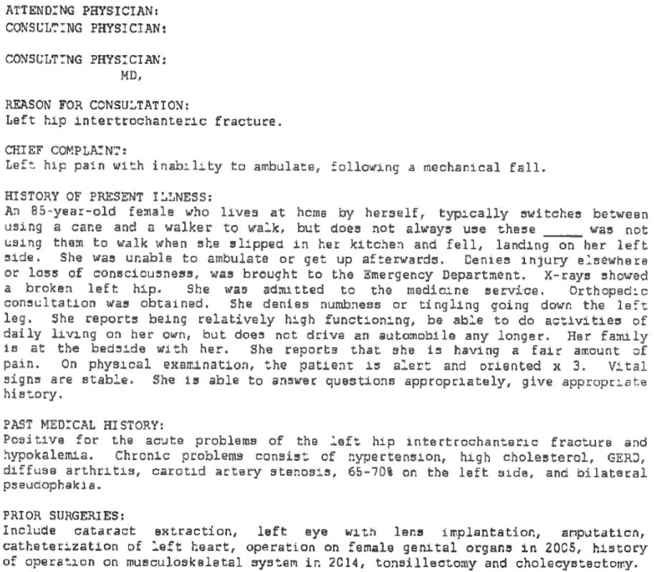
Notes:
For this note instead of leveling the EM let’s decide if it meets a consultation requirements.

Slide 40
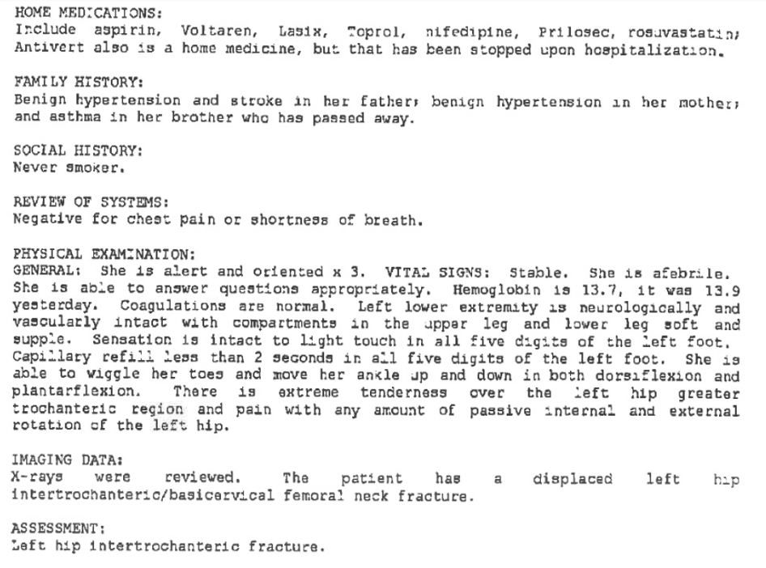

Slide 41
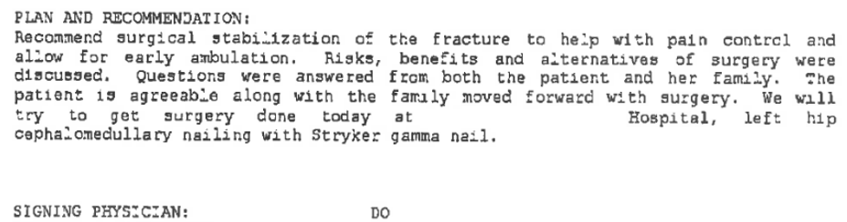
Notes:
Who requested?
Is there evidence of a ‘Recommendation of care’?
Where is the response? – hospital shared record?
How would you code this? Intent is no longer needed?

Slide 42
5
Strategies for Training Providers
Notes:
Steph Let’s talk strategy

Slide 43
General Principals of Medical Record Documentation
Each Patient Encounter should include:
Reason for Visit
Relevant History & Exam
Relevant Prior Diagnostic Tests
Assessment (Clinical Impression and/or Diagnosis)
Plan of Care
Notes:
In the spirit of lightening documentation burden, we need to rethink how much we are including in our notes. Pulling forward previous visits or history labs from the past 5 years causes confusion to those coming behind and reading the record. It also takes provider time to create these 10 page visit notes.
Another brick in our foundation is to Retrain coders and providers on what the basic documentation requires are
With the implementation of the 2021 EM guideline changes for outpatient EM services, the General principles of medical record documentation HAVE NOT UNCHANGED. While services vary in several ways, such as the nature the type of visit, the amount of physician work required, may require an office procedure….Per the CMS EM guide…..the minimum elements are essentially the same… These include:
• Reason for the encounter
• relevant history, and or physical examination findings, and
• prior diagnostic test results that are relevant to the visit and the physician’s clinical decision making Important for MDM data calculation…hard for a coder to know what past tests were reviewed and relevant.
• Assessment: which is not just the ICD 10 codes pulled in from problem list… but the overall clinical impression and finally the
• Medical plan of care
These general principals do not require section headers for specific elements or be in a specific order….like we have been conditioned for the 1995 and 1997 guidelines.
There are a few additional principals…..next page

Slide 44
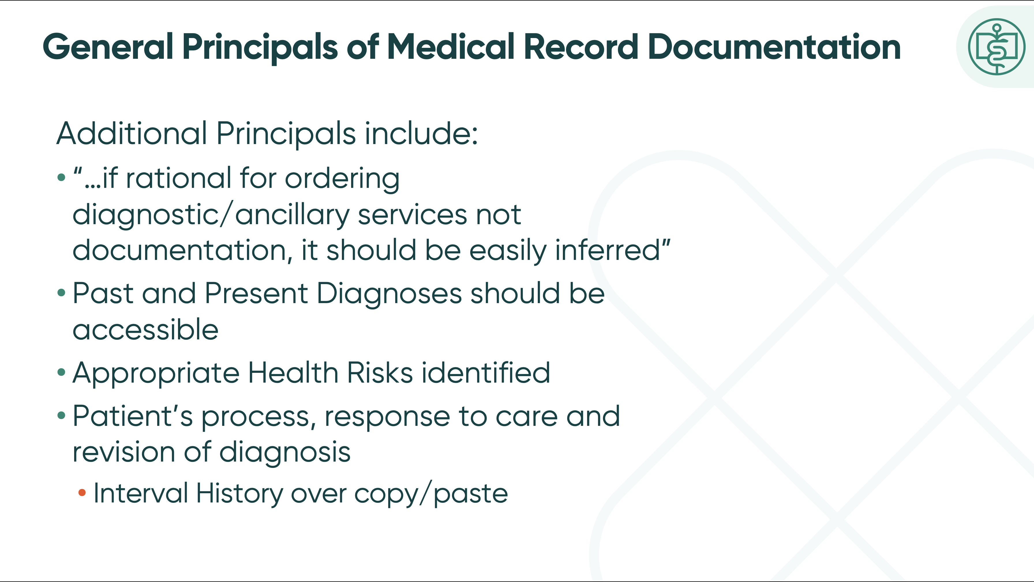
General Principals of Medical Record Documentation
Additional Principals include:
“…if rational for ordering diagnostic/ancillary services not documentation, it should be easily inferred”
Past and Present Diagnoses should be accessible
Appropriate Health Risks identified
Patient’s process, response to care and revision of diagnosis
  Interval History over copy/paste
Notes:
General principles Continued:
QUOTE FROM THE CMS EM GUIDE: if the rationale for ordering diagnostic and other ancillary services is not documented, it should be easily inferred
● “Past and present diagnoses should be accessible to the treating and/or consulting physician” Hospital record….or a shared record in the EHR…a statement to refer to these rather than pulling in the entire lists is ok Tell the story and document what’s relevant to the visit.
● Appropriate health risk factors should be identified
● AND it’s important to include The patient’s progress, response to and changes in treatment….THIS IS WHEN THE INTERVAL HISTORY IS IMPORTANT….UPDATING PLAN, NOT COPY PASTE….STATUS, ORDERS INSTRUCTIONS FROM TODAY OR YESTERDAY OR OLDER?

Slide 45
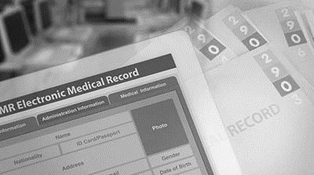
Clinical Concerns with Note Bloat from the Medical Literature
Patient Safety Issues
Weakens Written Interprofessional Communication
Hinders Development of a Patient Narrative
Dilutes Clinical Nuances
Detracts from Direct Patient Interactions
Notes:
I through this slide in her because making clinical documentation changes is not just for coding purposes….I recently had the privileged to co-host a webinar with Dr CJ Wolf, one of our physician partners who spoke about not bloat and concerns for patient safety.
CJ made a point that sometimes physicians listen more to documentation changes when you approach it form a clinical perspective rather than a coding perspective.
Lots of literature out there that supports curing note bloat.

Slide 46
Training Strategies for Providers
“Taming the EHR” by DR Marie Brown professor of IM at Rush Medical College
“The Impact of Structured and Standardized Documentation on Documentation Quality; a Multicenter, Retrospective Study”
“The Electronic Medical Record and How It Can Be Used to Communicate the Patient Story Across the Continuum of Care”
“Effect of Outpatient Note Templates on Note Quality: NOTE (Notation Optimization through Template Engineering) Randomized Clinical Trial”
“Documentation of Clinical Reasoning in Admission Notes of Hospitalists: Validation of the CRANAPL Assessment Rubric”
Notes:
Here are few resources you can reference as you consider different approaches in training your physicians…Taming EHR… talks about “team documentation” approach.. We have found that training clinicians often has higher success rate when it comes from peer.
Involve all of your team in the process of educating, pre go live quick checks, and implementing these 2023 EM guideline changes.

Slide 47
Communication Techniques
Handshake or greeting
Maintain direct eye contact
Take notes
Sit or stand up straight
Smile
Restate questions asked to be sure you understand
Avoid making threats, demands, or the word “fraud”
Listen!
Good posture and body language
Dress professionally
Be professional and honest
Notes:
READ and elaborate

Slide 48
Thank you!
Q/A

