Slide 1
What is the Revenue Cycle?

Slide 2
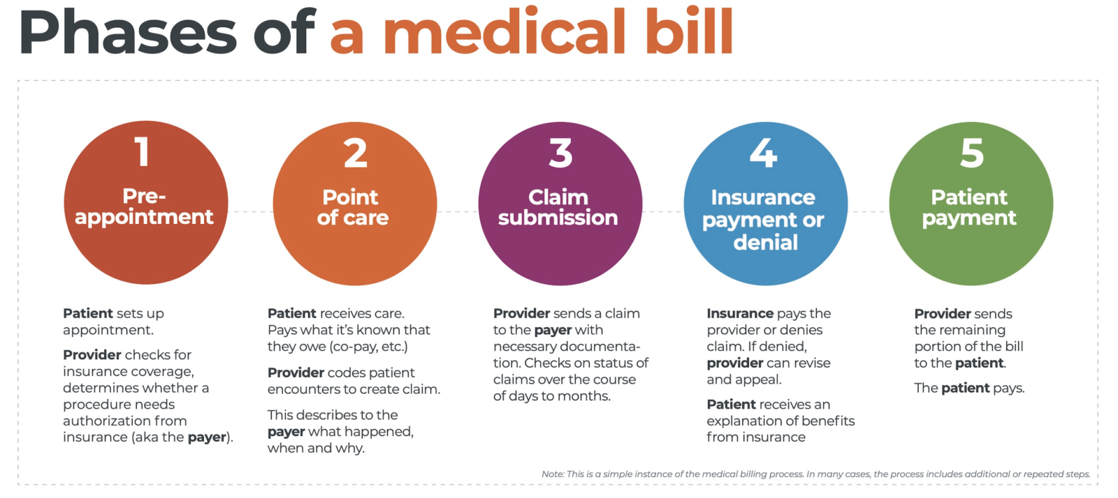

Slide 3
What else do we consider Revenue Cycle…
credentialing
contract management
rejection processing
third party follow-up
collections

Slide 5
Where things go wrong
During credentialing/contract negotiation
When the patient calls in.
At the front desk.
During coding/prior authorization
During remittance processing/rejection management
Denials management

Slide 6
During Credentialing /Contract Negotiation
Providers being wrongly credentialed.
Incorrect specialty selected with payers.
Out of date contracts
Loss of privileges/ability to do the same procedures as before.

Slide 7
When the patient calls in.
Does not give correct insurance information.
Gives bad address/ bad phone number
Does not give legal name.

Slide 8
At the front desk
We don’t verify information (is everything the same)
We don’t scan insurance or id cards
We don’t update information in the system
We don’t collect the co-pay/ time of service payments
We don’t collect SNF/ or nursing home facility information.

Slide 9
During Coding/Prior Authorization
Wrong codes on prior authorization.
Prior auth was not done.
Incorrect code selection
Wrong DX code.
This list could be endless.

Slide 10
Remittance Processing/Rejection Management
Improper sorting by payment posters.
Rejections not being worked timely.
Auto sorting features not assigning to the right queues.

Slide 11
Denial Management
Denials not worked timely
Wrong steps being taken (reconsiderations, appeals, redeterminations)
Appeals not written correctly.
Resources not used to prove your point.
Not fighting denials at all.

Slide 12
How to know it’s going right!
We generally use KPI’s to determine if the revenue cycle is running at optimal efficiency. Some of the ones we use are.
Medical coding accuracy.
First Pass Resolution Rate
Missed Charges
Denial Volume
Denial Appeal Rate
Days In AR
Charge Lag
Clean Claims Rate
Point of Service and upfront collection rate

